Slide 1
Youth Collaboration for Youth Homelessness Stakeholders
Dana White - Program Officer, Technical Assistance

Slide 2
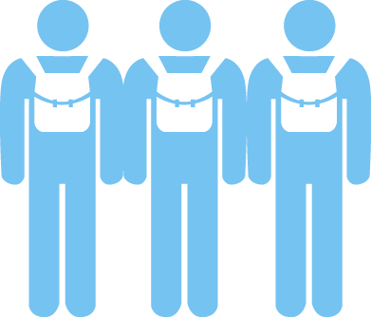
What we do:
Training & Education
Advocacy
Youth Collaboration
Notes:
True Colors United works within communities across the country to develop solutions that prevent and end youth homelessness in three ways:
Training & Education
We educate and collaborate with professionals working on the ground to ensure that lesbian, gay, bisexual, and transgender (LGBT) youth experiencing homelessness have access to the inclusive and affirming services they need.
Advocacy
We amplify the voices of lesbian, gay, bisexual, and transgender (LGBT) youth experiencing homelessness in government and media to ensure vital services and protections are in place to meet their needs.
Youth Collaboration
We provide lesbian, gay, bisexual, and transgender (LGBT) youth experiencing homelessness with leadership development opportunities that elevate their voices so they can play an active role in creating solutions.

Slide 3
Objectives.
Explain the Authentic Youth Collaboration Philosophy and why it’s important to our work to end youth homelessness
Provide an introduction to adultism and concrete examples to address adultism as an adult.
Provide a baseline for equity in youth collaboration.

Slide 4
Authentic Youth Collaboration

Slide 5
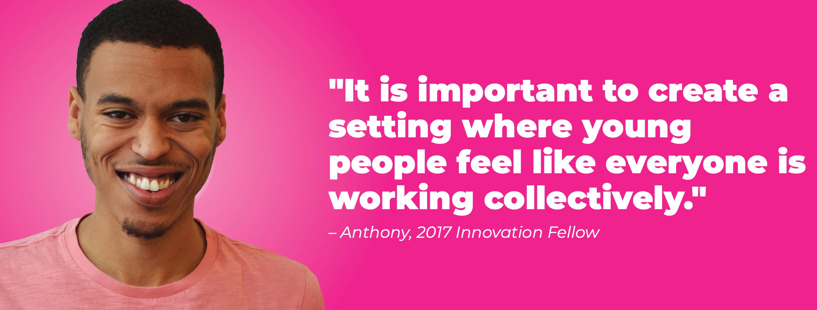
Authentic Partnership with Youth/Young Adults.
Be intentional about the decision-making power that youth have in your work.
Youth are the experts of their own truth.
When asking young people to be involved in your work, hear them out and build a reciprocal relationship where you honor their experiences, allowing their experiences and ideas to inform the process.
Notes:
Asking questions such as, “In what ways do youth directly impact decisions in my organization?” or “In what ways are youth a part of generating solutions?” and “How are youth in my organization benefiting from the value of their lived experience?” can keep you accountable to the young people you are working with.
As an adult partner, it is your responsibility not to speak for a young person, rather to elevate their voice in a way that is empowering.

Slide 6
Avoiding Barriers to Authentic Youth Collaboration.
Establishing and building trust is essential in any effective working relationship. Once positive rapport is established, genuine collaboration can begin.
Building Trust

Slide 7
Avoiding Barriers to Authentic Youth Collaboration.
An issue that often gets in the way of effective collaboration between youth and service providers is showy engagement, in which young people are invited to participate simply to create the impression of inclusion and diversity.
Meaningful Engagement

Slide 8
Avoiding Barriers to Authentic Youth Collaboration.
Young adults should have the freedom and agency to be the leaders of their own lives. Their autonomy should be promoted as they make decisions about the issues that impact their lives.
Meaningful Engagement

Slide 9
Transparency and Honesty
Developing a positive rapport and committing to authentic collaboration with young people requires radical transparency and honesty that goes beyond budgets. The young people you collaborate with should understand the relationships between all stakeholders and partners, have clear details about their compensation, and be privy to any changes in timeline or with deadlines.

Slide 10
Adultism

Slide 11
What is adultism?
Adultism describes the systems of privileged attitudes and behaviors that adults have over those of young people.
Adultism is driven by behaviors and attitudes that are based on the assumption that adults are better than young people and therefore entitles them to act upon or on behalf of young people without their agreement.

Slide 12
What’s the difference between ageism + adultism?
Ageism describes the systems of privileged attitudes and behaviors that younger people have over elders.

Slide 13
Call It Out
Calling out adultism whenever and wherever it shows up in working with young people is necessary for authentic youth collaboration, as it permeates housing systems and our culture. It often manifests in how meetings are planned and facilitated, as well as in designing and providing services to young people. Adultism is not only systemic but cultural and, like with other isms, adultism can be carried out through small or subtle ways, including microaggressions.

Slide 14
Listening Sessions
Listening Sessions are an effective way to ensure young people are providing necessary feedback to move your collaborative work forward in a way that is not adultist.
For this to be most effective and worthwhile, here are some tips:
Be specific about the intention. Prior to engaging in a listening session with YYA, be sure they clearly understand your intentions and the potential outcomes.
Include YYA in the development of the questions/feedback forms.
Allow YYA to facilitate when/where applicable.

Slide 15
Equity.
Equity is the fair treatment, access, opportunity, and advancement for all people, while at the same time striving to identify and eliminate barriers that have prevented the full participation of some groups.

Slide 16
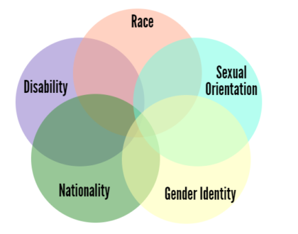
Intersectionality.
Dr. Kimberle’ Crenshaw
the interconnected nature of social categorizations such as race, class, and gender as they apply to a given individual or group, regarded as creating overlapping and interdependent systems of discrimination or disadvantage.

Slide 17
Youth and Equity
Authentic collaboration with young people requires a commitment to understanding how identity shapes experiences. Understand how racism and oppression has impacted your community. Young people come into this work with various and multiple identities (e.g. Black, Indigenous, LGBTQ+, different ability, etc.) which need to be acknowledged, accepted, and understood before authentic collaboration can truly take place
Historically, people experiencing homelessness have relied on systems that have taken their power away, like when a provider makes a housing decision for a young person.
We recommend that you analyze the demographics of your decision making body, as well as your YAB, to determine if the communities experiencing homelessness locally are accurately represented.

Slide 18
Equity (cont’d)
Have at least two seats for YYA with lived experience as a part of your (CoC) structure. In most cases this will mean that it has to be in writing. Write the delegation of these two seats into the CoC charter, bylaws, and agreement.
Decision-making bodies (CoC) should be representative of the communities experiencing homelessness. That will mean older adult partners must consider whether giving up their seat and encouraging it to be filled with a young person is a choice point.
Hire young people at every level. Peer support positions have been designed for young people but have limited the voice and perspective of each individual placed in those roles. If this is a beginning stage for young people in your community, focus on offering training that will prepare them for more advanced positions.

Slide 19
Q&A.

Slide 20
learn.truecolorsunited.org
Thank you.

