Slide 8
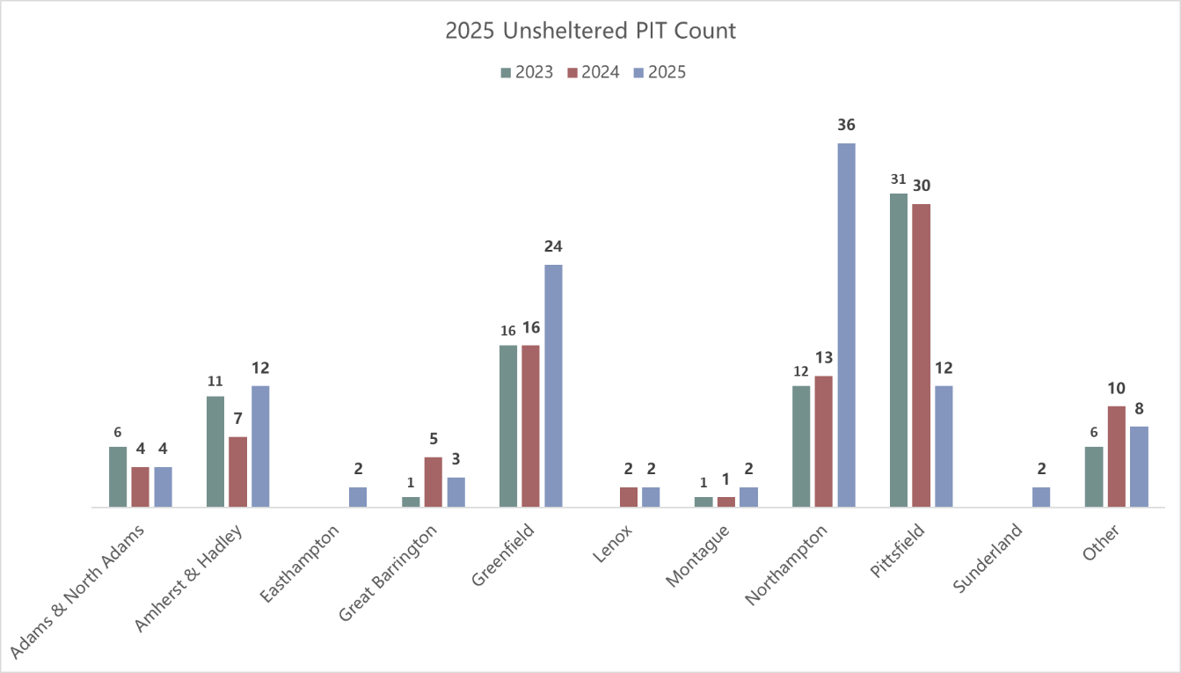

Slide 9
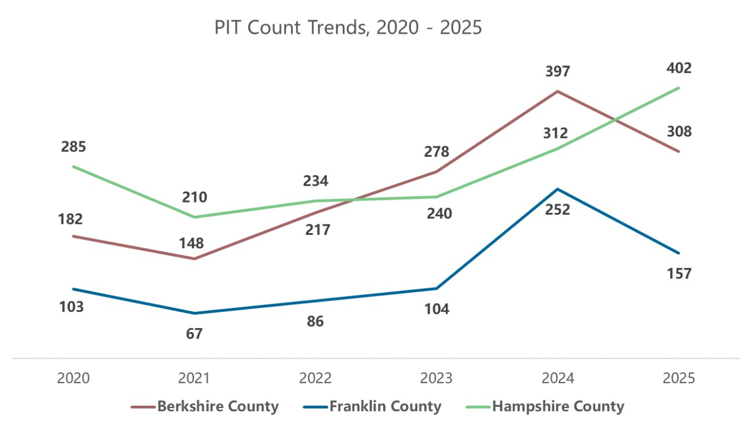

Slide 10
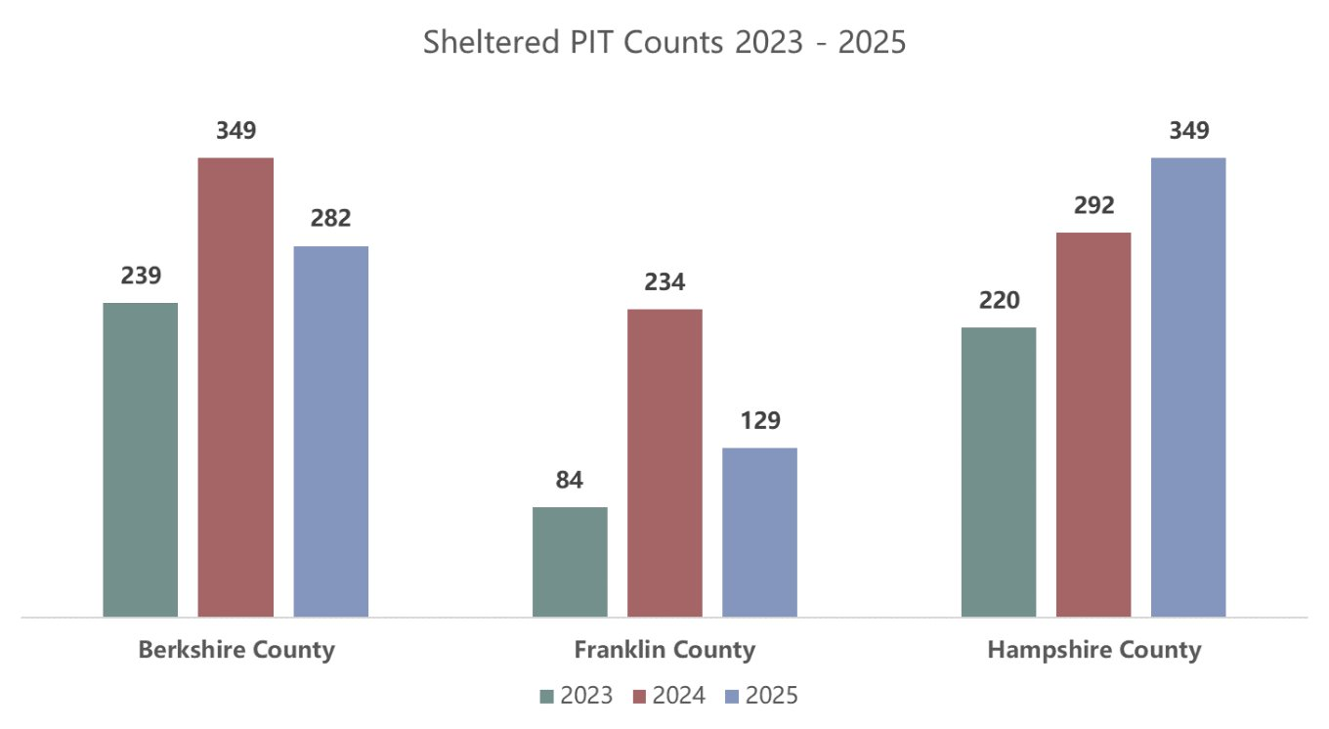

Slide 11
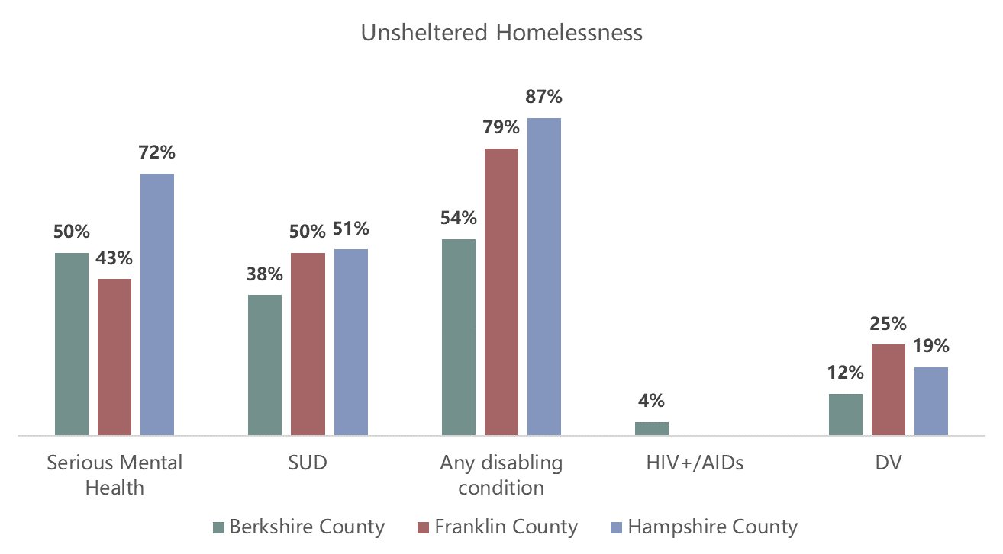

Slide 12
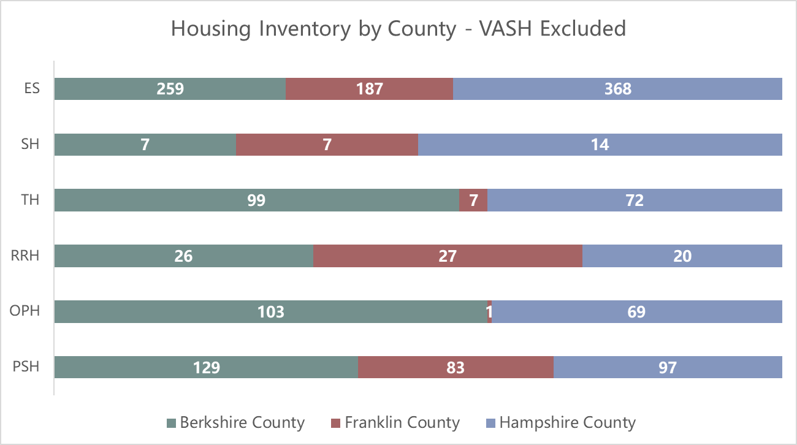
ES: Emergency Shelter
SH: Safe Haven
TH: Transitional Housing
RRH: Rapid Re-Housing
OPH: Other Permanent Housing
PSH: Permanent Supportive Housing

