Slide 1
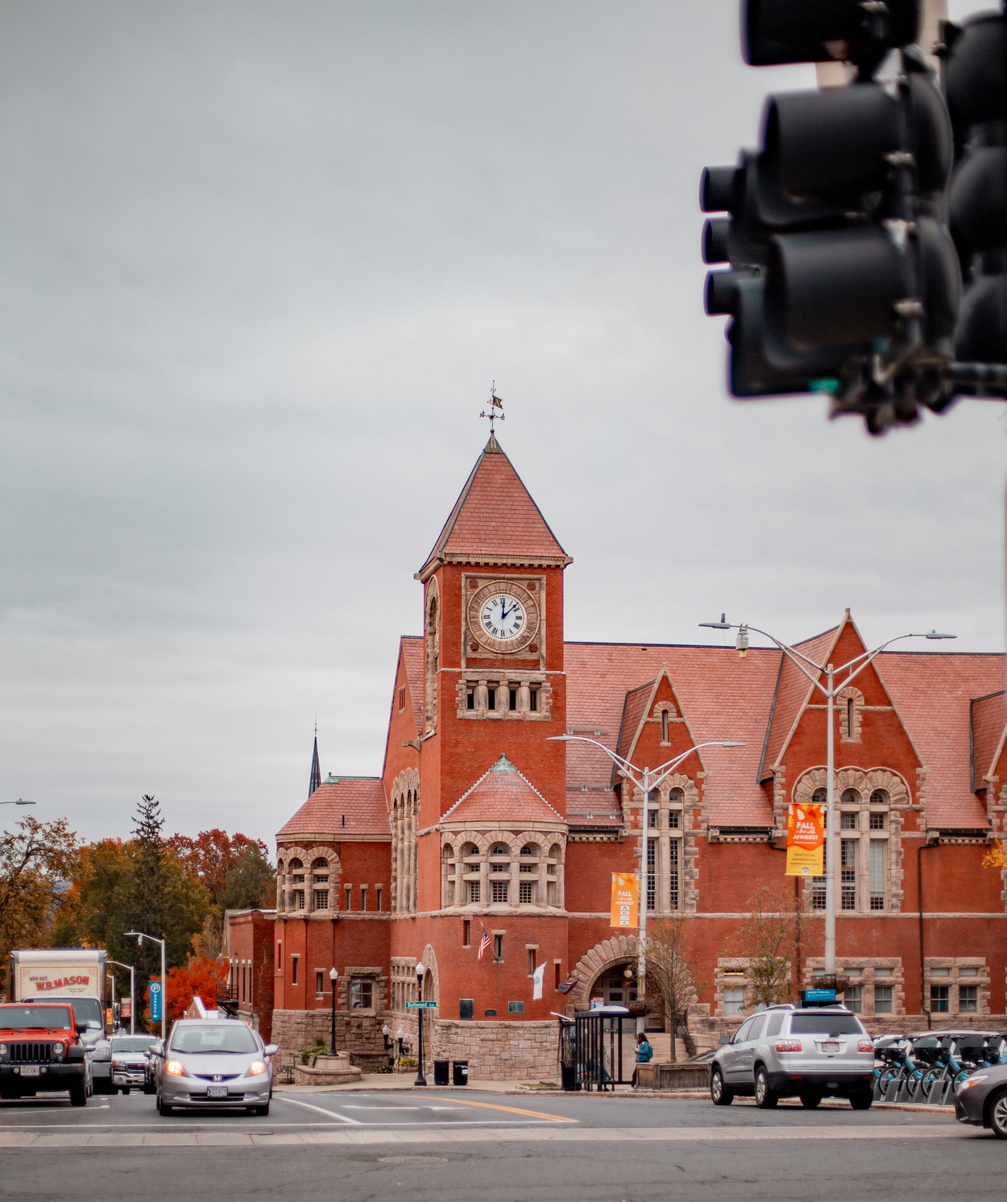
OVERVIEW OF AFFORDABLE HOUSING IN AMHERST:
FACTS, TRENDS, AND FUTURE
PRESENTED BY JOHN HORNIK, Amherst Municipal Affordable Housing Trust

Slide 2
DOES THIS SOUND FAMILIAR?
“This town suffers from a severe housing shortage. We want to be a welcoming and livable city, but people of all ages, backgrounds, and occupations are struggling to keep or find a home here. Our adult children can't afford to live here. People who work here can't afford to move here. Seniors can't afford to stay.”
“A combination of high land prices, restrictive zoning, an unpredictable, often lengthy permitting process, and neighborhood opposition to new multifamily development is making it very hard to build the kind of housing we need.”

Slide 3
WHY ARE WE IN THIS PICKLE?
THREE MAIN FACTORS:
POPULATION CHANGES
LACK OF HOUSING PRODUCTION
GROWTH OF UMASS ENROLLMENT

Slide 4
CHANGES IN AMHERST POPULATION OVER TIME: 1990-2020

Slide 5
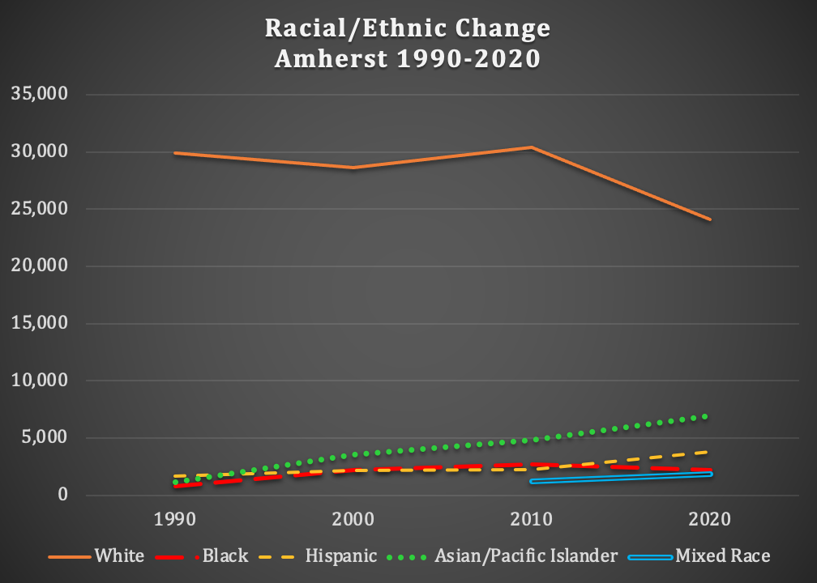
CHANGES IN DIVERSITY

Slide 6
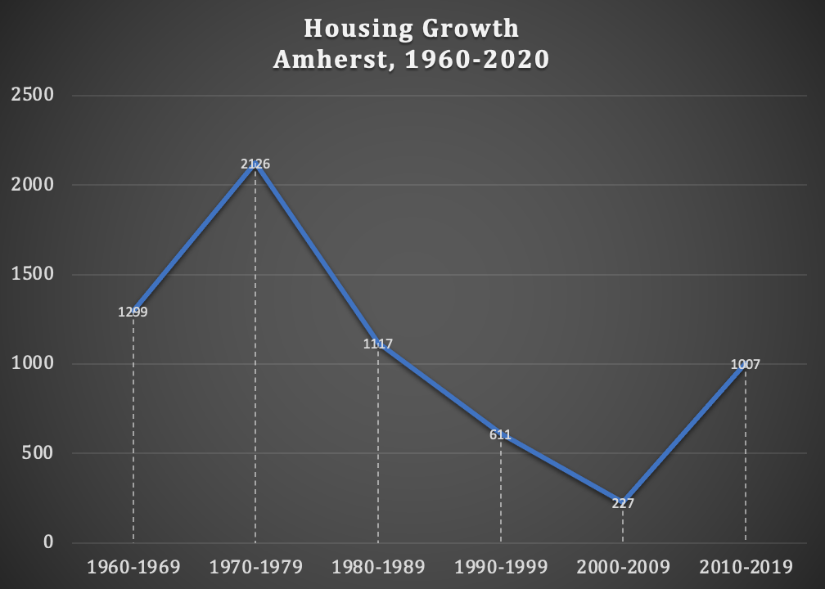
*242 UNITS IN 2020
CHANGES IN HOUSING GROWTH

Slide 7
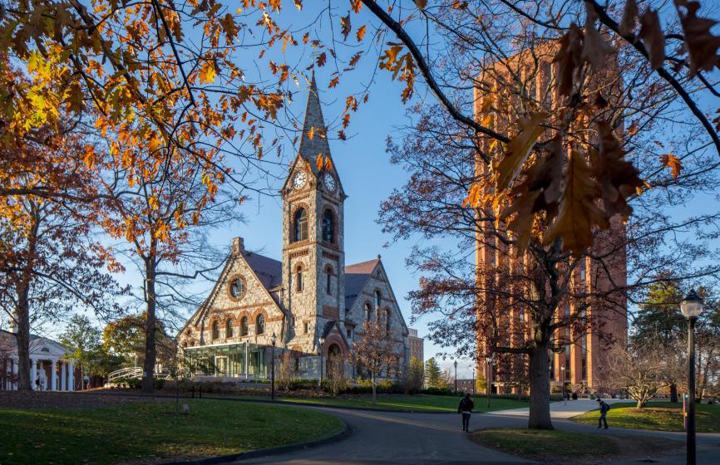
UNIVERSITY RESIDENTIAL PLANNING
ENROLLMENT: 28,000
ON-CAMPUS RESIDENTIAL UNITS: 14,000
*DIFFERENCE: 14,000
ANNOUNCED PLANS:
BUILD NEW UNITS: 1,000
REPLACE NORTH VILLAGE: 120
REPLACE LINCOLN APTS: 180
RENNOVATE EXISTING UNITS: 300
ACTUAL NET NEW UNITS: 400
*DIFFERENCE= THE IMPACT STUDENTS HAVE ON HOUSING IN AMHERST AND SURROUNDING COMMUNITIES

Slide 8
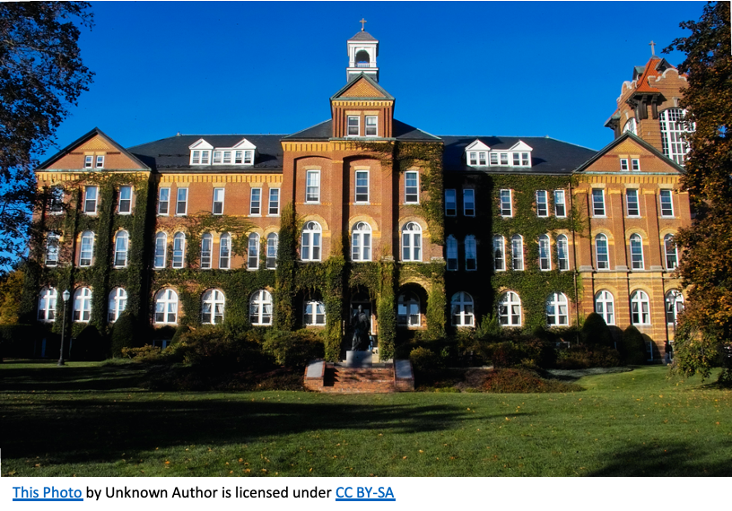
THE ROLE OF THE UNIVERSITY
As the largest landlord in Amherst, the University controls most of the supply. As it makes decisions on student enrollments, it controls most of the demand. When its demand outstrips its supply, the University has a very, very large economic impact.
It creates problems not only for students, but for people who work for the University, people who work for the Town, and people who work for local businesses.

Slide 9
OLDER RESIDENTS HAVE AGED OUT OF CHILD-RAISING, BUT THEY REMAIN A SIGNIFICANT PART OF THE TOWN’S RESIDENTIAL POPULATION
SUMMARY OF PROBLEMS FACED BY AMHERST IN AFFORDABLE HOUSING
LACK OF HOUSING PRODUCTION SINCE 2000, UNTIL THE PAST 2-3 YEARS
UNIVERSITY ENROLLMENT GROWTH HAS SIGNIFICANTLY OUTPACED ON-CAMPUS RESIDENTIAL GROWTH SINCE 2000

Slide 10
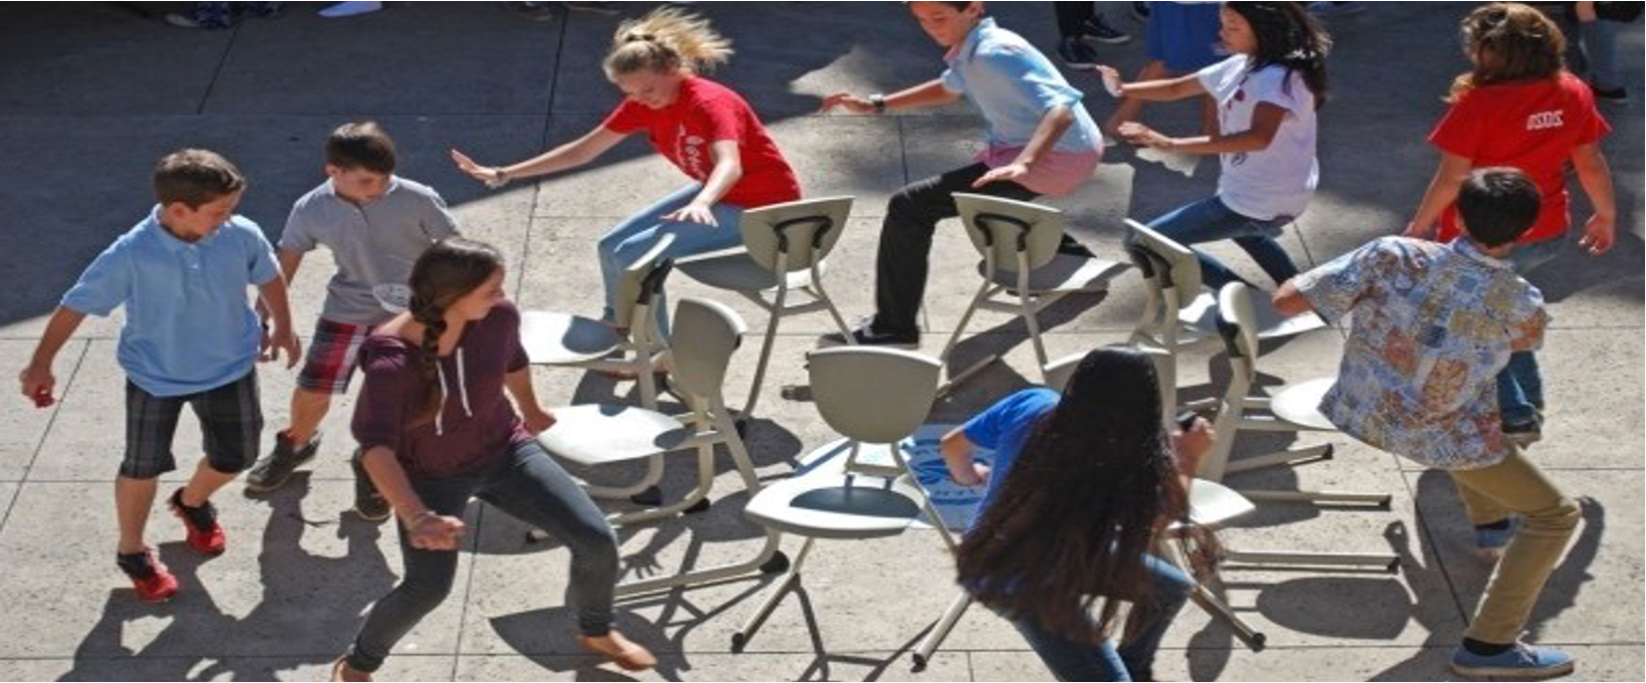
DO YOU RECOGNIZE THIS GAME?

Slide 11
WHAT ARE THE
CONSEQUENCES?

Slide 12
PURCHASING A NEW HOME
The Amherst Community Land Trust assists low-income, first-time homebuyers in purchasing a home. This year one family was successful in finding a home for $250,000, but a second family was consistently outbid in its efforts to become homeowners at the same or slightly higher amounts.
Like the cost of rental units, the costs of homes are rising in a seller’s market. Not only are there entrepreneurs buying up homes to rent to students, but there are people moving to Amherst from urban areas as a result of the pandemic.

Slide 13
MANY FEWER FAMILIES WITH CHILDREN
Edward, a single parent who works for the Town of Amherst, lived in a brick house for many years with rent increasing each year.Two years ago it reached the point where it was no longer affordable, and he and his son had to move out of Amherst.
The numbers of families with school age children has steadily declined since the Year 2000 from 2475 to about 1800. Over the same period the number of school age children residing in Amherst has dropped by more than 1,000.

Slide 14
NEW PH.D. - FIRST JOB!
Susan, a new Ph.D. came to UMass last year from another state on a research fellowship. She was unable to find affordable housing in Amherst. So she returned to the community she grew up in, living with her parents--45 minutes away from Amherst.
Prior to the pandemic, the vacancy rate for apartment rentals in Amherst was generally understood to be under 3%

Slide 15
WELCOME SCHOOL TEACHERS!
Beth, a teacher in another local school system, has lived in Amherst for several years with her two children in a market rate apartment. She was facing an increase in rent that would force her and her children to move out of Amherst. Luckily for her and her family, at the eleventh hour, she received a better paying teaching position.
In the newest apartment buildings in Amherst, advertised rents are $1900/month for a one-bedroom place and $3000/month for a two-bedroom place. These anchor the rental market causing increases in many other developments in Town.

Slide 16
HOUSING INSECURITY
Renters in Amherst
20% of Households are Cost Burdened
40% of Households are Severely Cost Burdened
Homeowners in Amherst
20% of Homeowners are Cost Burdened
<10% of Homeowners are Severely Cost Burdened
COST BURDENED= SPENDS MORE THAN 30% OF INCOME ON HOUSING
SEVERELY COST BURDENED= SPENDS MORE THAN 50% OF INCOME ON HOUSING

Slide 17
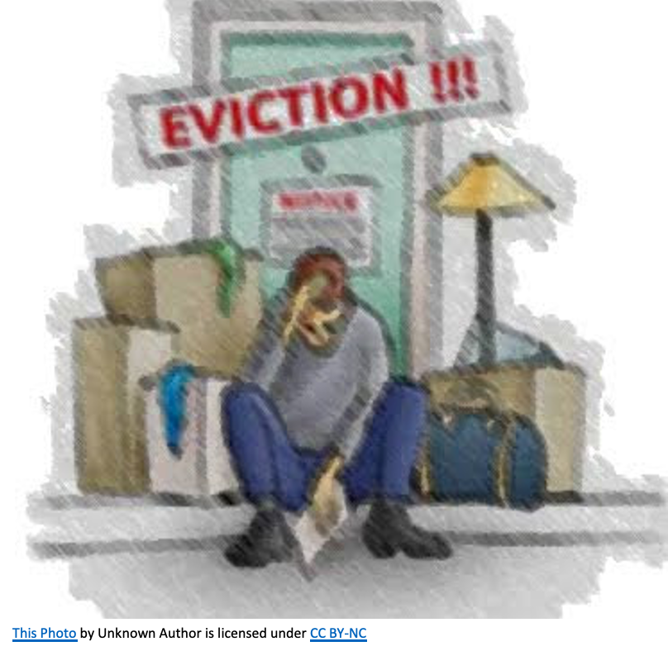
STATUS OF LOCAL FORECLOSURES AND EVICTIONS SINCE THE STATE MORATORIUM LIFTED IN OCTOBER:
Hampshire County:
30 Auctions
33 Petitions
212 Eviction Filings
Western Mass:
272 Executions Pending
Pending State Legislation: COVID19 Housing Equity Bill: Reduces risk of foreclosure and eviction

Slide 18
• If you are a student, developers will continue to build high rent apartments in Amherst, but there will be little to no growth on campus despite demand.
• If you already own your own home, the neighborhood around you may see more student rentals.
• If you are a family with school age children, opportunities to become a homeowner or renter at an affordable cost will continue to be slim.
• If you are an older adult living in Amherst and want to downsize, new opportunities to find an affordable place within the community in which you have lived may not materialize.
• If you are a a low-income renter, your rent will probably increase making your housing more insecure, while the quality of your housing may also diminish.
• Unless the University and Town Council makes major changes, the future is not optimistic.

Slide 19
•Maintained and increased number of affordable units on
the Subsidized Housing Inventory (SHI)
•Engaged the community in support of affordable housing
•Dedicated resources—funding, staff, and leadership—to
expand housing opportunities
•Continues to explore ways to increase affordable housing
•Updated Inclusionary Zoning Bylaw (2021) to require
construction of affordable homes in all new developments
greater than nine units
Over $! Million in CPA funds spent on Community Housing in past five years
IS
ANYTHING
GOOD HAPPENING?

Slide 20
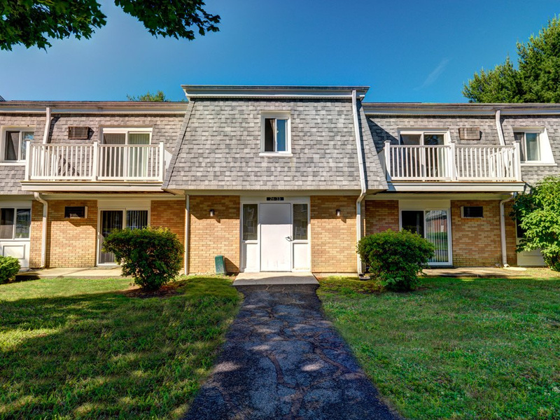
KEY PROJECTS
•North Square: mixed-use, mixed income rental development with 130 total units, 26 affordable units and commercial space
•Habitat for Humanity: homeownership units throughout town [5 recent homes]
•First Time Homebuyer Programs: Valley Community Development and Amherst Community Land Trust [14 households]
•Rolling Green: preservation of 42 affordable units•

Slide 21
DRAFT NEW TOWN HOUSING POLICY
The recommendations contained in this Policy are highly interdependent and are grouped into five primary action areas:
Goal I: Promote Greater Pathways to Homeownership and Integrated Communities through Increased Supply of a Diversity of Housing Types
Goal II: Increase the Supply and Variety of Affordable and Market Rate Rental Housing
Goal III: Create, Update, and Maintain Safe, Secure, and Environmentally Healthy Housing
Goal IV: Address Climate Sustainability and Resiliency of Housing Stock, Location, and Construction
Goal V: Align and Leverage Municipal Funding and Other Resources to Support Affordable Housing

Slide 22
MEASURING PROGRESS
Affordability
Minimum of 250 new units for households earning less than 80% AMI over the next 5 years, consistent with goals set in the Housing Production Plan
Reduce the percentage of renters who are cost burdened and severely cost burdened to a total of 50% within five years.
Reduce the percentage of owners who are cost burdened and severely cost burdened to a total of 20% of owners within five years.
Reduce the number of homeless individuals served at Craig’s Doors because they become housed.
Safe and Secure Housing
Reduce the number of health and safety violations identified by the inspections department.
Implementation of year-round sheltering option in Amherst.

Slide 23
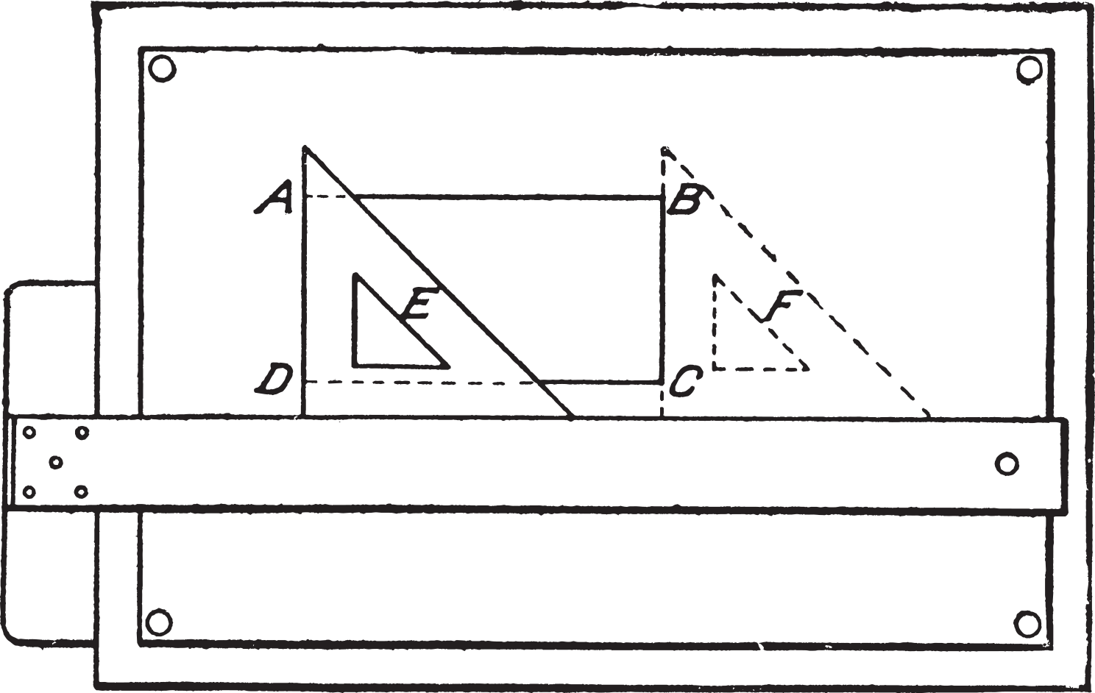
•Amherst Studio Apartments [Construction to begin in 2022]
•Affordable Development for Families: East Street and Belchertown Road [awaiting Town release of RFP]
•Strong Street Homeownership Development [property evaluation]
•ARPA Funding for retrofitting heating systems and weatherization, low-income rental development at University Motor Lodge, new subsidies for homeownership [proposed]
•Hickory Ridge development for older adults [to be proposed]
ON THE
DRAWING
BOARD

Slide 24
•Many multi-unit buildings are in need of both weatherization and up-to-date heating technology to operate more efficiently
•With subsidy programs from MassSave [Eversource], we can now afford to do that at very reasonable costs.
•If the Town chooses to invest ARPA funds to fill the gap between total costs and the MassSave subsidy, it will further reduce the costs of changing over.
•The Center for EcoTechnology, as a MassSave partner, will provide technical assistance to building owners, managers, and Town staff to midwife this process.
•As a result, we can expect to see:
Reduced costs for owners and renters
Better air quality in apartments
Improved health in households living in
HOUSING
AND
SUSTAINABILITY

Slide 25
REPORT:NOT JUST AMHERST
While the presence of UMass makes Amherst unique in some ways, the challenges that Amherst experiences are present throughout the Pioneer Valley.
See Greater Springfield Regional Housing Analysis Report [UMass Donahue Institute Report developed with support from Wayfinders and the Community Foundation]
An increasing housing supply gap could drive up prices
Housing instability pressures have remained serious since the Great Recession
More than half of all renters in the Pioneer Valley are housing “cost burdened”, spending 30 percent or more of their income on housing. This trend is even worse for communities of color in the region.

Slide 26
We need a partner in the University that recognizes its role in the local housing market and plans to develop 3-5 thousand new units on campus for its students, including those with families.
Set a reasonable goal of at least 250 new affordable units. If we don’t set goals and work hard on it, we will never get there.
Assure that these new units are available to both individuals and families, including persons who are homeless, disabled, seniors, etc.
Assure that these new units are not segregated or isolated, but close to services, including transportation.
Assist people seeking affordable housing in identifying and accessing available homes.
Maintain our commitment to supporting the Amherst seasonal shelter, even as we develop new housing
Above all, we need your ideas and your advocacy!
WHAT DO WE
NEED?

Slide 27
THANK YOU.

Slide 28
IF WE WERE TO
INITIATE A NEW
RENTAL DEVELOPMENT
FOR OLDER ADULTS, WHAT WOULD IT LOOK LIKE?

Slide 29
Why is the Housing Trust involved in this?
Promote a diversity of affordable housing in Amherst
Encourage development of specific projects
Amherst studio apartments (123 Northampton Road)
Belchertown Road-East Street development to serve families primarily
Homeownership opportunities for low-income families
Affordable apartments to serve older adults
Promote other housing-related Town goals (e.g., sustainability)
Develop a pipeline of programs and projects
Seek public support directly and with the Amherst Affordable Housing Advocacy Coalition
Collaborate with the Community Preservation Act Committee and Town Council

Slide 30
Preliminary Exploration of Ideas
Uncertainties
Don’t know where it would be sited
Don’t know if it would be approved by Town Council and the Zoning Board of Appeals
Don’t know what neighborhood opposition might materialize:
It doesn’t fit in with other residential development
It will add too much traffic
There’s no need for this type of housing

Slide 31
Early Conversation
To share ideas
To assess level of interest
To get feedback
To take advantage of our collective wisdom and experience
To develop a preliminary plan to present to the Town

Slide 32
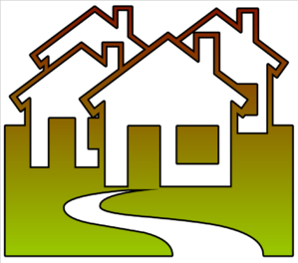
Options for senior living
Active adult communities. Active adult communities are neighborhoods made for older adults with either coordinated or integrated healthcare.
Independent living communities.
Assisted living residences.
Nursing homes.
Continuing care retirement communities (mix of the above).

Slide 33
2 Life Communities – Key Design Ideas
“Aging in Community” Model
Goal: No one has to leave (although not labelled as assisted living)
Addresses economic insecurity, loneliness
Can be mixed development, both subsidized and unsubsidized units (affordable to people dependent on social security)
Mostly one-bedroom with some two-bedroom

Slide 34
Design for Independent Living
Building design guidelines:
Ground floor=Village hub, encourages outsiders to visit, use facilities as appropriate
Large welcoming entry
Large and small rooms incorporated to support a variety of activities

Slide 35
Design for Independent Living
On-site staffing: Resident Coordinator and Activities Coordinator
Help residents navigate daily life
Coordinate healthcare services
Services come to residents
Agreements with outside agencies (e.g., Highland Valley Elder Services, Amherst Senior Center)
Arrange for activities, e.g., fitness services

Slide 36
Alternative Example: Senior Living Residences
Cape Cod Senior Residences (Bourne) [https://www.seniorlivingresidences.com/communities/cape-cod-assisted-living/]
Senior Living Residences (parent organization) – Assisted Living Health Facility [locally Armbrook Village]
Outdoor living spaces
Enriched daily programs
Restaurant-style dining with healthy food options

Slide 37
Design for Assisted Living
Studios, one- and two-bedroom apartments
Kitchenette
Walk-in shower
Emergency alert system
Individual thermostat control
Housekeeping and linen laundry service
Apartment maintenance and utilities
Wired for cable TV and phone

Slide 38
Financing Development:
For independent living residence with coordinated healthcare
Mix of public financing with supplementary fund raising
More likely to be affordable
Financing carries Age restrictions: 55 and over or 62 and over
For Facility with integrated healthcare (assisted living, continuing care retirement communities): Don’t know about financing.

Slide 39
Site Possibility: Hickory Ridge Golf Course
If Amherst purchases property for conservation land, there are 5-9 acres of developable property along West Pomeroy Lane.

Slide 40
What would you like to see?
Retirement community with Independent living? OR Assisted living facility? Including a healthcare facility (e.g., skilled nursing)
Rental apartments? Condos with partially refundable entry fee with monthly assessments?
All affordable? Mostly affordable, but some market rate units?
Disability accommodations?
Age restrictions? 55 and over? 62 and over?
Location?
Importance?
Staffing? 24/7?

Slide 41
THANK YOU, AGAIN.

