Slide 1
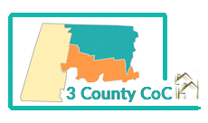
Three County Continuum of Care
Working to make Homelessness Rare, Brief, and Non-Recurring in Berkshire, Hampshire, and Franklin County

Slide 2
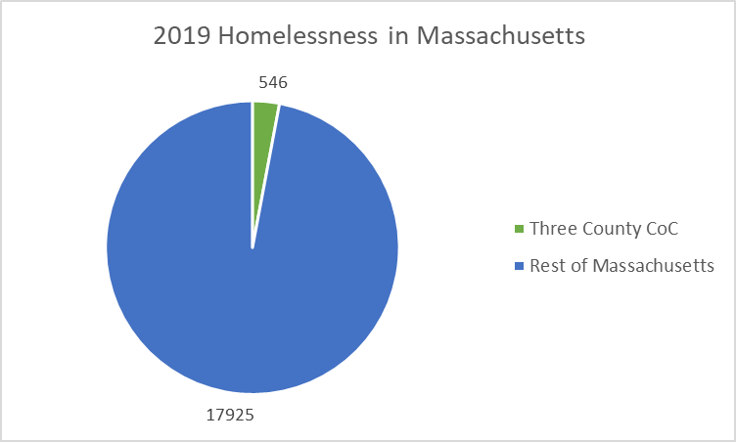
18,471 people in Massachusetts were counted as experiencing homelessness in 2019
Franklin, Hampshire, and Berkshire Counties accounts for approximately 2.9% of the statewide population of people experiencing homelessness. These figures represent a single night at the end of January.

Slide 3
Homelessness in Massachusetts
On April 30, 2019, there were 3,577 families with children and pregnant individuals in Massachusetts’ Emergency Assistance (EA) shelter program. 29 of these families with children were being sheltered in motels.
In the 2017-2018 academic year, public schools across Massachusetts were able to identify and serve 24,071 students who were experiencing homelessness, up from the 2016-2017 academic year count of 21,112 students who were experiencing homelessness.
On any given night in Massachusetts, the approximately 3,000 shelter beds for individuals usually are full or beyond capacity
Data on this page courtesy of Massachusetts Coalition for the Homeless - http://www.mahomeless.org/about-us/basic-facts

Slide 4
What is the HUD Continuum of Care Program?
The CoC is a regional planning and implementation body
The goal of the CoC is to house individuals and families as quickly as possible and provide the supportive services to maintain stable housing
The HEARTH Act of 2009 consolidated three separate McKinney-Vento homeless assistance programs into a single grant program, known as the CoC
(Courtesy of Congressional Research Service, https://www.everycrsreport.com/reports/RL33764.html)
Notes:
The Homeless Emergency Assistance and Rapid Transition to Housing Act of 2009 (HEARTH Act), enacted into law on May 20, 2009, consolidates three homeless assistance programs administered by The Department of Housing and Urban Development under the McKinney-Vento Homeless Assistance Act into a single grant program. The HEARTH Act also codifies into law the Continuum of Care program and planning process.
We follow what is called the interim rule and a code of federal regulations and a competitive application process annually for the funds, which are really meant to house chronically homeless, so really our most vulnerable neighbors.

Slide 5
HUD’s Goal of the Continuum of Care Program
Promote community wide commitment to the goal of ending homelessness;
provide funding for efforts by nonprofit program providers, area stake-holders, and state and local governments to house homeless individuals and families in a Housing-First Model;
minimize the trauma and dislocation caused to homeless individuals, families, and communities by homelessness;
promote access to and effect utilization of mainstream programs by homeless individuals and families;
and optimize self-sufficiency among individuals and families experiencing homelessness.

Slide 6
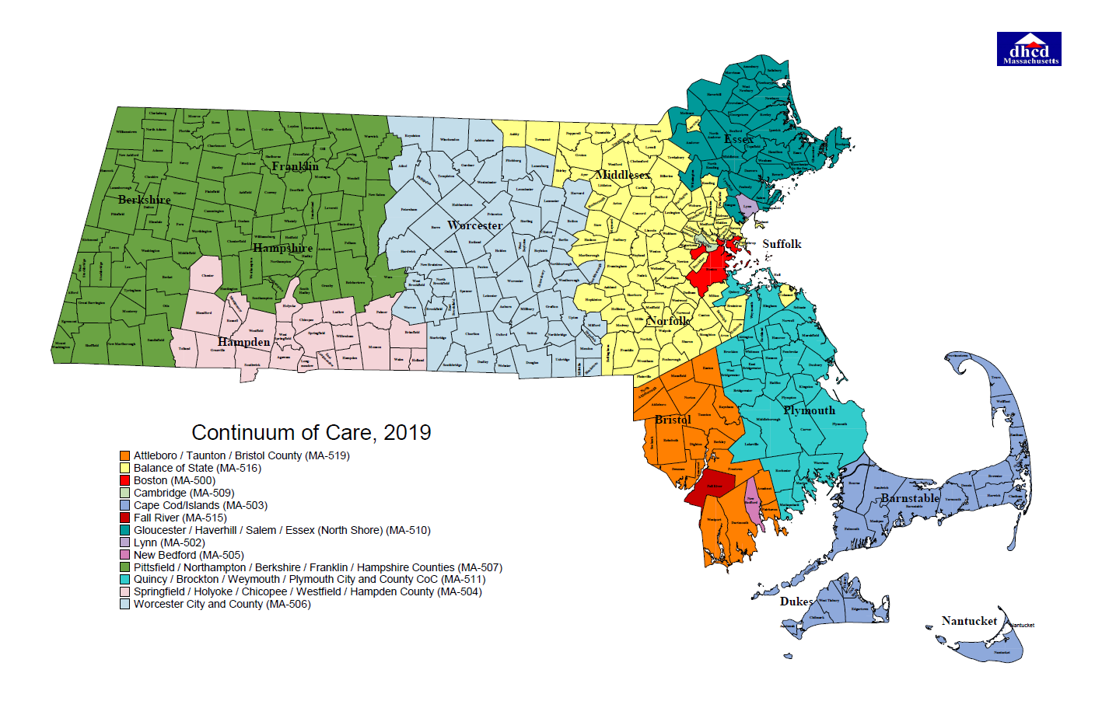
Massachusetts Continuums
Notes:
There are now 15 COC’s in the commonwealth, which is unusual. Normally there are just a few. You will see that Three County Covers a very large Geographic area, 1600 square miles

Slide 7
What Makes Us a Continuum?
The CoC Board of Directors
The Collaborative Applicant (CAPV)
The HMIS Lead (CAPV)
CoC Committees, Sub-committees, and Working Groups
The CoC Membership - This includes everyone in the room plus those who could not attend from:
CoC Funded Projects
CoC Funded and non-funded Coordinated Entry partners
(Courtesy of Strategies to End Homelessness, https://slideplayer.com/slide/3601057/)
Notes:
The membership includes everyone connected to the Western Mass Network to End Homelessness, area stakeholders, people with lived experience, and folks directly involved in our Board, our staff, our committees – which will be discussed a bit more in depth soon.
So, I have tried to think more broadly about how to describe the continuum and our work. We are sort of like a coalition, but we are also a funder. I really see it like a collective impact model.

Slide 8
The commitment of a group of actors from different sectors to a common agenda for solving a specific social problem
Collective Impact
Notes:
There are lots of social impact models out there, but I really like the Stanford Social Innovation review - which describes a group of diverse organizations coming together to solve complex problems. Ours being homelessness.

Slide 9
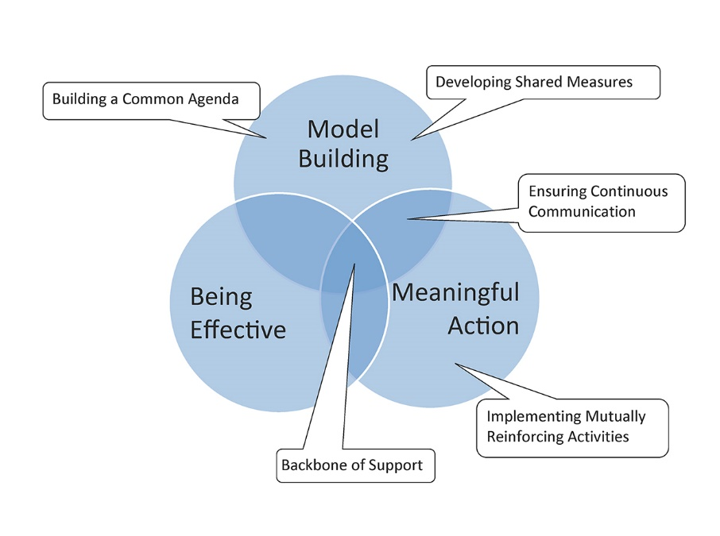
Five conditions of Collective Impact

Slide 10
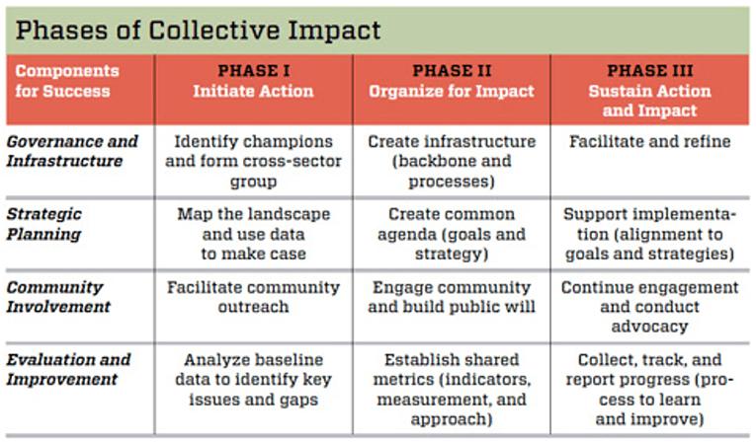

Slide 11
Community Action Pioneer Valley, Three County CoC’s Collaborative Applicant
How we see our role:
Key Components of the Collaborative Applicant role:
Guide a vision and strategy for Ending Homelessness;
Support and coordinate aligned activities;
Establish shared measurement practices;
Build public will;
Advance priorities of those most impacted.
Funding mobilization;
Data Collection and Reporting;
Administer and Support a Coordinated Entry Process;
Project Monitoring and Evaluation;
Community Organizing
Notes:
CAPV became the collaborative applicant early in 2019 and was fully staffed this September with Michele, our data manager, Brooke our program specialist, and myself. Prior to us, the CoC was housed at the Hilltown CDC.
as collaborative applicant is responsible for:
Preparing and submitting the consolidated application to HUD on behalf of entire CoC
Evaluating project performance and ranking renewal applications
Evaluating and reporting system-wide performance to HUD and the community
Providing leadership and technical assistance to CoC-funded programs and CE partners
Site monitoring
Community engagement
Creating partnerships between organizations
But through Collective Impact, the CoC is positioned to : guide strategy, leverage partnerships, create shared measurement practices, build the will of the people, and advance the voices of people with lived experience.

Slide 14
CoC Committees:
Equity and Inclusion Committee: Meets monthly. The contact person for this committee is Keleigh Pereira, the CoC Program Director: kpereira@communityaction.us
Coordinated Entry Committee: Meets quarterly. The contact person for this committee is Brooke Murphy, the CoC Program Specialist: bmurphy@communityaction.us
Data Evaluation Committee: Meets monthly. The contact person for this committee is Michele LaFleur, the CoC Data & Evaluation Manager: MLaFleur@communityaction.us
Ranking Evaluation Committee: Meets quarterly. The contact person for this committee is Keleigh Pereira, the CoC Program Director: kpereira@communityaction.us
Youth Action Board: The Youth Action Board is a youth-only committee and already meets regularly. If you are interested in participating in the work of the Youth Homelessness Demonstration Project, please contact Keleigh Pereira kpereira@communityaction.us or Lisa Goldsmith lgoldsmith@communityaction.us

Slide 15
Continuum of Care Components
Emergency Shelter (ES): is any facility whose primary purpose is to provide temporary or transitional shelter for the homeless in general or for specific populations of the homeless. In Massachusetts we have a large ES program run by the State specifically for families.
Transitional housing (TH): provides temporary housing for the certain segments of the homeless population, including working homeless making insufficient wages or homeless individuals with mental or physical disabilities who have trouble affording long-term housing, and is set up to transition their residents into permanent, affordable housing within a reasonable amount of time (usually 24 months).
Permanent Supportive Housing (PSH): is permanent housing with indefinite leasing or rental assistance paired with supportive services to assist homeless persons with a disability or families with an adult or child member with a disability achieve housing stability.
Rapid Re-Housing (RRH): RRH rapidly connects families and individuals experiencing homelessness to permanent housing through a tailored package of assistance that may include the use of time-limited financial assistance and targeted supportive services
Supportive Services Only (SSO): This program provides services to homeless individuals and families living in the community. SSO recipients may use the funds to conduct outreach to sheltered and unsheltered homeless persons and families, link clients with housing or other necessary services, and provide ongoing support.
Notes:
These are the types of Components CoC funds cover, though HUD really doesn’t fund Emergency Housing Any More. Our CoC currently has two TH, one dual component TH and PSH, and the rest are PSH.

Slide 16
Notes:
So of course, the other piece is that are what’s called the “recipient” for the HUD funding and we have contracts with all of these folks, called “subrecipients” who invoice us for their programming in housing and supportive services. We have about 180 beds across our 3 counties. And receive oer 1.8 million in our grant annually..some of which funds our work and most of which funds these programs.

Slide 17
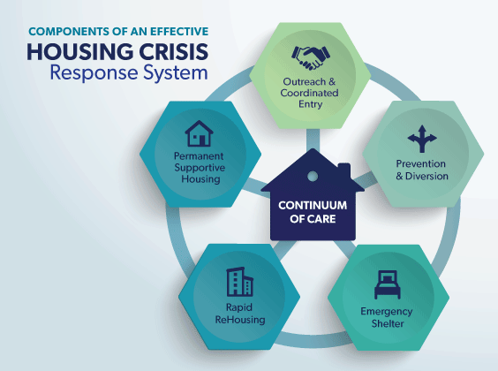
Three County CoC Coordinated Entry Partners
Amherst Community Connections
Berkshire County Regional Housing Authority
The Brien Center
Center for Human Development (CHD)
Cooley Dickinson Hospital
Community Housing Program (CHP)
Construct, Inc
Craig’s Doors
DIAL/SELF Youth & Community Services
Eliot CHS
Institute for Health and Recovery
Louison House
Way Finders
Hilltown Community Development
Northampton Veteran Services
The VA of Central & Western MA
ServiceNet Shelter and Housing
Soldier On, Inc
Franklin County Regional Housing & Redevelopment
Greenfield Housing Authority
Northampton Housing Authority
Amherst Housing Authority
(Courtesy of Gulf Coast Partnership, https://gulfcoastpartnership.org/2019/04/29/homeless-systems-training-may-23-2019/)
Notes:
n order to find, support, and house our chronically homeless neighbors, we have these partners that are critical in the work we do. The COC holds 3 case conferencing meetings a week, one in each county to discuss the needs of the homeless population, support case conferencing, and to match them to housing.
Vulnerability assessment

Slide 18
The Continuum of Care & Data
Reports Required by HUD:
Longitudinal Systems Analysis (LSA), formerly the AHAR
Systems Performance Measures (SPM)
Housing Inventory Count (HIC)
Point in Time Count (PIT Count)
Custom reporting:
Rates of chronic homelessness
Disparities among rates of homelessness or length of time homeless by race, age, ethnicity, or gender identity
Population specific data – individuals, families, veterans, people experiencing domestic violence
Information by county

Slide 20
CAPV’s CoC Board Membership
Existing Board Seats
Berkshire County Representative
Hampshire County Representative
Franklin County Representative
Homeless Advocate
Homeless or formerly Homeless Individual
McKinney Vento Education Liaison
Western MA Regional Network to End Homelessness Representative
Domestic Violence Provider
Emergency Solutions Grant Representative
Funded Project Representatives
New Board Seats/2019 Additions
Youth Action Board Representative
Affordable Housing Advocate
College Representative
Employer/Employment Agency Representative
Public Housing Authority Representative
DCF Representative (Required by the YHDP demonstration)

Slide 21
CoC Youth Homelessness Demonstration Program!
Franklin County designated a YHDP Community and is undergoing a planning process currently!
Creation of coordinated, community plan to prevent and end youth homelessness
$1.9 million available for projects that are consistent with plan over a two year period
2-year grant terms for demonstration projects beginning on 2020.
Projects that meet program statutory requirements may be renewed under the CoC Program
Notes:
YHDP slide – discuss three phases – creating a coordinated community plan, project design and implementation,

Slide 22
Questions?
Keleigh Pereira
Program Director
413-376-1184
kpereira@communityaction.us
Michele LaFleur,
Data & Evaluation Manager
413-376-1143
mlafleur@communityaction.us
Brooke Murphy
Homelessness Services and Billing Manager
413-376-1178
bmurphy@communityaction.us

