Slide 1
Three County CoC Annual Meeting 2020
Tuesday, September 29, 2020

Slide 2
Welcome and Meeting Agenda Keleigh Pereira - Program Director, Three County Continuum of Care
Membership votes - Brad Gordon
Providing Housing and Supportive Services during COVID-19 - Luis Martinez
Racial Equity Plan - Donald Whitehead and Jeff Olivet
Coordinated Entry System Work - Brooke Murphy
Point-In-Time Count - Michele LaFleur
Youth Homelessness Demonstration Program- Ayana Gonzalez, Ellen Fitzpatrick, Lisa Goldsmith, & Keleigh Pereira
Committee Recruitment - Brooke Murphy and Keleigh Pereira
Goals for Next Year and Closing - Theresa Nicholson

Slide 3
Current Need for Legislative Advocacy Pamela Schwartz, Western Mass Network to End Homelessness
Act to Guarantee Housing Stability during the COVID-19 Emergency & Recovery– stop Mass Evictions!
Right to Council in Evictions during COVID-19 – Pilot Program
Organizations and Elected Officials can sign on in support of the bill
Individuals can utilize their action page to call or email their legislators
https://homesforallmass.netlify.app/

Slide 4
Board and Membership Votes Brad Gordon - Executive Director, Berkshire Regional Housing Authority
CoC Board of Directors Introductions
CAPV as Collaborative Applicant
Lead updates and vote on Charter and Slate

Slide 5
Board Membership Update and Vote Brad Gordon - Executive Director, Berkshire Regional Housing Authority
Brad Gordon, Chair, Berkshire County Regional Housing Authority
Theresa Nicholson, Chair, Center for Human Development
Justine Dodds, City of Pittsfield
Earl Miller, Western Mass Recovery, DMH
Diana Abath, Women’s Resource Center, GCC
Andy Klatka, Eliot Community Human Services
Stacey Parsons, North Adams Public Schools, School-Housing Partnership Coordinator MV Regional liaison
Pamela Schwartz, Western Mass Network to End Homelessness
Heather Marshall, Elizabeth Freeman Center
Brad Gordon, Berkshire County Regional Housing Authority
Timothy Rivers, Youth Action Board
MJ Adams, City of Greenfield
Tina Schettini, Berkshire Community College
Cynthia Ray, Mass Hire Franklin Hampshire Career Center
Erin Cassidy, Amherst Housing Authority
Kasey Erickson, Department of Child and Family Services
Mike Hagmaier, Soldier On
Steve Connor, Central Hampshire Veterans Services
Betsy Shally-Jensen, A Positive Place
Philip Ringwood, Dial/Self Youth & Community Services
Kathy Keeser, Louison House
Jane Ralph, Construct
Theresa Nicholson, Center for Human Development
Melphy Antuna, Way Finders
Jay Sacchetti, Service Net
Dave Christopolis, Hilltown CDC

Slide 6
Continuum Charter Updates & Membership Vote Brad Gordon - Executive Director, Berkshire Regional Housing Authority
Board Charter –
Performance and Outcomes committee has been removed and the responsibilities of that committee have been shared between the Ranking and Evaluation Committee and the Board. This charter previously did not have Board specific responsibilities
Added in brief details regarding current workgroups since there are several workgroups meeting more frequently
Youth and Young Adult Committee began this fall and this is included
Some changes made to committee responsibilities to more clearly reflect efforts being made
HMIS charter-
Changes made were primarily to add system administration responsibilities through DHCD to reflect CoC’s decision last year to remain with them
Next year’s Charter will likely reflect a new HMIS system and the CoC’s HMIS lead opportunities that come with that

Slide 7
Providing Housing and Supportive Services During COVID-19 Luis Martinez – Program Manager, Center for Human Development – CoC Project Subrecipient

Slide 8
Racial Equity Planning Jeff Olivet & Donald Whitehead – jo consulting

Slide 9
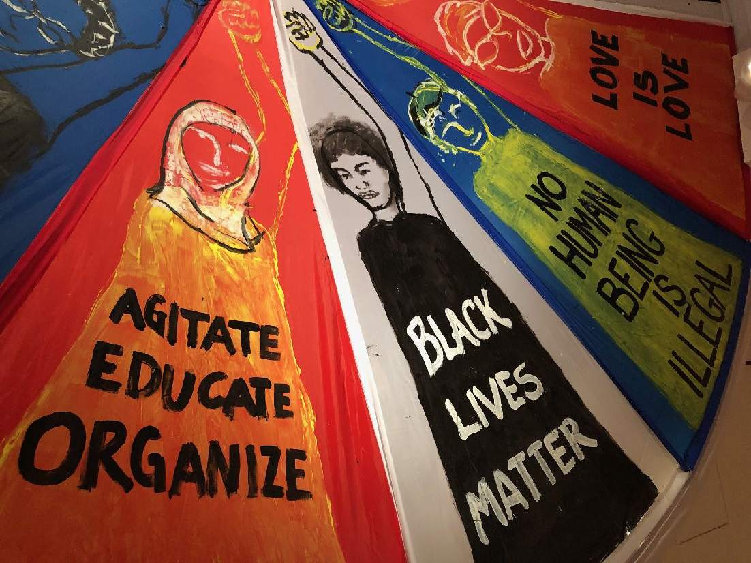
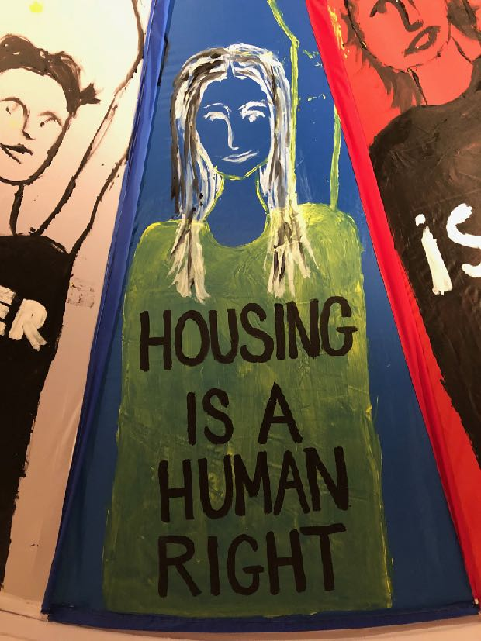
Three County Continuum of Care
Racial Equity Initiative Update
Donald Whitehead
Jeff Olivet
September 29, 2020

Slide 10
Goal of the Initiative
To embed racial equity in the Western Massachusetts homelessness response system.

Slide 11
Phase 1
February - June 2020

Slide 12
Racial Equity Work Group
Leadership training
Data assessment
Online Equity Training
YAB training
Action Planning
Key Activities

Slide 13
Diana Abath
Tanisha Arena
Dottie Arnold
Rafael Burgos-Mirabal
Diana Canales
Shaundell Diaz
Emily English
Lisa Goldsmith
Michele LaFleur
Myck LeMay
Brooke Murphy
Keleigh Pereira
Pamela Schwartz
Betsy Shally-Jensen
Kelsey Wessels
Kaia Willey
Shabazz Wilson
Racial Equity Workgroup

Slide 14
Data Highlights

Slide 16
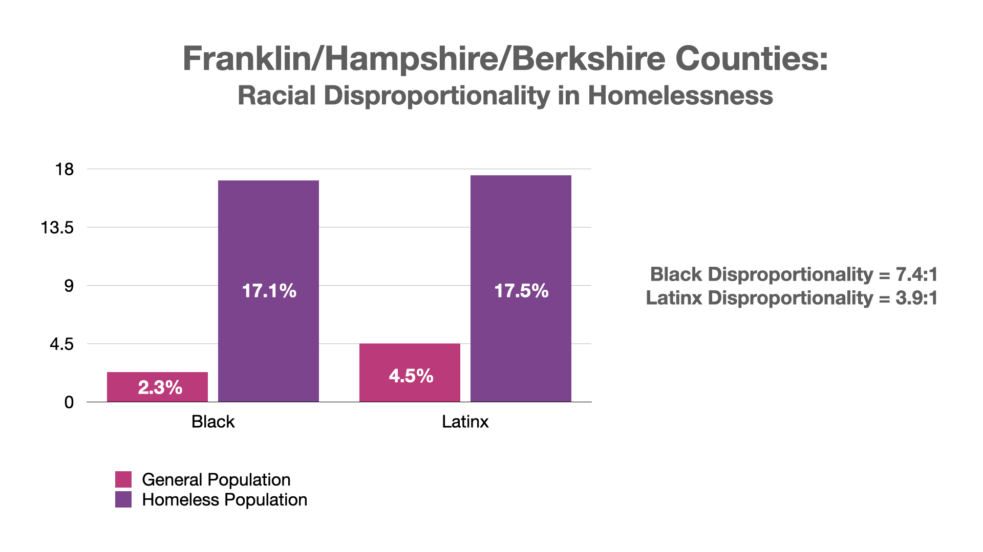

Slide 17
Youth and Young Adults
16% identify as African American (compared to 4.5% of gen. pop.)
35% identify as Latinx (compared to 7% of gen. pop.)
Three County CoC

Slide 18
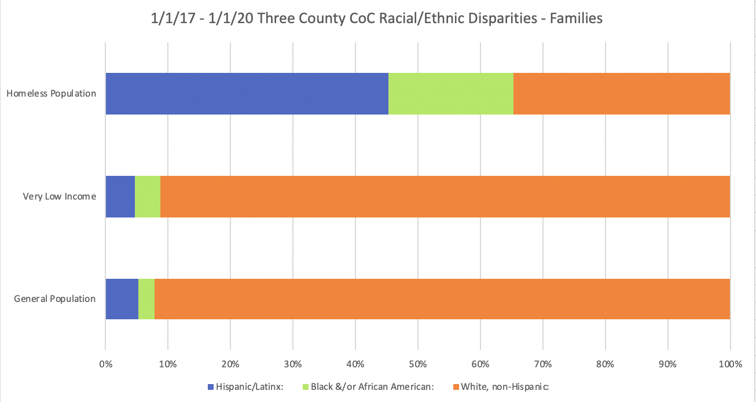
Families

Slide 19
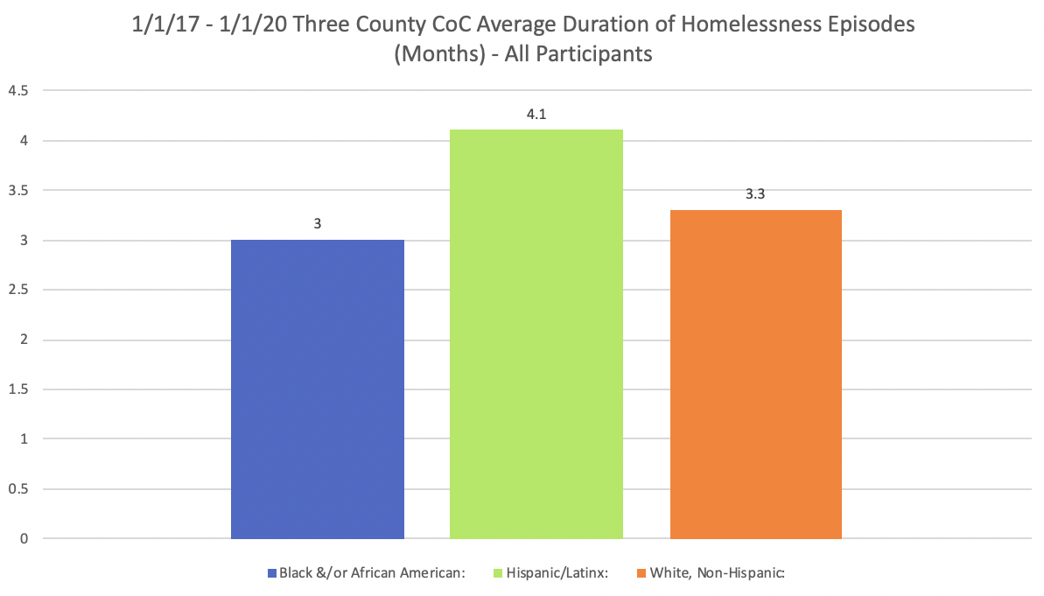
Duration of Homelessness

Slide 20
Housing Outcomes
HOMELESS POPULATION:
17.1% Black
60% White, non-Hispanic
17.5% Hispanic

Slide 21
Housing Outcomes
HOMELESS POPULATION:
17.1% Black
60% White, non-Hispanic
17.5% Hispanic

Slide 22
Phase 2
July 2020 - June 2021

Slide 23
Coordinated Entry
Data
Organizational Training and Development
Affordable Housing
Lived Experience
Legislative Policy
Racial Equity Action Plan
Priority Focus Areas

Slide 24
Finalize action plan
Implementation coaching
Ongoing learning
YHDP-specific work
Community convening (Dec/Jan)
CoC Board support
Phase 2 Activities

Slide 25
Centering lived experience.

Slide 26
Structural
Institutional
Interrupting Racism
Interpersonal

Slide 27
www.RacialEquityPartners.com

Slide 28
Coordinated Entry System 2019-2020 Brooke Murphy – Homeless Services and Billing Manager, Three County Continuum of Care
Three County CoC Coordinated Entry System:
Brief background on CE purpose and goals
Current CE system
Assessment tools and prioritization

Slide 29
CE Accomplishments 2019-2020
Accomplishments:
Successful placements
Improvements in HMIS system and CE use
Increased participation
Adjusting CE to COVID-19 pandemic
Creation of CE Workgroup
Coordinated Entry Specialist position
Website

Slide 30
Coordinated Entry System Work: Ongoing & Pipeline
Coordinated Entry Workgroup- Meeting biweekly on Wednesdays 3:00-4:30
Racial equity framework
System mapping
Community resource tool/list
CE Vulnerability Assessment and Prioritization
Incorporating YHDP Projects and YYA Coordinated Entry
Planning for YHDP projects
YYA CE
Notes:
Next steps:
Finalize community resource
Finalize Assessment tool and prioritization
Spring 2021 trainings

Slide 31
Point-In-Time Count Michele LaFleur – Data and Evaluation Manager, Three County Continuum of Care
2020 PIT Count Conducted January 29, 2020

Slide 32
What is the Point in Time (PIT) Count?
An unduplicated count of persons experiencing sheltered and unsheltered homelessness on a single night.
CoC's nationwide are required to conduct a PIT Count at least bi-annually at the end of January.
Notes:
The PIT Count is an unduplicated count of persons experiencing sheltered and unsheltered homelessness on a single night.
CoC's across the nation are required to conduct a PIT Count at least bi-annually at the end of January. Generally, Massachusetts tries to coordinate so that all MA CoCs are conducting one on the same night.
For the sheltered count, we pull Emergency Shelter and Transitional Housing data from the HMIS and extrapolate missing demographic data.
For the unsheltered count, community partners and volunteers conduct surveys with people who experienced homelessness on the determined night for up to a week following that night.

Slide 33
Three County Wide Data on Families with Children
42 households with at least one adult and child:
86 children, 49 adults
Gender: 84 Female, 51 Male
Ethnicity: 73 Non-Hispanic/Latinx, 62 Hispanic/Latinx
Race: 94 White, 17 Black and/or African American, 24 Multiple Races

Slide 34
Three County Wide Data on Households Without Children
442 households with individuals or families without children:
31 youth and young adults (18-24), 419 over 24 years old
Gender: 102 Female, 345 Male, 3 Transgender
Ethnicity: 405 Non-Hispanic/Latinx, 45 Hispanic/Latinx
Race: 360 White, 61 Black and/or African American, 3 Asian, 3 American Indian or Alaska Native, 4 Native Hawaiian or Other Pacific Islander, 19 Multiple Races

Slide 35
County Level PIT Breakdown
Hampshire County: 252 People
Berkshire County: 116 People
Franklin County: 75 People
218 in Shelter, 34 Unsheltered
89 in Shelter, 27 Unsheltered
34 in Shelter, 41 Unsheltered

Slide 36
THANK YOU!
Louison House, Inc.
ServiceNet, Inc.
Eliot Community Human Services
U.S. Census
Craig's Doors
Elizabeth Freeman Center
Soldier On
Berkshire Food Project
Amherst Survival Center
Hilltown Community Development Corporation
Construct, Inc.
Berkshire Food Project
Tapestry Harm Reduction
Great Barrington Police
Children's Advocacy Center of Franklin County and North Quabbin, Inc
Notes:
A special thank you to everyone who made the PIT Count possible this year, we would not be able to get this snapshot of homelessness in our community without your help!

Slide 37
How Does COVID-19 Affect This?
Possible delays, less reliable data
Notes:
There are a few ways the COVID-19 pandemic could affect the 2021 PIT Count:
HUD is considering pushing the unsheltered count back or taking away the requirement. If this is the case, the Three County CoC would pursue conducting an unsheltered count in the Spring if it is possible by then.
If the unsheltered PIT count is not postponed, we can expect to have a more difficult time conducting surveys of people who are unsheltered due to health concerns.

Slide 38
Current Shelter Data & Updates
Notes:
Regardless, if the Pandemic is still affecting the U.S. we can anticipate fewer people to be sheltered as congregate shelters adjust to allow more space between each person.

Slide 39
Hampshire County
Grove Street and the Cot Shelter in Northampton are at capacity with 25 people and maintain a waitlist.
Anecdotally, shelter staff are reporting a significant uptick in encampments and unsheltered homelessness in Northampton.
Craig's Doors in Amherst is not open currently but will contract with DHCD to lease 20 hotel rooms for the winter months.
Currently, Craigs Doors is supporting people in encampments in Amherst and has installed a shower outside of the Resource Center.
Craig's Doors is also searching for a new site for the shelter.

Slide 40
Franklin County
Currently the Wells St Shelter in Greenfield has capacity for 20 people and maintains a waitlist of 20-25.
The Wells Street Shelter is undergoing a renovation of the 2nd floor to increase capacity by 20 beds.
Shelter staff in Greenfield are reporting an increase in encampments downtown and people sheltering in parks and parking garages.
There will be no Warming Center at the Salvation Army this winter.

Slide 41
Berkshire County
Pittsfield is seeing a big increase in encampments- there have been reports of around 40 people between encampments.
The City of Pittsfield has approved a special permit for the shelter to move downtown and there is a site search underway.
At it's current location at Barton's Crossing, the Pittsfield shelter can serve between 10 and 12 people.
North Adams is also seeing an increase in emergency housing calls but has limited capacity for shelter.
Louison House is the only emergency housing option in North Adams with a capacity to serve 22 people.

Slide 42
HUD’s Youth Homelessness Demonstration Program (YHDP) Ayana Gonzalez – Senior Associate, Technical Assistance Collaborative, Inc. Ellen Fitzpatrick - Associate, Technical Assistance Collaborative, Inc. Lisa Goldsmith – Youth Homeless Services Manager, Three County CoC Keleigh Pereira - Program Director, Three County CoC

Slide 43
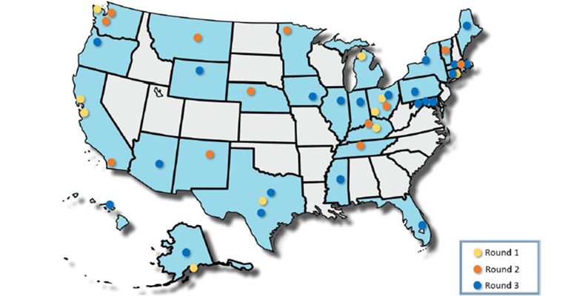
HUD’s Youth Homelessness Demonstration Program (YHDP) Ayana Gonzalez & Ellen Fitzpatrick – Technical Assistance Collaborative, Inc.
Over $150 million in awards, 44 communities
Engagement in a coordinated community planning process to develop strategies that meet the needs of YYA in each respective community
Authentic youth collaboration and leading with youth voice are essential elements
Notes:
Talking points:
With the launch of Opening Doors: Federal Strategic Plan to Prevent and End Homelessness in 2010, the Federal Administration established goals to prevent and end homelessness, including ending youth homelessness by 2020. Obviously we have reached that date and there is much to be done, but this has sparked momentum across the country and many communities have made incredible progress.
The Youth Homelessness Demonstration Program (YHDP) is a HUD-funded initiative designed to reduce the number of young people experiencing homelessness.
Understanding that youth homelessness is unique because young people are still developing, and therefore the response to youth homelessness must be unique to meet those needs, YHDP creates a framework for communities to do very intentional planning around establishing a system that responds effectively and efficiently to the young people in their communities.
44 communities funded to date, over $150 million awarded to fund youth serving projects. Communities are asked to engage in a collaborative, cross-system planning process to develop a coordinated community plan to end youth homelessness. This process incorporates each community’s Youth Action Board, as HUD understands that young people often have the best solutions to the challenges they face and meaningful participation and leadership from young people with lived experience is an essential element.

Slide 44
Projected Impact of Round 1 & 2 Projects Ayana Gonzalez & Ellen Fitzpatrick – Technical Assistance Collaborative, Inc.
6,500 total youth and young adults (YYA) projected to receive services and housing assistance across both the round 1 and 2 demo periods
1,110 YYA projected to be diverted from the homeless response system and reconnected with their support network
Over 2,000 new crisis beds, safe and stable units, or vouchers created to house YYA
2,700 YYA projected to be placed in permanent housing through Rapid Rehousing or Permanent Supportive Housing programs
Notes:
While we do not yet have aggregate data on the impact and outcomes from Rounds 1 and 2 of YHDP, we do have a sense of the project impact based on the YHDP-funded project applications that were approved during these rounds. Read slide data.
Feel free to jazz this up visually of course – I realize it is sort of a boring slide!

Slide 45
Coordinated, Community Planning Process Overview Lisa Goldsmith – Youth Homeless Services Manager, Three County Continuum of Care
Background
8 Month Planning Process, Technical Assistance
Engaged a range of stakeholders
Vision/Guiding Principles/Governance Structure/Continuous Quality Improvement
Youth/Young Adult Action Board
Franklin County envisions
a community where all young people have equitable access to safe, quality, stable housing and the supports and opportunities they need to thrive.
Notes:
Thank you Ellen and Ayana for providing some context for us regarding YHDP.
To bring the discussion of YHDP to a more local level, in 2019, the CoC through Community Action submitted an application to HUD to have Franklin County designated a YHDP community and, as many of you learned at the last annual meeting, we received the designation about a year ago.
Since then, with support from a number of technical assistance providers, such as TAC, we have engaged a range of stakeholders, including young people, the Dept. of Children and Families, juvenile justice, education, family services, domestic violence and homeless providers and many others to create our coordinated, community plan to prevent and end youth/young adult homelessness.
Our plan included a number of HUD requirements, such as the creation of a Vision Statement, which you can see on the slide, guiding principles, and a governance structure; all of which framed our work. It also included a plan for continuous quality improvement. We will be looking at data to determine how well we are following our plan and making changes as needed.
Central to all of this has been our Youth/Young Adult Action Board. This is a group composed of young people with lived experience of homelessness, who were an integral part of our planning process and taught us, and continue to teach us, about the real experiences of young people in our community and how to genuinely include people with lived experience in our work. We are incredibly grateful to have had their voices included and for their continuing involvement as we implement our plan.

Slide 46
Coordinated, Community Planning Process Implementation Lisa Goldsmith – Youth Homeless Services Manager, Three County Continuum of Care
Goals, Objectives and Action Steps
Identification
Prevention
Coordinated Entry and Crisis Response
Stable Housing
Sustainability
Committees/Work Groups
Youth/Young Adult Homelessness Committee (Next Meeting 10/22)
Notes:
With HUD approval of our plan, we were awarded $1.9 million for projects to address the needs in our community and to create a system to better support young people experiencing or at-risk of homelessness.
Keleigh will discuss the specifics related to the projects in a moment, but the other outcome of the planning process was the creation of our Goals, Objectives and Action Steps, which will be the focus of our plan implementation process.
Before I describe these, I need to say that although our plan is focused on Franklin County, all of this this will affect the entire Continuum of Care because we will be making broader systems changes and have projects that will have ripple effects throughout the Continuum.
So, we structured our plan around 5 main areas and goals, all of which have additional objectives and action steps.
Here are our goals:
Identification-The Franklin County community has a coordinated system to identify all YYA who are experiencing or at risk of homelessness.
Prevention-The Franklin County community implements a collaborative system of prevention and diversion strategies to support YYA who are at risk of experiencing homelessness.
Coordinated Entry and Crisis Response-All YYA experiencing or at risk of homelessness in Franklin County have access to a “no wrong door” Coordinated Entry (CE) system that provides: appropriate assessment, immediate crisis response, individualized support, and safe housing options.
Stable Housing-The Franklin County community connects YYA who are at risk or experiencing homelessness to accessible supports and low-barrier, stable housing opportunities.
Sustainability-The Franklin County community develops sustainable partnerships, plans, resources, and system capacity to ensure that the community’s shared vision can be achieved and maintained.
We will be engaging all of the CoC committees and work groups in the work of implementing the plan, but we have established the CoC Youth/Young Adult Homelessness Committee to oversee the implementation process. If you are interested in this Committee, please feel free to reach out to me and our next meeting is on October 22nd.
I will now pass this to Keleigh to talk more about the projects.

Slide 47
CoC YHDP Funded Projects Keleigh Pereira - Program Director, Three County Continuum of Care
Funding Process
Over 1.9 Million available for Housing & Supportive Services in Franklin County
Request for Proposals Released in March
Applicants Approved for 2 - year Projects through Selection Team
Projects Awarded
DIAL/SELF Youth and Community Services
Medium-term Rapid Rehousing – 4 units
Mental Health Association
Housing Navigators and short to medium term Rapid Rehousing Dollars – 6 units
Permanent Supportive Housing Project – 8 units
Gándara Center
Joint short-term Transitional Housing
and medium-term Rapid Rehousing – 18 units
Notes:
^{Funding Process}
Along with the YHDP Designation, Franklin County was awarded Over 1.9 Million available for Housing & Supportive Services for Youth and Young Adults in Franklin County
We released a Request for Proposals in March of this year, just before COVID hit and thankfully had developed important relationships with area agencies that demonstrated interest in joining this effort during the planning process.
We utilized a selection team including youth and young adults from our Youth action board, local housing experts, and youth serving agencies to approve projects for a two year period.
^{Projects Awarded}
Dialself Youth and Community Services was awarded small medium term RRH project of 4 units to add to their already extensive portfolio of housing programs and services for this population. They are currently Franklin County’s leading YYA housing partner and already a subrecipient of this CoC.
Mental Health Association who has experience with the Hampden County COC, joins our team of providers serving youth and young adults with a program involving Housing Navigators that will work to bridge gaps for YYA entering the Coordinated Entry system, and short to medium term Rapid Rehousing Dollars – 6 units and a second project that offers Permanent Supportive Housing Project specifically for youth with disabilities – 8 units.
Gandara Center adds their expertise in YYA services in western Mass, including as an already subrecipient to the Hampden Cty CoC to Franklin County and the Three County CoC with a joint component program serving both young families and individuals that includes both Joint short-term Transitional Housing and medium-term Rapid Rehousing – totalling 18 units of choice for housing opportunities.
We couldn’t be more thrilled with what this means for increased services for our homeless young people and as you can see is a full continuum of differing housing types for this vulnerable population. What is even more exciting is that these projects can serve youth that present in the three county area (which includes the Berkshire area and Hampshire County) with a demonstrated connection to Franklin County.
Community Action and the three County Continuum were also awarded additional funding to address the needs of increased coordinated entry for youth and young adults and for our housing management system of data collection and reporting. These project will begin right away in October and are looking for landlord to engage and in making homelessness rare, brief, and non-recurring for youth, to offer success for the future. Some of them are also looking to hire staff for these programs and there is a job fair coming up, this Friday, through Harmon Personell supporting these projects in finding appropriate candidates. If you are looking to learn more about these programs, please reach out to Lisa goldsmith or myself.

Slide 48
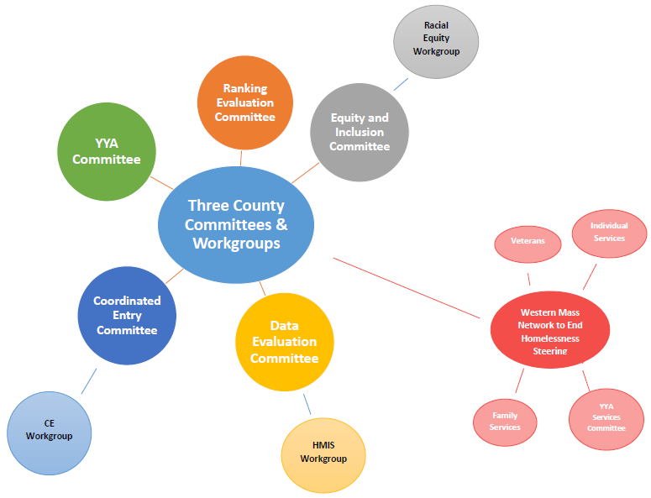
Three County Committees and Workgroups Brooke Murphy – Homeless Services and Billing Manager, Three County CoC
Notes:
Youth and Young Adult Services Committee

Slide 49
Three County CoC Committees Brooke Murphy – Homeless Services and Billing Manager, Three County CoC
Ranking and Evaluation Committee
Meets quarterly and then monthly during site monitoring on 4th Friday 9:00-10:30a
Contact: Keleigh Pereira kpereira@communityaction.us
Data Evaluation Committee
Meets every other month on the 1st Friday 9:00-10:30a
Contact: Michele LaFleur mlafleur@communityaction.us
Equity and Inclusion Committee
Meets monthly on the 3rd Friday from 9:00-10:30a
Contact: Brooke Murphy bmurphy@communityaction.us
Coordinated Entry Committee
Meets quarterly on the 2nd Tuesday from 3:00-4:30p
Contact: Brooke Murphy bmurphy@communityaction.us
Youth and Young Adult Homelessness Committee
Meets quarterly on the 2nd Thursday from 4:00-5:30p
Contact: Lisa Goldsmith lgoldsmith@communityaction.us

Slide 50
Three County CoC Workgroups Keleigh Pereira - Program Director, Three County Continuum of Care
HMIS Workgroup – Derived from Data Evaluation Committee
Meets biweekly on Thursdays from 9:00-10:00a
Contact: Michele LaFleur mlafleur@communityaction.us
Racial Equity Workgroup – Derived from Equity and Inclusion Committee
Meets monthly – typically on a Monday afternoon
Contact: Keleigh Pereira kpereira@communityaction.us
Coordinated Entry Workgroup – Derived from Coordinated Entry Committee
Meets biweekly on Wednesday from 3:00-4:30p
Contact: Brooke Murphy bmurphy@communityaction.us

Slide 51
Committee Recruitment Goals 2020 Keleigh Pereira - Program Director, Three County Continuum of Care
Update committee list with active and interested members
Expand outreach and engage new members
Prioritize engaging and recruiting people with lived experiences of homelessness and accessing supportive services in Three Counties
Prioritize engaging, recruiting, and centering Black people and people of color
Identify needs around Goal 2
Outreach, compensation, meeting times, changing practices, etc.
Identifying co-chairs for each committee/workgroup

Slide 52
Closing & Upcoming Plans Theresa Nicholson- Director of Diversion, Shelter, and Housing, Center for Human Development
Collaborative Applicant, Board and Membership
YHDP project implementation
Strategic planning for implementation of the Coordinated Community Plan to End Youth Homelessness
Maintain or increase funding
Racial Equity
Development of Racial Equity Plan
Evaluation of the CoC projects, CoC lead, Board, and Membership in achieving goals of Racial Equity Action Plan
Diversification of CoC board, lead staff, and membership
Coordinated Entry
Equity in CoC housing placements and CE system
HMIS Lead
Procure new HMIS system for the Continuum of Care
Conduct a robust, collaborative, equitable, and true Point in time and Youth count
Improve Project Data quality and train partners on data entry, collection, privacy, and security
Notes:
Collaborative Applicant, Board and Membership
To successfully implement all YHDP projects in the fall of 2020 & and conduct continuous quality improvement for the two year demonstration period.
begin strategic planning for implementation of the Coordinated Community Plan to End Youth Homelessness
To maintain or increase funding
Racial Equity
to provide evaluation of the CoC projects, CoC lead, Board, and Membership in our community effort to creating equitable practices, to provide community trainings and strategy sessions for the development of the CoC’s Racial Equity Action Plan, and to provide Youth and Young Adult leadership in a commitment to anti-racist practices in the Three County area.
To support the CoC in further diversification of it’s board, lead staff, and membership.
Coordinated Entry
To address equity in our housing placements, further develop our tools for CE assessment tools, intake, prioritization, and increase access for special populations in our CE system. To create effective outreach and system mapping to engage all homeless persons in the system.
HMIS Lead
to identify and procure a new HMIS system for the Continuum of Care and the HMIS lead agency
To conduct a robust, collaborative, equitable, and true Point in time and Youth count in adherence to regulatory practices that will inform stakeholders and funders of annual numbers of persons presenting in sheltered and un-sheltered homelessness.
To better our Project Data quality and train partners on data entry, collection, privacy, and security

