Slide 1
Three County CoC Annual Meeting 2021
Thursday, September 23, 2021

Slide 2
Welcome and Meeting Agenda Brad Gordon, Executive Director of Berkshire Regional Housing Authority Three County Coc Board of Directors Co-chair
Membership Vote on Updated Governance & HMIS Charters; Board Directors Slate - Brad Gordon
A Year in Review
Pandemic’s Impact on the CoC – Keleigh Pereira, Three County CoC Director, Community Action Pioneer Valley
A Look at the Data – Michele Lafleur, Three County CoC Data and Evaluation Manager, Community Action Pioneer Valley
Accomplishments – Brooke Murphy, Three County CoC Housing Services and Billing Manager, Community Action Pioneer Valley
Lived Experience of Homelessness Panel, facilitated by Shaundell Diaz, Three County CoC Coordinated Entry Specialist, Community Action Pioneer Valley
Landlord Engagement Question and Answer – facilitated by Shaundell and Brooke
What’s Happening Now
Network Advocacy - Pamela Schwartz, Director of the Western Mass Network to End Homelessness
MHSA Initiatives - Calpurnyia Roberts, A Place to Live, Director, Massachusetts Housing and Shelter Alliance.
Racial Equity Work – Shaundell Diaz
Engaging the Voices of Lived Experience – Shaundell Diaz
Engaging Landlords and Housing People Experiencing Homelessness – Shaundell Diaz
Coordinated Entry Improvements – Brooke Murphy
New Homelessness and Management Information System – Michele LaFleur
Closing –Theresa Nicholson, Director of Homeless Services, CHD, co-chair Three County CoC Board of Directors

Slide 3
Board and Membership Votes Brad Gordon Keleigh Pereira Michele LaFleur
2021 Board Slate Membership Vote
CoC Governance Charter updates
HMIS Charter updates
Membership Charter Votes

Slide 4
Board Membership Update and Vote Brad Gordon
Board Members to be Voted On (Term Ending 2023)
Officers & Permanent Required Seats | Representative
Berkshire County Representative | Justine Dodds, City of Pittsfield
Hampshire County Representative | Earl Miller, Western Mass Recovery, DMH
Franklin County Representative | Diana Abath, Women’s Resource Center, GCC
Homeless Advocate | Andy Klatka, Eliot Homeless Services
McKinney Vento Education Liaison | Stacey Parsons, North Adams Public Schools School-Housing Partnership Coordinator MV
Western MA Regional Network to End Homelessness Representative (WMNEH) | Pamela Schwartz, WMNEH Consultant
ESG Representative(s) | Brad Gordon, Berkshire County Regional Housing Authority, and CoC Board Co-Chair

Slide 5
Board Membership Update and Vote Brad Gordon
Board Members to be Voted On (Term Ending 2023)
Project Representatives (PR) & Other | Representative
Veterans Services – Central Hampshire Veterans Services | Steve Conn Veterans Services – Central Hampshire Veteran’s Services
Dial Self Youth and Community Services | Philip Ringwood
Construct | Jane Ralph
Center for Human Development | Theresa Nicholson
Village Center – Hilltown CDC | Dave Christopolis

Slide 6
Governance Charter Updates & Membership Vote- Changes to CoC Mission Statement Brad Gordon
Suggested Mission:
The Three County Continuum of Care (CoC) MA-507 promotes and guides a community-wide vision, strategy, and commitment to efforts to prevent and end homelessness; mobilizes funding; improves coordination and integration of mainstream resources and programs targeted to people experiencing homelessness through a housing first model; and establishes system-wide data collection and performance measurement practices to ensure successful housing strategies and equitable housing for vulnerable populations.
The CoC strives to engage funded projects in processes and procedures that are anti-racist, free of bias, and advances the priorities of those most impacted by homelessness. The CoC geography includes Franklin, Hampshire, and Berkshire counties in western Massachusetts.

Slide 7
Governance Charter Updates & Membership Vote -Addition of Diverse Representation Keleigh Pereira, Brad Gordon
Commitment to Diversifying CoC Membership- Board and Committees
The Three County CoC is committed to a Membership that reflects the diversity of populations served by the CoC, including diversity in race, ethnicity, gender identify, sexuality, disability, geography, housing status, languages spoken, and lived experience of homelessness. The CoC shall conduct periodic surveys to evaluate diversity of current membership to identify diversity needs.
Notes:
The board and committees of the CoC were surveyed recently and of the responders, 23% identified as GLBTQ, 27% had lived experience of homelessness, 7% were black or African American and just over 9%, Hispanic, Latino or Latinex. The population we serve has a much higher percentage of racial diversity and we want to be sure we are increasing the number of voices at our tables and the board has chosen to support a written commitment to this in our Charter.

Slide 8
Governance Charter Updates & Membership Vote – Equity & Inclusion Committee - Keleigh Pereira, Brad Gordon
Review CoC reports that present data on disparities, (primarily the Annual Racial Disparities report) and make recommendations to the Board and Collaborative Applicant based on findings.
Support the CoC in conducting surveys and evaluations, about racial equity in our practices. For example, create surveys to Identify barriers to professional advancement.
Evaluate CoC policies and procedures to ensure that we provide equitable, and trauma-informed practices, in our housing work and make recommendations of policy change based on findings. For example, changing Coordinated Entry prioritization to address equity in housing referrals.
Monitor language and distribution of CoC communications to remove barriers to inclusivity. For example, reviewing, and revising job descriptions with a racial equity lens.
Set expectations for and evaluate how the CoC is supporting inclusion of people from underrepresented groups in the workforce including, varying races, ethnicity, gender, class, disability, economic level, and sexual orientation. For example, rate all hiring managers on recruitment, retention and promotion of underrepresented staff.
Monitor and support the implementation of an anti-discrimination policy, which ensures equal access to housing for protected classes in HUD programs.
Support matters of equal access and cultural sensitivity of our programs and practices for various populations, including accessibility for hearing impaired and other languages.
Collaborate with other CoC committees around CE-related goals and action steps, including the Youth and Young Adult Committee, CE Committee, and Data Evaluation Committee
Create and/or provide ongoing training, such as, Leadership training for BIPOC staff, Unconscious Bias and Racism training, cultural humility and professional development opportunities. For example, to create career paths within and across all agencies, and promote pay equity.

Slide 9
HMIS Charter Updates & Membership Vote Michele LaFleur, Brad Gordon
Reflection of our move from Social Solutions ETO to Bitfocus' Clarity HMIS.
Identifying new features available to us.
Remove mentions of the "Data Security plan" and changing the "Privacy Plan" to be the "Privacy & Security Plan"
Changed "Data Warehouse Integration" section to "Data Integration"
Altering language to reflect the new process of uploading data to Clarity instead of the Green River Data Warehouse.
Commitment to Equity section added to reflect the CoC's commitment to promote equity within all our work and includes specific actions the HMIS Lead will assist with/take.
Notes:
Changes made were most often a reflection of our move from Social Solutions ETO to Bitfocus' Clarity HMIS which will begin in December of this year. In some cases, just changing the language and in others identifying new features available to us. Other changes include removing mentions of the "Data Security plan" and changing the "Privacy Plan" to be the "Privacy & Security Plan" as well as changing the "Data Warehouse Integration" section to be the "Data Integration" section and altering the language to reflect the new process of uploading data to Clarity instead of the Green River Data Warehouse. Finally, a commitment to Equity section has been added to reflect the CoC's commitment to promote equity within all our work and includes specific actions the HMIS Lead will assist with.

Slide 10
A Year in Review Pandemic’s Impact on the CoC – Keleigh Pereira A Look at the Data – Michele LaFleur Accomplishments - Brooke Murphy

Slide 11
A Look at Data Michele LaFleur – Data & Evaluation Manager
Notes:
Here we have a chart looking at the number of people who entered permanent housing after leaving emergency shelters or transitional housing from 2017-2019 compared with the number who exited to permanent housing in 2019-2021 and we can see a dramatic increase from 272 people in the green bar to 549 people in the blue bar. There were a lot more people who exited shelters in general between 2019 and 2021 so in terms of the percentage of people who exited to permanent housing it was an increase from 27.84% to 30.81%. This significant increase in the number of people being housed over the past two years is in large part thanks to the work of ServiceNet, Craigs Doors, Louison House, Eliot Human Services, and many youth veteran service providers working hard to secure housing for people experiencing homelessness as well as, of course, all of the providers providing housing or supportive services.
From 977 exits to 1782 total.

Slide 12
A Look at Data – Equity in Housing Outcomes Michele LaFleur – Data & Evaluation Manager
Notes:
In this chart we're looking at the same two time frames again but here we're looking at a racial and ethnic breakdown of, out of everyone in a particular population who exits shelter, what percentage of people are heading to permanent housing. Looking at this chart we can see that there have been improvemenets in some areas but there's still a lot of work to do. The percentage of black or african american individuals who exit to perment housing has gone down a little bit while the percentage of Non-Latino white individuals and Latino/a/x individuals of any race is increasing.

Slide 13
A Look at Data – Equity in Housing Outcomes Michele LaFleur – Data & Evaluation Manager
Notes:
This next chart shows how people of different races are spending different amounts of time in homelessness before they enter permanent housing and compares 2017 through 2019 in green with 2019 through 2021 in blue. Even though more people are entering housing as we saw earlier, they're spending longer amounts of time in homelessness before being housed than in previous years, likely due to a shortage of affordable and available housing.

Slide 14
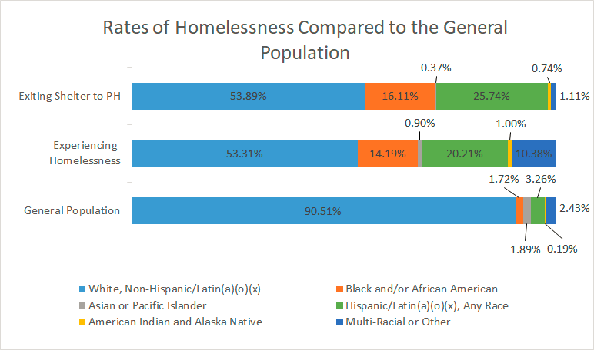
A Look at Data – Equity in Housing Outcomes Michele LaFleur – Data & Evaluation Manager
General Population data pulled from ACS, 2019 5-year estimates
Notes:
When we look at the racial breakdown of everyone in the Three County area compared with everyone in shelter or emergency housing (2019-2021) and everyone exiting shelter to permanent, we still see significant disparities in who is experiencing homelessness. White, non-Latina/o/x persons make up just over 90% of the general population but just about 53% of everyone experiencing homelessness although this number is fairly close to the percentage of white, non-latino/a/x individuals entering permanent housing. We can see significant overrepresentations of Black, Latino, American Indian and Alaskan Native, and Multi-racial individuals and families in the population experiencing homelessness compared to the general population but we also know there are societal reasons behind this. People of color historically and currently are subject to discriminatory lending and hiring practices, redlining, overincarceation, and other forms of institutional racism that also contribute to less generational wealth which all create additional barriers in finding and maintaining housing. We do see here that Black and Latino/a individuals and families make up a greater percentage of everyone exiting to permanent housing than everyone experiencing homelessness, which is a positive, but we also see that people who are multi-racial make up over 10% of the population experiencing homelessness and yet just over 1% of the population exiting homelessness to permanent housing.

Slide 15
A Look at Data – Requesting Local Data Michele LaFleur – Data & Evaluation Manager
Looking for more data?
Outcomes, rates of homelessness
By race, ethnicity, gender, age range, disabling condition
Federal reports and a request form for other local data can be found here:
https://www.threecountycoc.communityaction.us/local-data
Notes:
If you're interested in seeing more data or have questions on what was just presented, please visit our website or reach out to me directly and we'll do our best to find and send what you're looking for. Next I would like to invite Brooke Murphy, the Homeless Services and Billing Manager for the Three County CoC, to talk about some accomplishments over the past year.

Slide 16
Accomplishments Brooke Murphy
Housing Development Coordination
Racial Equity Action Planning
WMNEH – pulling together stakeholders
YHDP advancement
Housing placements
Emergency Housing Vouchers
Housing authority
partnerships
Landlord and Property Owner Engagement Initiative
Lived Experience initiatives
DV work with NASH
Coordinated Entry Assessment
Shelter support
Project-level accomplishments

Slide 17
Lived Experience of Homelessness Panel Shaundell Diaz
A Positive Place
Maritza
Miguel
Louison House
Amy
Dickilyn
Center for Human Development
Lisa
Liz
Notes:
Good afternoon folks, my name is Shaundell Diaz and I am the Coordinated Entry specialist with the COC. Today I feel very honored and prvledged to present to you 3 project representatives and 3 very strong woman who will be sharing their story of Lived experience of Homelessness. I myself have lived experience of homelessness, it has taken me 5 years to get back on my feet the road has not been easy, and I still have many challenges ahead of me, but I take pride in the fact tht I am in the position that I am now, and that I am actually able to influence, educate, and make changes on a systemic level.

Slide 18
Landlord Engagement Question and Answer Brooke Murphy Shaundell Diaz
Charles Swabey –Housing Provider in North Adams
Katie Meirnecki – HMR Properties Manager in Northampton
Kathy Wiggins – Property Manager, Berkshire County.
Notes:
Brooke will do intro
Brooke: Can you please introduce yourself and tell us a bit about you as a landlord – where, how long, how many buildings, anything else you’d like to share?
Shaundell: You are participating today on this panel because you rent to individuals and/or families who have formerly experienced homelessness. We want to hear about your experience as a landlord.
Struggles
Successes
Needs of tenants
Brooke: What has your experience been working with services providers?
Can you give some examples of positive experiences?
Has there been a time where you were working with a services provider and it didn’t work out?
How can providers build strong relationships with landlords?
Shaundell: Why have you chosen to rent to people experiencing homelessness?
Brooke: What would you to say to other landlords who are hesitant to rent to people receiving housing assistance or working with service providers?
Shaundell: What can the CoC do in our landlord engagement efforts to reach more landlords and bring more landlords into this work?

Slide 19
What’s Happening Now
A Walkthrough of New State and Federal Resources
Pamela Schwartz
Massachusetts Housing & Shelter Alliance Initiatives
Calpurnyia Roberts
Racial Equity Work
Shaundell Diaz
Engaging the Voices of Lived Experience
Shaundell Diaz
Engaging Landlords and Housing People Experiencing Homelessness
Shaundell Diaz
Coordinated Entry Improvements
Brooke Murphy
New Homelessness and Management Information System
Michele LaFleur

Slide 20
Network to End Homelessness - Advocacy Agenda Pamela Schwartz
COVID-19 Housing Equity Bill H.1434/S.891
Close to 3,000 eviction filings in Western MA alone since the lifting of the state eviction moratorium in October, 2020 (20,000 statewide).
Right to Counsel in Evictions H.1436/S.874
Over 98% of tenants facing evictions are unrepresented while 81% of landlords have a lawyer.
The HOMES Act H.1808/S.921
The Act Promoting Housing Opportunity and Mobility Through Eviction Sealing (HOMES) will protect tenants from being unfairly branded with an eviction record if they don’t have a judgment against them, if they weren’t actually evicted or if they didn’t do anything wrong
Notes:
COVID-19 Housing Equity Bill
H.1434/S.891
Close to 3,000 eviction filings in Western MA alone since the lifting of the state eviction moratorium in October, 2020 (20,000 statewide). This bill will:
take evictions for non-payment of rent for COVID-19 reasons out of the courts and allow for the required time to obtain rental assistance
protect the most vulnerable tenants from forced removal for COVID-19 non-payment
pause no-fault evictions during the COVID-19 recovery period
pause residential foreclosures and require mortgage forbearance based on federal policies
Right to Counsel in Evictions
H.1436/S.874
Over 98% of tenants facing evictions are unrepresented while 81% of landlords have a lawyer.
Right to Counsel is a part of a comprehensive approach to level the playing field, prevent displacement, and provide housing stability for very vulnerable people in our communities.
The HOMES Act
H.1808/S.921
The Act Promoting Housing Opportunity and Mobility Through Eviction Sealing (HOMES) will protect tenants from being unfairly branded with an eviction record if they don’t have a judgment against them, if they weren’t actually evicted or if they didn’t do anything wrong. This bill will:
Seal all eviction cases as soon as they are filed and while pending, until and unless an allegation is proven.
Seal no-fault evictions and other types of housing cases, such as when tenants are seeking to get repairs made.
Make non-payment and fault eviction cases publicly available when there is a judgment against the tenant on the merits, or there is an agreement for judgment and the tenant has actually been evicted.
Seal all eviction records after 3 years and provide a process to seal records for good cause before the 3-year point.

Slide 21
Network to End Homelessness – Advocacy Agenda Pamela Schwartz
Tenant Opportunity to Purchase Act (TOPA) H.1426/S.890
(Western MA lead sponsor Senator Jo Comerford)
Transfer Fee Legislation H.1377/S.868
Authorizes a transfer fee of between .5% and 2% on real estate transactions above either the statewide median sale price for single family homes (currently $529,000) or the county median sale price for single family homes if a locality’s median is lower than the statewide median.
Addressing the Cliff Effect H.208/S.119
(Western MA lead sponsors: Representative Patricia Duffy and Senator Eric Lesser)
This bill would create a three-year Western Massachusetts pilot program for 100 working families or individuals earning low incomes who receive any form of public assistance. It offsets the disproportionate impact that the Cliff Effect has on families transitioning out of public assistance, allowing participants to transition off of benefits without facing an income cliff.
Notes:
Tenant Opportunity to Purchase Act (TOPA)
H.1426/S.890
(Western MA lead sponsor Senator Jo Comerford)
TOPA would allow municipalities the option of providing tenants in multi-family buildings the right to match a third-party offer when their homes are being sold.
Tenants could designate their rights to a non-profit or local housing authority, or partner with an affordable housing purchaser.
TOPA does not regulate sales price and explicitly exempts small owners.
Transfer Fee Legislation
H.1377/S.868
Authorizes a transfer fee of between .5% and 2% on real estate transactions above either the statewide median sale price for single family homes (currently $529,000) or the county median sale price for single family homes if a locality’s median is lower than the statewide median.
A local option real estate transfer fee is an effective, efficient and equitable tool for raising necessary revenue for affordable housing in communities across the Commonwealth.
Addressing the Cliff Effect
H.208/S.119
(Western MA lead sponsors: Representative Patricia Duffy and Senator Eric Lesser)
This bill would create a three-year Western Massachusetts pilot program for 100 working families or individuals earning low incomes who receive any form of public assistance. It offsets the disproportionate impact that the Cliff Effect has on families transitioning out of public assistance, allowing participants to transition off of benefits without facing an income cliff.

Slide 22
Massachusetts Housing and Shelter Alliance Initiatives Calpurnyia Roberts

Slide 23
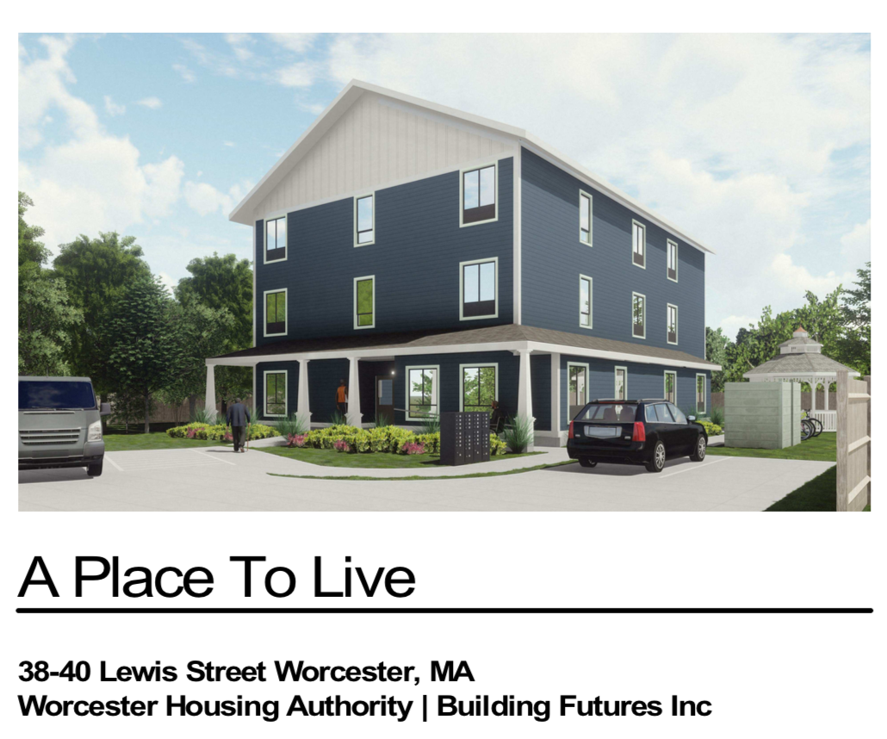

Slide 24
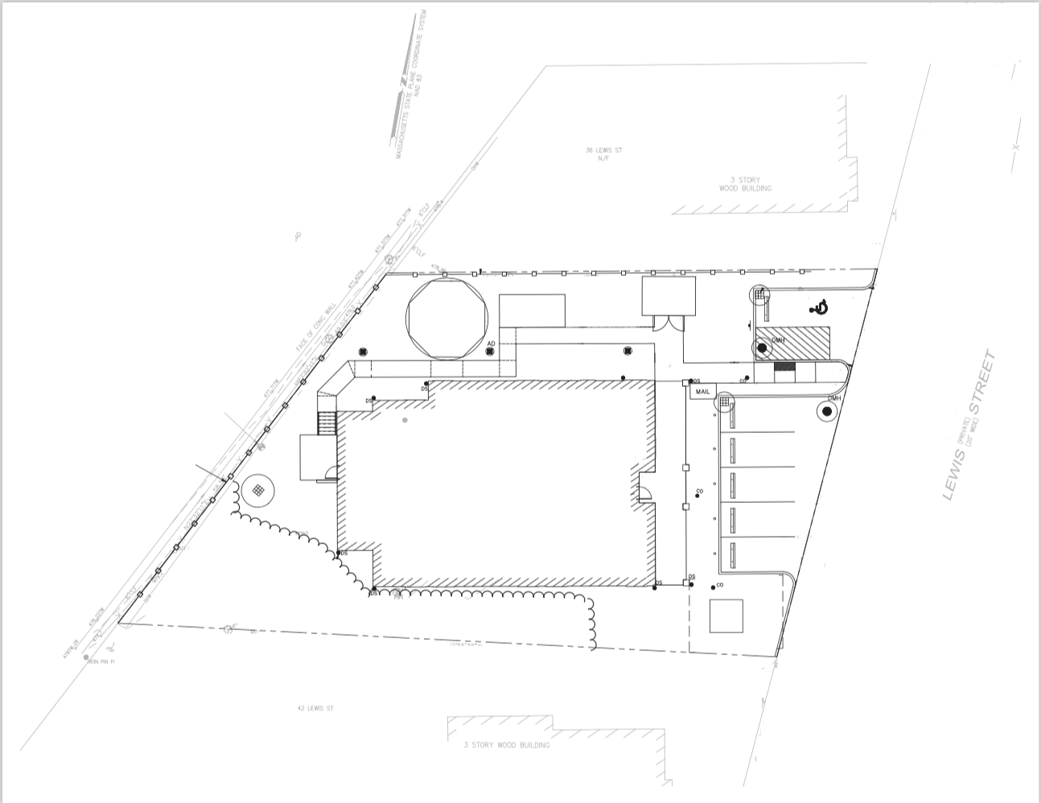

Slide 25
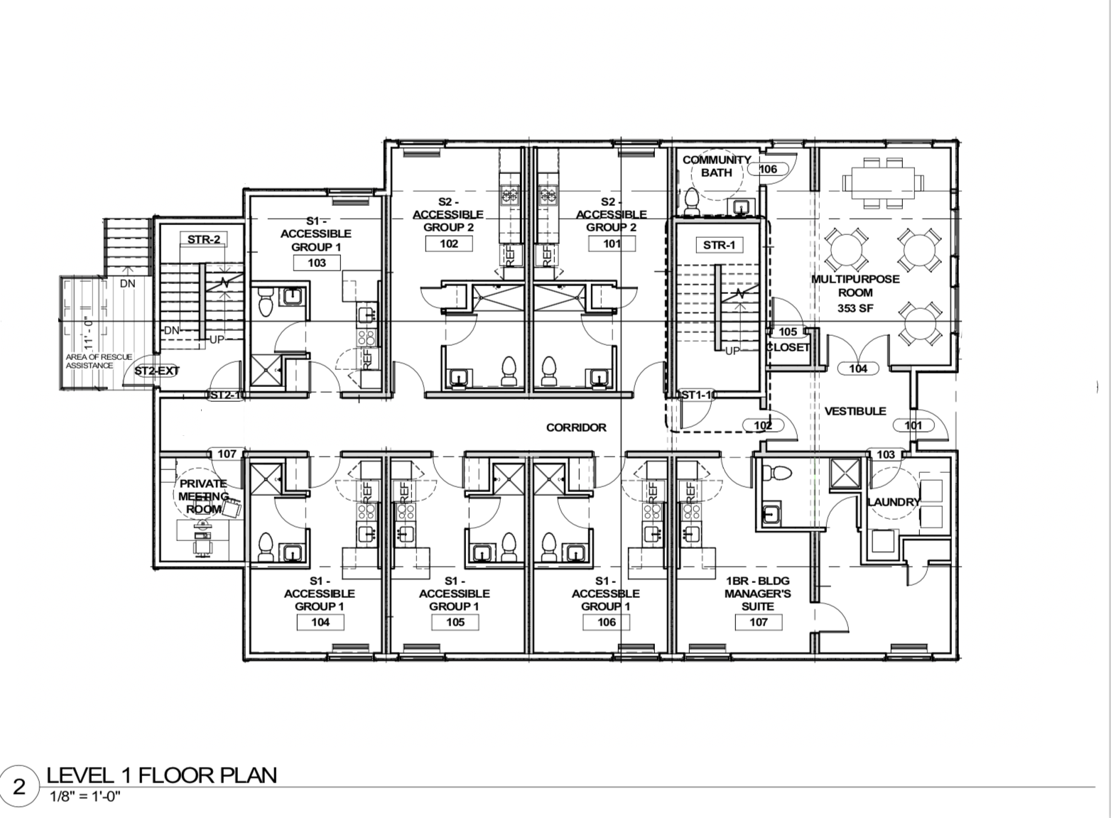

Slide 27
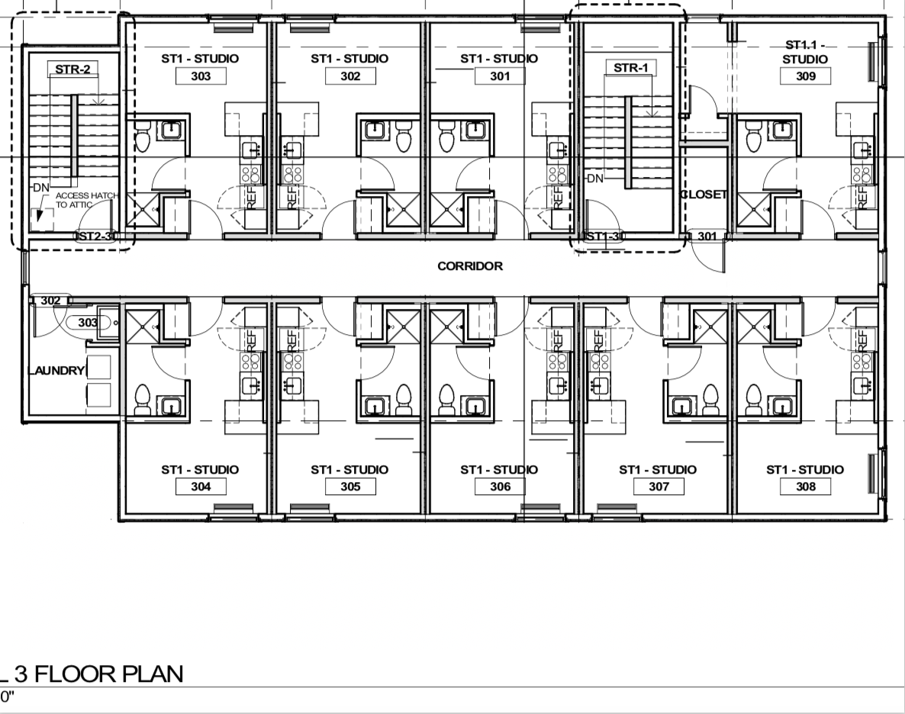

Slide 28
Racial Equity Work Shaundell Diaz
Three County Racial Equity Action Plan
Priority 1: Coordinated Entry
Goal: Redesign the coordinated entry, assessment, and prioritization system to center racial equity.
Priority 2: Data
Goal: Ensure that the CoC’s homeless population reflects the racial, ethnic, and linguistic diversity of the populations we serve without disparities in performance measures.
Priority 3: Organizational Training and Development
Goal: Increase Organizational efforts towards anti-racism work and Support the hiring, retention, and leadership development of a diverse and inclusive workforce in CoC-funded organizations and partners.
Priority 4: Housing Continuum
Goal: Increase shelter capacity and availability of low-barrier housing accessibility for people of color experiencing homelessness.
Priority 5: Lived Experience
Goal: Bring people with lived experience of homelessness into decision-making roles
Priority 6: Legislative Policy
Goal: Influence local and state policy and funding to support communities of color to prevent and end homelessness.
Notes:
Centering racial equity in our homelessness response is more urgent than ever. We have spent more than a year working with consultants to analyze our data to determine how the local homelessness response is centering the needs of POC,
we have provided trainings for the community, held strategy sessions with our projects and our coordinated entry partner agencies to consider our goals, and based on that, to develop a long term plan for disrupting racism in our CoC’s system of care.
Through the strategies outlined in this plan, we will work together to center racial equity in everything we do to prevent and end homelessness in Franklin, Hampshire, and Berkshire Counties. The main priorities are on Coordinated Entry, Data, Organizational Training and Development, Housing Continuum, Lived Experience, and Legislative Policy, as listed here on the screen. And we need more people at the table!

Slide 29
Racial Equity Plan: "What we are working on now"
Coordinated Entry
Finalizing and Piloting New Assessment Tool
Data
Racial Disparities Report and Advocacy
Organizational Training and Development
Trainings, Charters and Surveys
Housing Continuum
Increasing COC Board/Committee Participation/Setting Goals in Charter
Lived Experience
Recruitment/Building Community Partnerships
Legislative Policy
COVID-19 Housing Equity Bill, Right to Counsel in Evictions, etc.
Notes:
Here are just some of the Racial Equity Focal Points as outlined in the previous slide, that the COC is working on now:
Coordinated Entry; Finalizing and piloting the new assessment tool; including racial disparities tracking; identifying new data to collect; measurable outcomes planning; intake and procedures planning; language access planning; identifying accessibility needs; Coordinated Entry Continuous Quality Improvement and Evaluation planning
Data; Examining CE racial disparities report to identify highest acuity disparity| CE work group is tasked with identifying strategies to reduce high acuity disparity| Stratifying performance measures in annual racial disparities report by REaL across all household types and project types to identify racial disparities which basically means that we'll look at performance measures (exits to housing, increases in income, etc) by race, ethnicity, and primary language to see if there are racial or ethnic disparities within different project types or household types (individuals and families, essentially)|and advocating for increased warming spaces in underserved locations
Organizational Training and Development: DV/trafficking training through CoC; update CoC charter re: demographic goals; and survey board and committees
Housing Continuum: Increase participation in the CoCs Board/Committees/setting goals in charter; increasing landlord engagement efforts; Through-out the month of July the COC in Partnership with Community Legal Aid provided a CORI sealing training for partners/ in August CLA also provided a COC wide Educational Session that was focused on how they provide legal assistance with a broad range of legal issues including family law matters for survivors of domestic violence, housing (eviction and housing discrimination), public benefits, elder law, employment law, education law, veterans legal issues, immigration (in the subsidiary, Central West Justice Center), and criminal records and reentry legal issues.
Lived Experience: Recruitment in progress w/sharing of Flyer; Communication and partnerships are under way, and the creation of a Lived Experience Advisory Group facilitated by partners with Lived Experience.
Legislative Policy: COVID-19 Housing Equity Bill, Right to Counsel in Evictions, which Pamela Scwartz from the Western Mass Network to End Homelessness spoke about earlier.

Slide 30
Engaging Voices of Lived Experience Shaundell Diaz
NOTHING ABOUT US, WITHOUT US
Paid Expertise
Value experience
Value of time
Marketing and Outreach
Equity and Inclusion Committee is working on finalizing a Lived Experience Flyer
Committee is developing engagement strategies
Notes:
Shaundell: The Three County CoC is dedicated to advancing the voices of people with lived experience of homelessness in its work and its impact. These voices are often absent at decision-making tables, and, along with partner coalitions, the CoC is committed to the policy-making principle of “nothing about us without us.” This policy intends to recognize the expertise, value, and time of the people who receive them, and to ensure that people who can provide this perspective are present when needed. We have and will continue to identify funding resources to support the inclusion of diverse perspectives in the CoC’s work. Flyer: to share among our partners participants, and the community, to bring folks with Lived Experience to participate in our various committees. And we are specifically working to engage people with lived experience in the work of the CoC, including some current board of directors openings and a liaison for landlord engagement activities, so please be in touch with me if you know anyone that might be a great fit, or connect to any of our staff.

Slide 31
Engaging Landlords and Housing People Experiencing Homelessness Shaundell Diaz
The CoC and our housing programs are committed to the mission of preventing and ending homelessness by:
Building and maintaining strong, mutually-beneficial partnerships with local landlords and owners.
Providing assurance of rent payments and tenancy supports
Ensuring case management and mediation services
Providing landlord financial incentives
Creating relationships with local landlords
Notes:
The COC and our housing programs are committed to the mission of preventing and ending homelessness by building and maintaining strong, mutually-beneficial partnerships with local landlords and owners. Providing a level of assurance to landlords regarding rent payments, tenancy supports and case management and mediation services that seeks to ensure leases and property expectations are maintained. The COC along with partner agencies convene bi-weekly to strategize the work around LL Engagement. With the help of the Landlord Engagement workgroup and the Equity and Inclusion Committee together we created a LL flyer to share in the community, and a LL Survey to gage local landlords.

Slide 32
Coordinated Entry Improvements Brooke Murphy
Coordinated Entry Assessment tool
Redesign with racial equity lens
Coordination with DV providers
Adjusting CE for survivors
Emergency Housing Vouchers
Increased housing stock
Underrepresented populations in data
New outreach initiatives
DCF, healthcare, and Correctional facliities re: discharge planning
Case Conferencing
Youth and Young Adults and Veterans
Increased participation from new and existing partners

Slide 33
New Homelessness Information Management System Michele Lafleur
Community Action Pioneer Valley has contracted with Bitfocus, Inc. to provide their Clarity Human Services HMIS.
Our new system is called the CAPV Clarity HMIS
Will be starting to use this system beginning on December 9th, 2021
CAPV will be doing all the system administration for this system
All CoC and ESG funded projects will join as well as individual shelters and non-HUD funded programs designed to support those experiencing homelessness
Massachusetts Emergency Assistance Family Shelters and HomeBASE programs will remain in the HMIS administered by DHCD
A series of trainings and community conversations will be held beginning in October and continue through early next year
Notes:
The Three County CoC has been using a data collection and reporting system, called an HMIS or homeless management information system, provided by the Massachusetts department of Housing and Community development (DHCD) for years and we're currently in the process of setting up a new HMIS which is going to be administered by Community Action Pioneer Valley. We've mentioned this a little bit earlier in the meeting but just wanted to provide a little bit more information about what's happening. Our new system is the Community Action Pioneer Valley Clarity HMIS and the world Clarity is in the name because that's the name given to the HMIS product itself, developed by our new vendor Bitfocus, Inc. Our plan is to begin using this new system on December 9th of this year and it will include all CoC and ESG/Emergency Solutions Grant funded programs as well as non-HUD funded programs within the Three Counties designed to support those experiencing homelessness. We'll be holding a series of trainigs and community conversations this fall and winter around the new HMIS so HMIS users be on the lookout for a schedule to be coming soon. Please reach out to me with any questions on the new HMIS. Next I want to introduce Theresa Nicholson, Director of Homelessness Services at the Center for Human Development and a co-chair of the Three County CoC Board of Directors for some closing remarks.

Slide 34
Closing & Three County CoC Funding Competition Theresa Nicholson
The Three County CoC has released a Request for Proposals (RFP) for renewal, expansion, and new projects for housing and supportive services specifically to serve persons experiencing homelessness in Berkshire, Hampshire, and Franklin Counties. Project types allowable in this competition are:
Renewal Permanent Supportive Housing (PSH), Rapid Rehousing (RRH), and Joint Transitional Housing-Rapid-Rehousing (TH-RRH).
New project types are Permanent Supportive Housing (PSH), Rapid Rehousing (RRH), and
Rapid Rehousing (RHH) & Coordinated Entry (CE-SSO) to support victims of Domestic Violence.
Applications must be completed in esnaps by 5pm on October 15, 2021.
Visit our events page to learn more!
https://www.threecountycoc.communityaction.us/news-events

Slide 35
How to Get Involved in the CoC's Regional Efforts Theresa Nicholson
Join the Board of Directors, The CoC is actively recruiting for the following:
Persons with Lived Experience of Homelessness (financial compensation for meeting attendance is available)
Representative from the CAPV Youth Action Board (financial compensation for meeting attendance is available)
Representative from a Housing Authority in the Three County Area &
An Affordable Housing Advocate or Developer
Join one of our committees:
Equity and Inclusion Committee and the Racial Equity Workgroup: Each Meets monthly. The contact person for this committee is Shaundell Diaz, sdiaz@communityaction.us
Coordinated Entry Committee: Meets quarterly. The contact person for this committee is Brooke Murphy, bmurphy@communityaction.us
Data Evaluation Committee: Meets monthly. The contact person for this committee is Michele LaFleur, MLaFleur@communityaction.us
Ranking Evaluation Committee: Meets quarterly & more often during the Annual Funding competition. The contact person for this committee is Keleigh Pereira, kpereira@communityaction.us
Youth and Young Adult Homelessness Committee: Meets Monthly. If you are interested in participating in the work of the Youth Homelessness Demonstration Project, please contact Teri Coopman tkoopman@communityaction.us

