Slide 1
Mark Jachym Springfield CTC Gabe Quaglia Tapestry Health
Accessing
Substance Use Treatment

Slide 3
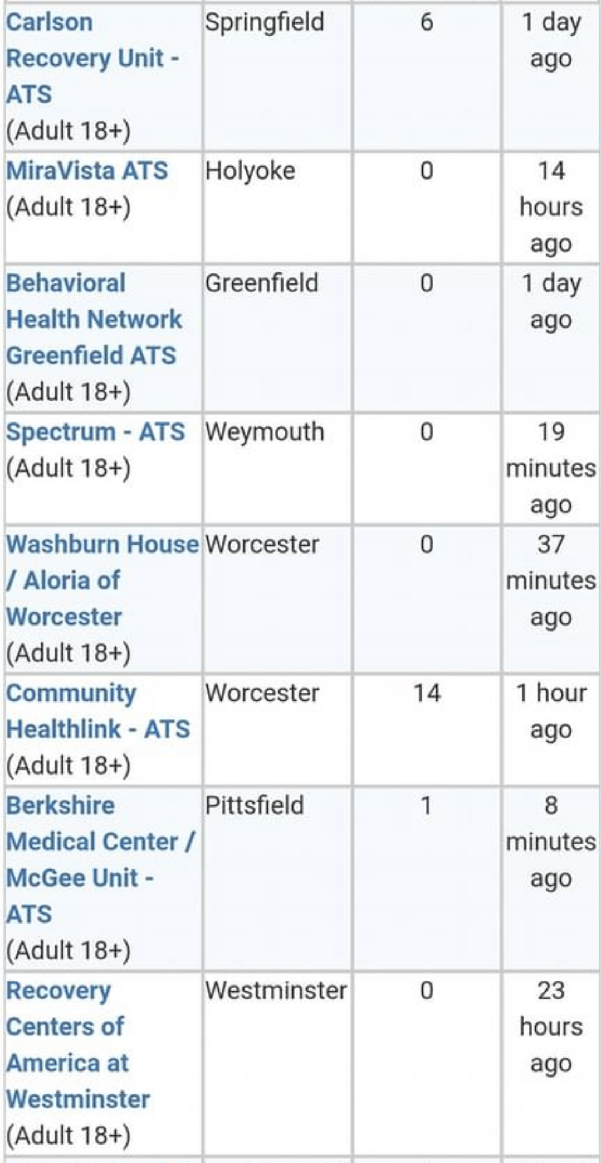
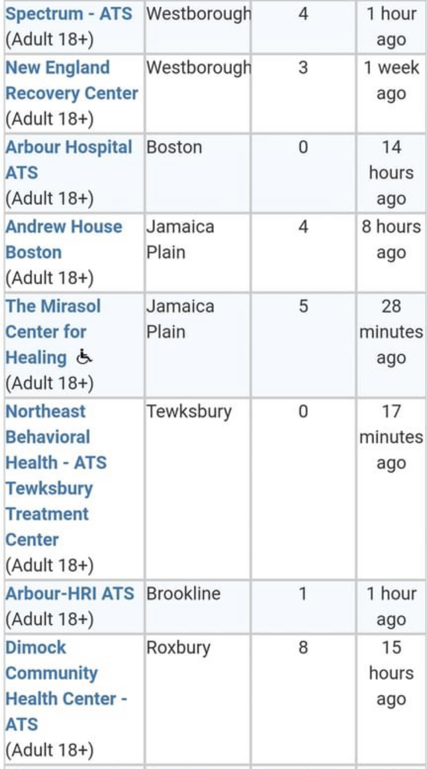
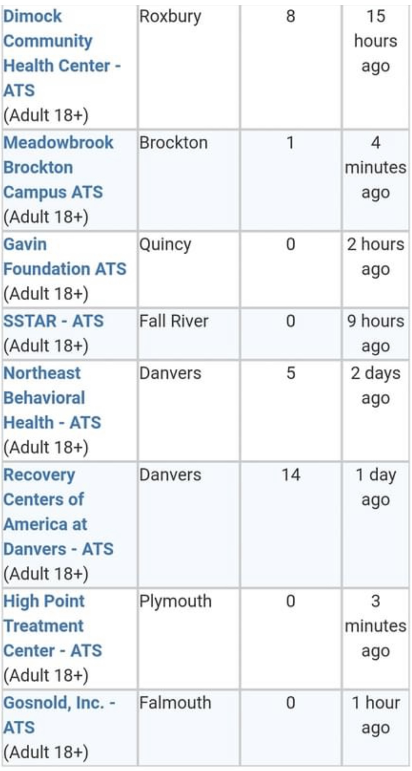

Slide 4
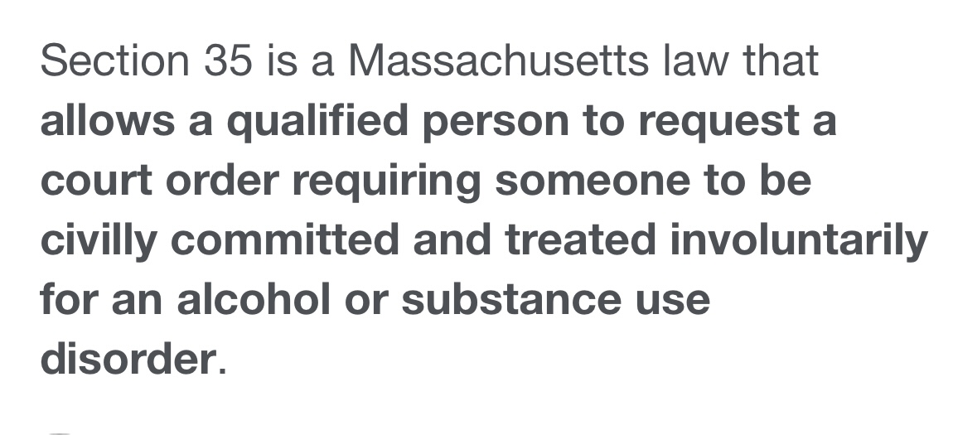
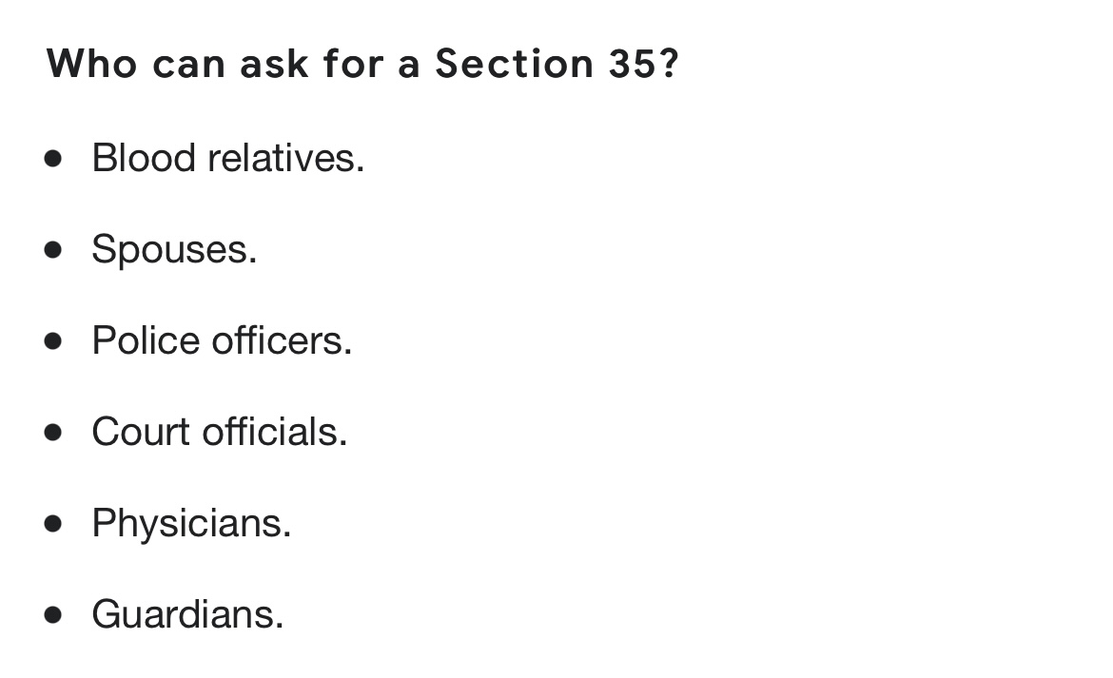
Involuntary Treatment

Slide 7
All Pregnant Women seeking substance use treatment have priority access to treatment in Massachusetts. If you need further assistance in accessing services for pregnant women, please call the Institute for Health and Recovery at 617-661-3991 or 866-705-2807 HIV+ status also have priority

Slide 8
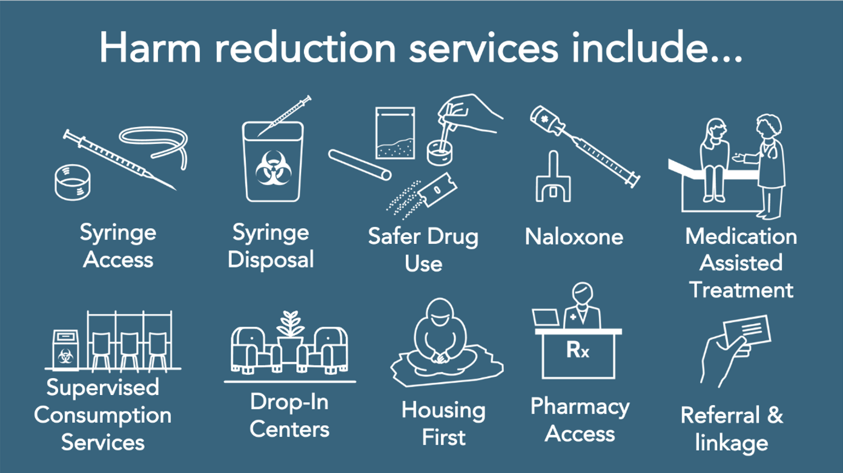
Harm Reduction

Slide 11
Not all sober housing is certified Call or check website before choosing a sober home

Slide 12
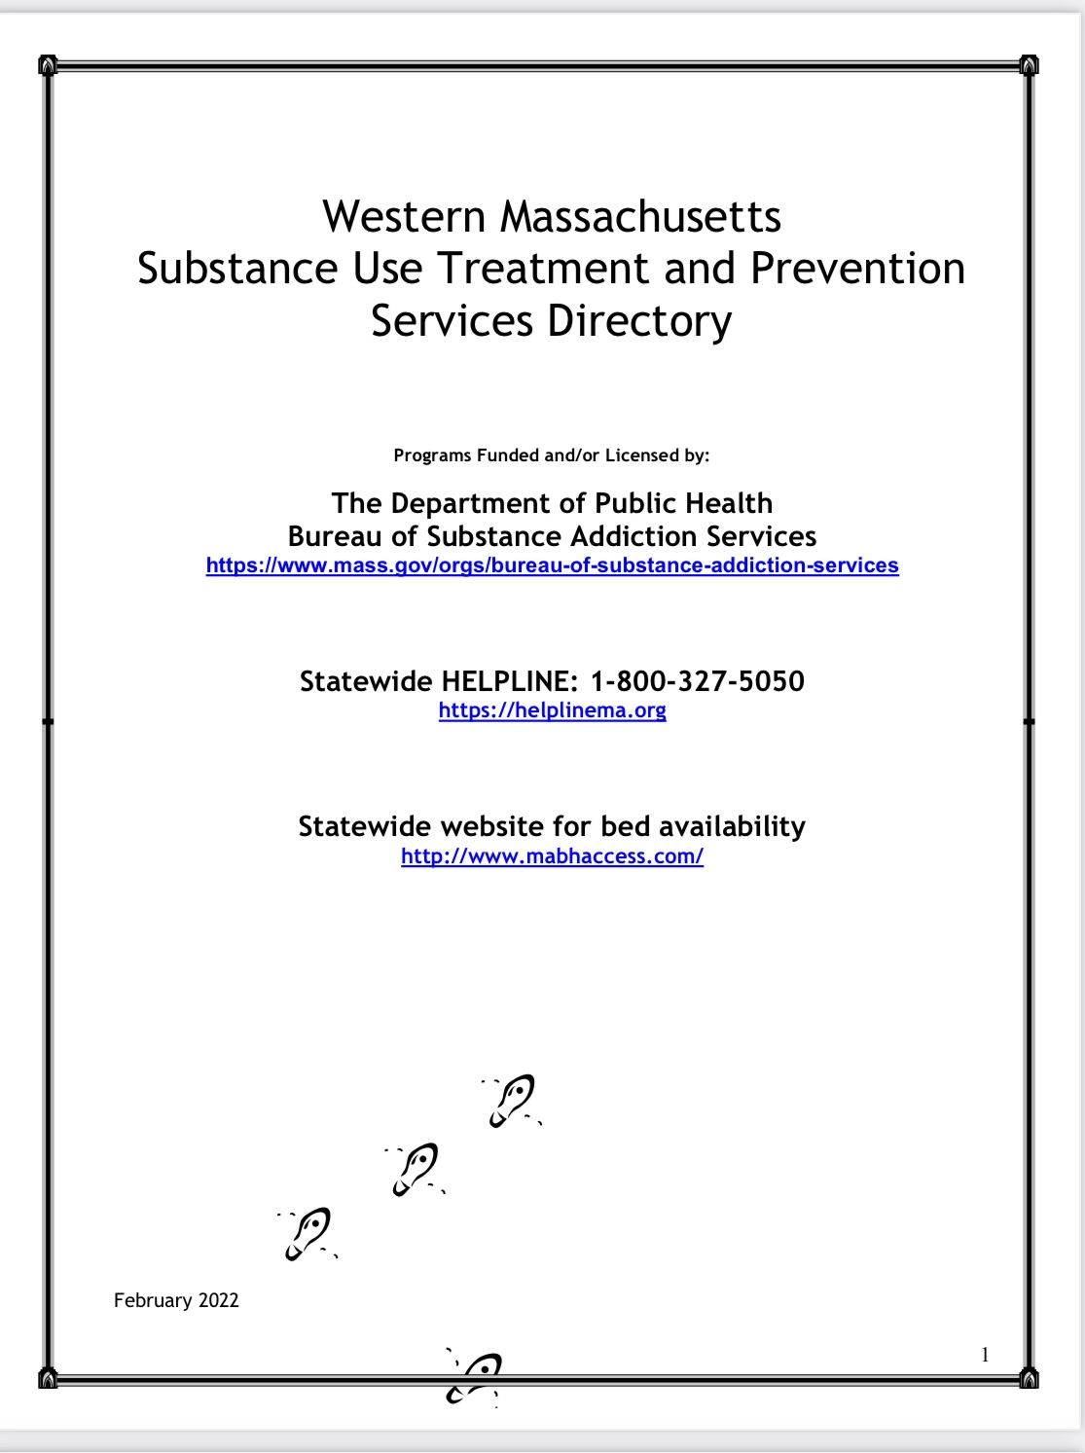
Updated packet will be uploaded in chat

Slide 13
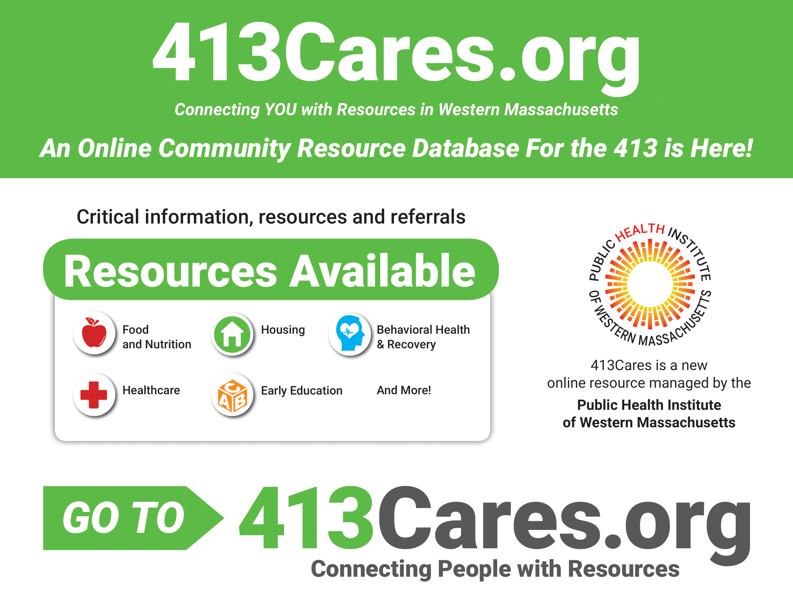

Slide 15
Recovery is different for everyone. No two pathways are identical. What may work for one person may not work for another.

