Slide 1
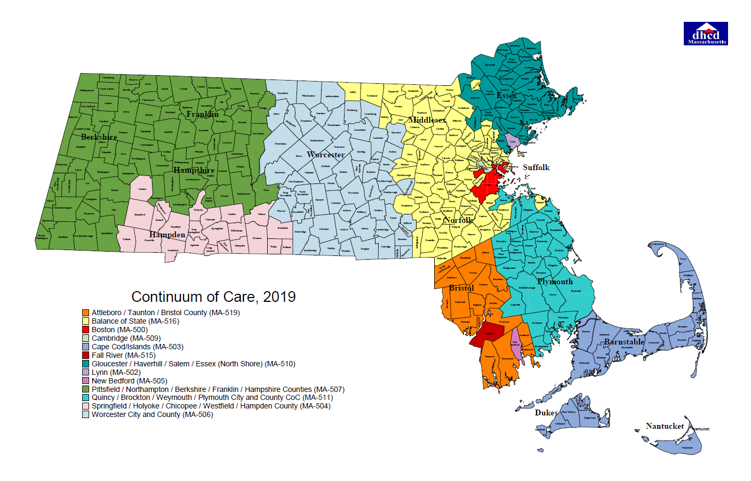
Three County Continuum of Care
Coordinated Entry

Slide 2
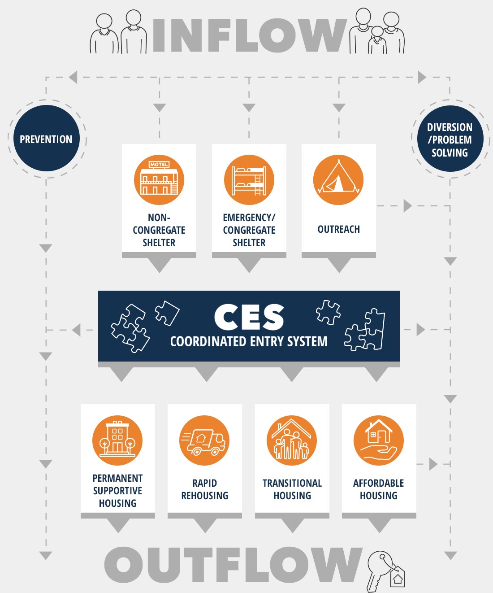
Coordinated Entry System
Access
Assessment
Prioritization
Referral
In three county that includes:
Vulnerability Assessments
By names list
Case conferencing
Notes:
To give a sense of the Coordinated Entry work we do.
It includes work that is being done to provide triage support to people that are at risk of homelessness, and diversion efforts to keep someone from entering into homelessness. Once someone has entered into homelessness, we are assessing for emergency shelter, basic needs, street outreach. And then the system purpose is to provide equity to housing access.
partner agencies work to provide assessments for people experiencing homelessness – sheltered or unsheltered. Often these agencies are working with this family or individual in outreach or case management. the COC then builds a by names list through our data system, in order of vulnerability score..the person with the highest vulnerability is placed at the top. When we say “vulnerability level”, we mean vulnerability to the elements of homelessness. It’s important to remember that our partner agencies are working with a broader number of those in homelessness than they assess for the CE system.
Step 1: Standardized access: Ensures all those seeking access to their community’s homelessness system engage the system through the same coordinated and standardized process regardless of where or how they present for services.
Step 2: Standardized screening and assessment: Uses a standardized approach for all those presenting for homelessness assistance to gather information on factors that can prevent and end their homelessness and inform the types of services and housing that meet their needs and strengths.
Step 3: Standardized prioritization: Ensures that those with the most severe service needs and levels of vulnerability are prioritized for limited housing and other non-emergency homelessness assistance resources that meet their needs.
Step 4: Coordinated referral: Ensures that someone can be referred to any homelessness dedicated housing and services for which they qualify and are prioritized for across the entire community.

Slide 3
Equitable Housing Access
Prioritization for those most vulnerable
Low Barrier
Housing First
Person-Centered
Fair and Equal Access
Emergency Service Connection
Standardized Assessment and Access
Inclusive
Referral protocols in place
Outreach
Ongoing planning and system evaluation
Informing local planning
Leverages local capacity
Partner agency safety planning
Using HMIS and systems tracking
Full Geographic Coverage
Notes:
main purposes of coordinated entry is to ensure that people with the most severe service needs and levels of vulnerability are prioritized for housing and homeless assistance. HUD’s policy is that people experiencing chronic homelessness should be prioritized for permanent supportive housing.
In addition to prioritizing people experiencing chronic homelessness, the coordinated entry process prioritizes people who are more likely to need some form of assistance to end their homelessness or who are more vulnerable to the effects of homelessness.
Prioritization principles must be consistently applied and may reflect the following vulnerability factors:
significant health or behavioral health challenges or functional impairments
high utilization of crisis or emergency services, including emergency rooms, jails, and psychiatric facilities to meet basic needs;
the extent to which people are unsheltered;
vulnerability to illness or death;
risk of continued homelessness;
vulnerability to victimization, including physical assault, trafficking, or sex work; or
other factors determined by the community and based on severity of needs.
Our community uses a community specific assessment tool that is a built out ot the Arizona Mattrix. Each week there is a case conferencing meeting in each community. We follow our COC’s written standards for prioritization, we hold a CE committee that provides feedback quarterly to how the system is running, and we specifically work to be sure that our housing system follows HUD’s expectations.

Slide 4
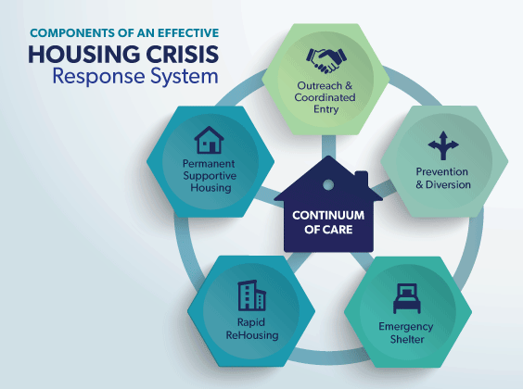
Three County CoC Coordinated Entry Partners​
Amherst Community Connections​
Cooley Dickinson Hospital/A Positive Place
Berkshire County Regional Housing Authority​
Brien Center
Center for Human Development (ICAPP, Grace House, COC PSH, Gfld Family Inn)
CAPV Family Center
CAPV Youth & Workforce Development Programs
CAPV Community Resources and Advocacy
Construct, Inc​.
Clinical & Support Options, Craig’s Doors​
Department of Mental Health
DIAL/SELF Youth & Community Services​
Eliot CHS​
Gandara Center, Inc.
Berkshire Community Health Programs
Franklin County Regional Housing & Redevelopment
Way Finders​
Healthcare for the Homeless
Hilltown Community Development​
Mental Health Association, Inc.
Northampton Veteran Services​
The VA of Central & Western Mass
ServiceNet Shelter and Housing​
Soldier On, Inc​
Greenfield Housing Authority​
Northampton Housing Authority​
Amherst Housing Authority
Safe Passage (DV)
NELCWIT (DV)
Elizabeth Freeman Center(DV)
The Salasin Project(DV)
Notes:
This is a list of our current coordinated entry partnerships across the continuum. You will notice that some say “assessors” these are people currently trained or being trained on conducting vulnerability assessments.
In identifying placements from the Coordinated Entry by-names list into YHDP Project placements, this community will prioritize the following, in a housing first*, low-barrier, youth choice, and Multisite centralized access, meaning at several locations in a community, sometimes referred to as hubs or a hybrid approach.

Slide 5
Continuum of Care Components
Emergency Shelter (ES): is any facility whose primary purpose is to provide temporary or transitional shelter for the homeless in general or for specific populations of the homeless. In Massachusetts we have a large ES program run by the State specifically for families.
Transitional housing (TH): provides temporary housing for the certain segments of the homeless population, including working homeless making insufficient wages or homeless individuals with mental or physical disabilities who have trouble affording long-term housing, and is set up to transition their residents into permanent, affordable housing within a reasonable amount of time (usually 24 months).
Permanent Supportive Housing (PSH): is permanent housing with indefinite leasing or rental assistance paired with supportive services to assist homeless persons with a disability or families with an adult or child member with a disability achieve housing stability.
Rapid Re-Housing (RRH): RRH rapidly connects families and individuals experiencing homelessness to permanent housing through a tailored package of assistance that may include the use of time-limited financial assistance and targeted supportive services
Supportive Services Only (SSO): This program provides services to homeless individuals and families living in the community. SSO recipients may use the funds to conduct outreach to sheltered and unsheltered homeless persons and families, link clients with housing or other necessary services, and provide ongoing support.

Slide 6
The Six Principles of Trauma Informed Care
1. Safety:
Both clients and staff must feel physically and psychologically safe while in the building and working with the staff.
2. Trustworthiness and Transparency:
Trust should be developed continuously through transparency and rapport-building. Operations and decisions should not feel shady or deceitful.
3. Peer Support:
Foster hope and safety by encouraging people to share with and support each other as they navigate difficult experiences.
4. Collaboration and Mutuality:
Discourage staff silos, and encourage every level and role of staff that they are an important piece of the collaborative team effort to make the organization safe and trustworthy.
5. Empowerment, Voice, and Choice:
Empower both staff and clients to voice their opinions, contribute to the conversation, collaborate in choices, and speak up. Recognize strengths and allow trauma to unite and empower rather than isolate and silence.
6. Cultural, Historical, and Gender:
Reject stereotypes. Teach and practice cultural competency. Recognize historical traumas. Offer services to empower and increase accessibility to care.
Notes:
Trauma Informed programs and services should recognize the full impact of trauma and understand how to assist and support trauma victims. The program’s policies, its rules, activities, and everything else that guides the program must be integrated with an understanding of trauma and thereby promote safety, safe spaces (Physical/Social Environment) and steps toward reconnection and recovery (Herman, 1992; SAMHSA, 2015).

Slide 7
Identifying Eligibility – Chronic homelessness
Homeless Individual With a Disability
(SUD) Substance use disorder
Serious mental illness
Developmental disability
Post Traumatic Stress Disorder (PTSD)
Cognitive impairment (brain injury)
Chronic physical illness or disability
Lives in a place not meant for human habitation, safe haven, or in emergency shelter; and
Has been homeless continuously for:
At least 12 months, or
At least 4 separate occasions in the last 3 years – which combined equal 12 months.
(some additional factors could include incarceration or treatment facility for fewer than 90 days/family with a head of household that meets the chronic criteria)
Notes:
HUD issued a final rule in December of 2015 on the definition of “chronically homeless” used in the Continuum of Care Program.

Slide 8
Identifying Eligibility – Youth and young Adult Homelessness
Category 1 – Literal Homelessness
• Shelter including emergency shelter, transitional housing, or hotel or motel paid by government or charity;
• Street or other place not meant for human habitation (ex. car, garage, park, abandoned building); OR
• An institution (ex., jail, hospital, juvenile detention that the youth is exiting and where the youth was a resident for 90 days or less AND the youth resided in emergency shelter or place not meant for human habitation immediately prior to entering that institution.
Category 2 – Imminent Risk of Homelessness
• In own housing, but being evicted within 14 days;
• A hotel or motel paid for by someone other than a government or charitable organization, including the youth, family, or friends where the youth cannot stay for more than 14 days (often due to lack of ability to continue paying); OR
• With family or friends and being asked to leave within 14 days, which includes:
Youth staying with their biological parents, relatives, any individual they identify as family or a Friend
Youth who are moving from one home to another “couch surfing” and cannot stay at their current home or “couch”
or Youth who are in a legal guardianship
Notes:
Category 1 – Literal Homelessness
Youth, including pregnant and parenting youth, in the following living situations:
• Shelter including emergency shelter, transitional housing, or hotel or motel paid by government or
charity;
• Street or other place not meant for human habitation (ex. car, garage, park, abandoned building); OR
• An institution (ex., jail, hospital, juvenile detention) that the youth is exiting and where the youth was a resident for 90 days or less AND the youth resided in emergency shelter or place not meant for human
habitation immediately prior to entering that institution.
Category 2 – Imminent Risk of Homelessness
Youth, including pregnant and parenting youth, in the following living situations:
• In own housing, but being evicted within 14 days;
• A hotel or motel paid for by someone other than a government or charitable organization, including the youth, family, or friends where the youth cannot stay for more than 14 days (often due to lack of ability to continue paying); OR
• With family or friends and being asked to leave within 14 days, which includes:
Youth staying with their biological parents, relatives, any individual they identify as family or a
Friend
Youth who are moving from one home to another “couch surfing” and cannot stay at their current home or “couch”
or Youth who are in a legal guardianship
Category 4 – Fleeing Violence
Youth, including pregnant and parenting youth, fleeing or attempting to flee their housing or the place they are staying because of domestic violence, dating violence, sexual assault, stalking, or other dangerous or life threatening conditions related to violence that has taken place in the house or has made them afraid to return to the house, including:
• Trading sex for housing;
• Trafficking;
• Physical abuse;
• Emotional abuse, such as threats, intimidation, and exposure to trauma;
• Family conflict that has caused a youth to feel physically or emotionally unsafe and unable to stay in
their current living situation;*
• Financial abuse, such as controlling a youth’s income or stealing a youth’s identity in order use their
credit;
• Violence (or perceived threat of violence) because of the youth’s sexual orientation or gender identity;
• Active drug/illegal substance use in the youth’s current housing;
• Gang or neighborhood violence that is being directed to a youth in their home;** OR
• Other illegal activity in the household that is putting a youth or a youth’s child at risk
Additionally, the youth must have no safe, alternative housing, resources or support networks to maintain or
obtain permanent housing.
*If youth are under the age of 18 you may be required to report family conflict resulting in abuse or
neglect to the local child welfare agency. It is important to understand the mandatory reporting laws for
child abuse and neglect in your local jurisdiction.
**Gang or neighborhood violence has to be directed at the youth in their home not just in the general
community to be eligible under category 4.

Slide 9
Identifying Eligibility – Youth and young Adult Homelessness
Category 4 – Fleeing Violence
Youth, including pregnant and parenting youth, fleeing or attempting to flee their housing or the place they are staying because of domestic violence, dating violence, sexual assault, stalking, or other dangerous or life threatening conditions related to violence that has taken place in the house or has made them afraid to return to the house, including:
• Trading sex for housing;
• Trafficking;
• Physical abuse;
• Emotional abuse, such as threats, intimidation, and exposure to trauma;
• Family conflict that has caused a youth to feel physically or emotionally unsafe and unable to stay in their current living situation;*
• Financial abuse, such as controlling a youth’s income or stealing a youth’s identity in order use their credit;
* Violence (or perceived threat of violence) because of the youth’s sexual orientation or gender identity;
• Active drug/illegal substance use in the youth’s current housing;
• Gang or neighborhood violence that is being directed to a youth in their home;** OR
• Other illegal activity in the household that is putting a youth or a youth’s child at risk
Additionally, the youth must have no safe, alternative housing, resources or support networks to maintain or
obtain permanent housing.
*If youth are under the age of 18 you may be required to report family conflict resulting in abuse or neglect to the local child welfare agency. It is important to understand the mandatory reporting laws for child abuse and neglect in your local jurisdiction.
**Gang or neighborhood violence has to be directed at the youth in their home not just in the general community to be eligible under category 4.
Notes:
Category 1 – Literal Homelessness
Youth, including pregnant and parenting youth, in the following living situations:
• Shelter including emergency shelter, transitional housing, or hotel or motel paid by government or
charity;
• Street or other place not meant for human habitation (ex. car, garage, park, abandoned building); OR
• An institution (ex., jail, hospital, juvenile detention) that the youth is exiting and where the youth was a resident for 90 days or less AND the youth resided in emergency shelter or place not meant for human
habitation immediately prior to entering that institution.
Category 2 – Imminent Risk of Homelessness
Youth, including pregnant and parenting youth, in the following living situations:
• In own housing, but being evicted within 14 days;
• A hotel or motel paid for by someone other than a government or charitable organization, including the youth, family, or friends where the youth cannot stay for more than 14 days (often due to lack of ability to continue paying); OR
• With family or friends and being asked to leave within 14 days, which includes:
Youth staying with their biological parents, relatives, any individual they identify as family or a
Friend
Youth who are moving from one home to another “couch surfing” and cannot stay at their current home or “couch”
or Youth who are in a legal guardianship
Category 4 – Fleeing Violence
Youth, including pregnant and parenting youth, fleeing or attempting to flee their housing or the place they are staying because of domestic violence, dating violence, sexual assault, stalking, or other dangerous or life threatening conditions related to violence that has taken place in the house or has made them afraid to return to the house, including:
• Trading sex for housing;
• Trafficking;
• Physical abuse;
• Emotional abuse, such as threats, intimidation, and exposure to trauma;
• Family conflict that has caused a youth to feel physically or emotionally unsafe and unable to stay in
their current living situation;*
• Financial abuse, such as controlling a youth’s income or stealing a youth’s identity in order use their
credit;
• Violence (or perceived threat of violence) because of the youth’s sexual orientation or gender identity;
• Active drug/illegal substance use in the youth’s current housing;
• Gang or neighborhood violence that is being directed to a youth in their home;** OR
• Other illegal activity in the household that is putting a youth or a youth’s child at risk
Additionally, the youth must have no safe, alternative housing, resources or support networks to maintain or
obtain permanent housing.
*If youth are under the age of 18 you may be required to report family conflict resulting in abuse or
neglect to the local child welfare agency. It is important to understand the mandatory reporting laws for
child abuse and neglect in your local jurisdiction.
**Gang or neighborhood violence has to be directed at the youth in their home not just in the general
community to be eligible under category 4.

Slide 10
Data Collection and Reporting
HMIS System Engagement
Client record - Name, DOB, SSN, & basic demographics after signed release
Enrolled in the CE project (current living situation included)
Vulnerability Assessment completed and referred to the BNL
After case conferencing referral process –referral completed & required data elements.
Program acceptance/Enrollment OR referred back to the CE project/BNL (if denied).
Current work-arounds for survivors:
Coding in the data system if entered by non- victims services providers.
Discussion of needs outside of case conferencing for coded survivors on the BNL
When opportunities arrive in case conf. discussions/nothing identifiable is shared.
Notes:
client records are created in HMIS with name, DoB, SSN, and basic demographics completed according to the client's signed release and information they are willing to share.Clients are enrolled in the coordinated entry project and their current living situation is recorded (current living situation is a required data element to collect for those in coordinated entry at each contact)Client vulnerability assessments are entered in HMIS and the clients are referred to the by names listAfter a referral is made for the client during case conferencing, Shaundell goes into the HMIS and refers that client to the project (to capture required data elements on referrals from coordinated entry)Programs then either accept the referral and enroll the client or present a reason not to accept the referral and return that client to the by names list. (whether or not a referral was accepted and why not is a required data element to report)

Slide 11
Some Components of the DV Expansion Project
Housing Navigation Placed within Victims Service Provider agency/programs
Connection between CES partners and survivor’s case workers/Cross training on housing and Trauma care.
Alternative CE processes/Model of Access for people fleeing DV while adhering to the same requirements (will need to determine level of integration).
Addressing Data Collection & Reporting concerns/requirements
Innovation for improving core components of CES to address safety, confidentiality, & autonomy to this population from crisis
Ensuring/Improving EQUAL equitable access for survivors of domestic and sexual violence to safe housing options & support services.
Identifying and Addressing additional needs identified by People with Lived Expertise/VSP.
Continous Quality Improvement
Notes:
Survivors face many barriers to finding and maintaining safe and stable housing and we understand that our system requires modifications based on providing safe access and individualized supports/reduced risks. We need to develop a framework that recognizes the impacts of trauma specifically to survivors and emphasis on physical and emotional safety. May include a different process for assessment & model of access:
different access points, and tools for households fleeing domestic violence/sexual assault
Could be decentralized/separate or be integrated in some way

Slide 12
Questions? https://www.threecountycoc.communityaction.us/
Keleigh Pereira
Program Director
Three County CoC
kpereira@communityaction.us
Michele LaFleur
Data & Evaluation Manager
Three County CoC
mlafleur@communityaction.us
Shaundell Diaz
Coordinated Entry Specialist
Three County CoC
sdiaz@communityaction.us
Brooke Murphy
Homeless Services and Billing Manager​
Three County CoC
bmurphy@communityaction.us
Jay Levy
Regional Manager
Eliot CHS
jlevy@eliotchs.org
Erin Forbush
Director of Operations
ServiceNet, Inc
eforbush@servicenet.org
Kelsey Wessels
Director of Youth and Young Adult Programs
DIAL/SELF YCS
kwessels@dialself.net
Notes:
Reminder: April 15th training on CE in HMIS – 1-3pm– Case conferencing discussion/ Conducting Coordinated Entry Assessment, Events, and data tracking in HMIS.

