Slide 1
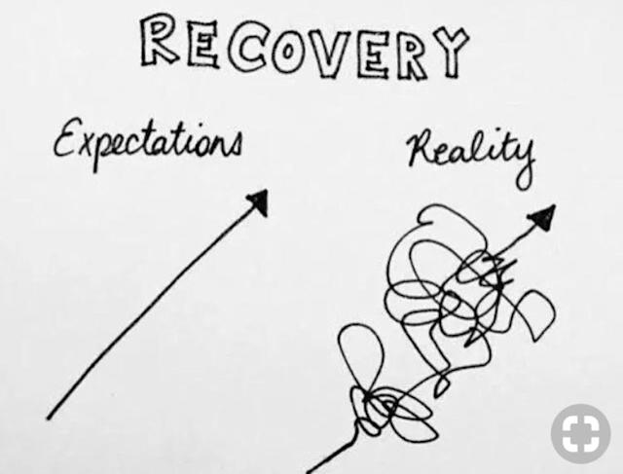
Treatment Access
Talking about it

Slide 2
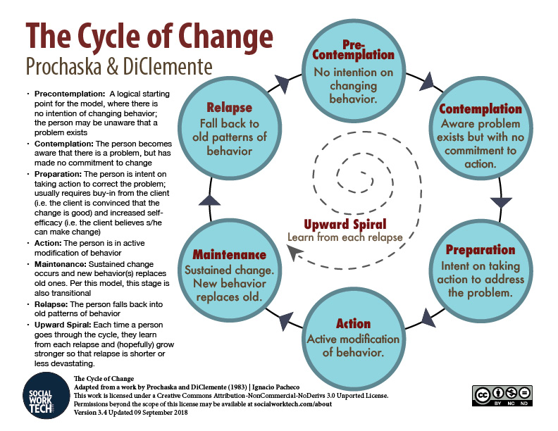
Stages of Change

Slide 3
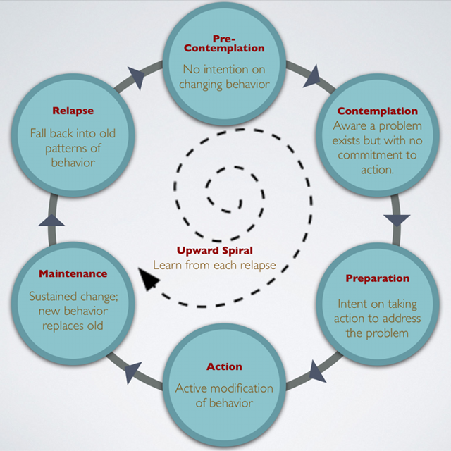
Work can be done in all stages

Slide 4
Questions to ask
What has worked for you before?
What is preventing you from wanting to reduce or stop usage?
What is your ideal treatment?
What would need to happen to get you to enter treatment?

Slide 5
Not "forcing" treatment is not revolutionary
If he does not want to stop drinking, don't waste time trying to persuade him. You may spoil a later opportunity...
If he does not want to see you, never force yourself upon him. Neither should the family hysterically plead with him to do anything...
Unless your friend wants to talk further about himself, do not wear out your welcome. Give him a chance to think it over. If you do stay, let him steer the conversation in any direction he likes. Sometimes a new man is anxious to proceed at once. And you may be tempted to let him do so. This is sometimes a mistake. If he has trouble later, he is likely to say you rushed him. If he thinks he can do the job in some other way, or prefers some other spiritual approach, encourage him to follow his own conscience...
But point out that we alcoholics have much in common and that you would like, in any case, to be friendly. Let it go at that."
Big Book of AA - 1939

Slide 6
Any Positive Change

