Slide 1
Three County CoC Annual Meeting
Thursday, September 29, 2022
1-3pm

Slide 2
Welcome Brad Gordon Co-Chair CoC Board Executive Director Berkshire County Regional Housing Authority

Slide 3
Welcome and Meeting Agenda Brad Gordon, Executive Director of Berkshire Regional Housing Authority Three County CoC Board of Directors Co-chair
Keynote – Kamaar Taliaferro, amateur genealogist, community activist, and lifelong Pittsfield resident, "Contextualizing Redlining"
The CoC’s Regional Efforts - Keleigh BenEzra, CoC Program Director, Community Action Pioneer Valley
A Year in Review
Coordinated Entry System Expansion to meet the needs of Survivors – Keleigh BenEzra
Emergency Housing Vouchers in our Region- Shaundell Diaz, CoC Coordinated Entry Specialist
Youth Homelessness - Shaundell Diaz & Members of the Youth Action Board, Rhea and Olivia.
The Western Mass Network to End Homelessness -Pamela Schwartz, Director of WMNEH

Slide 4
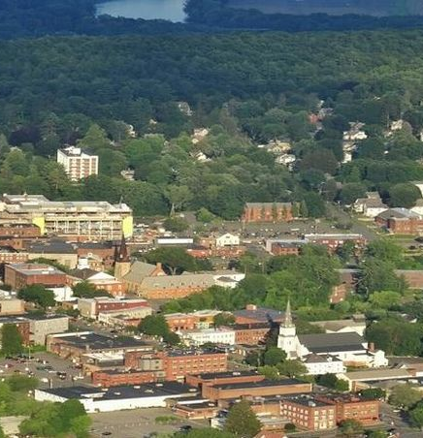
Welcome and Meeting Agenda Brad Gordon, Executive Director of Berkshire Regional Housing Authority Three County CoC Board of Directors Co-chair
What’s Next?
New Housing Opportunities in the CoC
Housing the Disabled Homeless – Dr. Jessica Bossie, Independent Housing Solutions.
Louison House Capital Project – Kathy Keeser, Executive Director, Louison House
Racial Equity Efforts – Shaundell Diaz and Lisa Sirabella (CoC Board member & People with lived Experience Advocate.)
A look at Data – Michele LaFleur, CoC Data and Evaluation Manager
Membership Vote on Updated Governance & HMIS Charters; Board Directors Slate - Brad Gordon
Closing –Brad Gordon

Slide 5
CoC Membership Survey Results Keleigh BenEzra Three County CoC Program Director Michele LaFleur Three County CoC Data & Evaluation Manager
Commitment to Diversifying CoC Membership- Board and Committees
The Three County CoC is committed to a Membership that reflects the diversity of populations served by the CoC, including diversity in race, ethnicity, gender identify, sexuality, disability, geography, housing status, languages spoken, and lived experience of homelessness. The CoC shall conduct periodic surveys to evaluate diversity of current membership to identify diversity needs.
Notes:
Keleigh - Last year, The board and committees of the CoC made a commitment to diversify the membership in order to more fully represent the population we serve and to increase the number & voices at our tables and the membership supported a written commitment to this in our Charter.
We created a demographic survey this year and had 34 respondents. Certainly, our membership is larger than this group, but what we learned is still informative. We will continue to evaluate the membership, if you didn’t get a chance to take the survey.
Michele is going to share a bit of what it told us.

Slide 6
Survey Responses
34 Responses
Almost 75% female
6% transgender
2/3 between the ages of 25 and 55
Approximately 1/3 identify as LGBTQ+
12% identify as BIPOC
17.6% identify as Hispanic or Latino/a/x
~6% of respondents identify as Black or African American
~6% of respondents identify as American Indian, Native American, or Indigenous
38% of respondents identified experience with homelessness
25% of respondents identify as having a disabling condition
Notes:
Michele -
Experiencing homelessness- HUD’s definition, someone enrolled in a shelter or transitional housing program or literally unsheltered, this data does only includes those in ES or TH
12% non-binary or genderqueer compared to 0.4% of those enrolled in shelter or transitional housing over the past year
6% identify as transgender compared to 1% of the population in ES or TH
35% female experiencing homelessness, 63% male
12% youth and young adults, YYA make up 7.4% of those experiencing homelessness
25 -55 year olds make up 2/3 of membership, 56% of pop experiencing homelessness
80% identify as white compared to 80% of the population experiencing homelessness
~6% of responders identify as Black or African American compared to 13.4% of those experiencing homelessness.
~6% of responders identify as Native American, American Indian, or Indigenous compared to 14.9% of those experiencing homelessness.
~17.6% of responders identify as Black or African American compared to 13.4% of those experiencing homelessness.
Lack of representation of Black and African American ind compared to those experiencing homelessness
Across survey responses it was clear that those working in this field have a wide variety of life experiences which inform their work, including substance use. 47% of responders identified an adverse childhood experience
Stop slide show at end of this slide

Slide 7
Breakout Group Questions
How would we dilute concentrated poverty,
What to do about wage and wealth inequality,
How to soften the blows from the constellation of disparate impacts or discriminatory practices?
What land use policies on the municipal scale will increase more equitable development?
How do we build relationships based in trust and reciprocity between historically marginalized communities and the institutions that were responsible for their marginalization?
What does allyship act like?

Slide 8
How to Get Involved in the CoC's Regional Efforts Keleigh Pereira
Join the Board of Directors, The CoC is actively recruiting for the following:
Persons with Lived Experience of Homelessness (financial compensation for meeting attendance is available)
Representative from the CAPV Youth Action Board (financial compensation for meeting attendance is available)
Join one of our committees:
Equity and Inclusion Committee and the Racial Equity Workgroup: Shaundell Diaz, sdiaz@communityaction.us
Coordinated Entry Committee & DV Expansion Planning team: Keleigh BenEzra kbenezra@communityaction.us
Data Evaluation Committee: Michele LaFleur, MLaFleur@communityaction.us
Project Ranking & Evaluation Committee: Keleigh BenEzra, kbenezra@communityaction.us
Youth and Young Adult Homelessness Committee: Shaundell Diaz, sdiaz@communityaction.us
People with Lived Experience Action Board: Shaundell Diaz, sdiaz@communityaction.us
Notes:
The Three County Continuum of Care is committed to ending homelessness in Hampshire, Franklin, and Berkshire Counties in western Massachusetts through providing funding, monitoring and oversight for housing and services; a broad range of training opportunities for area providers; running the annual point in time count and various other opportunities to recognize the region's gaps in services and funding advocacy needs and we work to guide a regional vision. We seek out ways to increase and strengthen the resources available for those experiencing homelessness. The Three County CoC strives to engage funded agencies and partners in processes and procedures that are anti-racist and bias-free and that advance the priorities of those most impacted by housing instability.
How can you get involved if you aren't already? You can join our board or one of our committees. Most of our committees meet monthly and some quarterly. All are an opportunity to lend feedback and voice to the work of the CoC and to meet HUD's standards and best practices in providing funding and monitoring programs.

Slide 9
CoC & Partner Agency Trainings Keleigh Pereira
Upcoming virtual Three County CoC trainings
Identifying and Defining "Chronic Homelessness" (required for - 10/13
Defining and Documenting Homelessness in HMIS – 10/27
Western Mass Network to End Homelessness, Voter Registration Info Session – 10/14
Commercial Sexual Exploitation of Children (CSEC) Training – 11/04
Community Legal Aid (CLA) Info Session – 11/10
Massachusetts Housing & Shelter Alliance (MHSA) CoC Member Trainings - Fall 2022
Institutional Transformation: Becoming an Antiracist Organization –10/19
Making Change: How to Use Spheres of Influence – 11/2
Making Change: Allyship and Activism –11/16
Developing Diverse Organizations – 11/30
2023 Series in the Works:
PLE Racial Equity Training Series with Racial Equity Partners
Victim Services & Housing Partner Trainings on safety/confidentiality with
Safe Housing Alliance
Equal Access and Anti-discrimination training & consultation work with Translate Gender
Notes:
Another way to continue the mission of ending Homelessness is to attend an upcoming training or to make us aware of trainings you know about. This is the list of trainings coming this fall through the CoC or our Partners that are specifically responding to initiatives of the CoC. For example: CE assessors and funded agencies support those we serve in documenting and making referrals in HMIS. In this 2-part training series, we will review identifying and documenting Chronic Homelessness, as well as documenting, reporting and making referrals in HMIS. This series is open to anyone, but funded agencies have required staff attendance.
I am also excited to share a new training series brought to you by MHSA in collaboration with the Southshore, Worcester County and Three County CoCs. This series begins in October, so register soon! Presented by Racial Equity Partners(REP), who is well known by the membership if the Three County CoC, the series will offer four (4) virtual sessions, each exploring a topic that will help us continue advancing racial equity in our work to end homelessness. These sessions are for members and/or affiliates of the Continuums of Care, their staff, and people in the communities served by them.● You must pre-register to attend and receive the Zoom link.
If you have interest in any of these trainings or to join the work of the COC, visit our website or reach out to any of our staff. I will put the website link in the chat.

Slide 10
A Year in Review
Notes:
At the annual meeting we like to give you at least a snapshot of what we have been working on and what’s to come.
This past year we have had many focuses.

Slide 11
A Few of This Year's Efforts
Housing Development Coordination
Racial Equity work with Racial Equity Partners
WMNEH – pulling together stakeholders
Youth Homelessness Work
Increased Housing placements
Emergency Housing Vouchers
Project-level accomplishments
Landlord and Property Owner Engagement Initiatives
Lived Experience initiatives
DV work with Safe Housing Alliance
Coordinated Entry Evaluation and Responsive Planning
Shelter & Services Procurement support
Housing authority
partnerships
Notes:
Community Action Pioneer Valley is what’s called the Collaborative Applicant (meaning we work to secure and administer all of the region’s funding for housing and services to meet the needs of people experiencing homelessness), the HMIS lead (leading the work of data collection & reporting for the experiences and needs of this population in the Three County area; and Coordinated Entry System’s Lead agency adderess accesses to housing and services.
In addition, The Staff at CAPV support the Membership’s efforts in addressing the systemic challenges of housing insecurity and homelessness.
That means we are continually developing initiatives, based on Federal requirements and local priorities and needs.

Slide 12
Recent and Planned Coordinated Entry Improvements Keleigh BenEzra
Coordinated Entry Assessment tool
Released a new Assessment Tool with racial equity lens
Coordination with DV providers
Applied for and received funding to support an expansion for survivors
Emergency Housing Vouchers
Increased housing stock
Prioritized populations overrepresented in homelessness
Planned New outreach initiatives
DCF, healthcare, and correctional facilities re: discharge planning
Case Conferencing
Increased participation from new and existing partners/diversifying the faces of assessors
Now includes all the following population specific coordination: Chronic Homelessness, Veterans, Youth and Young Adults, Survivors of Domestic and Other Violence.
Notes:
Our vision includes a ‘housing first’ model and establishes rehousing strategies that ensure equitable housing for vulnerable populations through what’s called “Coordinated Entry”.
Coordinated entry is a nationally recognized process developed to ensure that everyone experiencing a housing crisis has fair and equal access to resources and are quickly identified and connected to housing based on their strengths and needs. In the Three County CoC, opportunities for housing and supportive services through CE can be accessed at several locations throughout the community. this community prioritizes low-barrier, client- choice, and Multisite centralized access, meaning at several locations in a community, sometimes referred to as hubs or a hybrid approach.
* Some of what we have been up to since the CoC moved to Community Action, is
1. our community invested time and expertise in creating a new vulnerability assessment tool
2. we increased partnerships with housing authorities and other agencies providing housing to people experiencing homelessness and updated our prioritization measures with the addition of Emergency Housing Vouchers in our region.
3. increased outreach efforts to more sectors of providers and systems that interface with those experiencing homelessness & increased the number of assessors training in the region to support someone experiencing homelessness and in need of housing problem solving.
4. and are including some population specific case conferencing meetings in order to fully grasp their unique needs and what specific resources might be available to them
3. Mostl recently, we increased funding to meet the needs of survivors of domestic violence.

Slide 13
Cross CE Systems Partnership Development
Victims Services World
Safe Passage (DV)
NELCWIT (DV)
Elizabeth Freeman Center(DV)
The Salasin Project(DV)
PLE
others
The Housing World
Coordinated Entry Partners
Shelter & Housing Providers
Municipal representatives
The CoCs
The Western Mass Network to End Homelessness
others
Cross Trainings
shared goals
Housing Navigation Partnerships
Prevention and Diversion work
Improving access
Sharing best practices
Partnering on housing applications
Notes:
We are working to engage VSPs in the work of coordinated entry in a way that has not been true in the past. We will soon begin holding case conferencing meetings specifically for those working with VSPs, in order to maintain the truest forms of confidentiality measures & training VSPs on conducting assessments. But what we learned last year, as we began to engage these partners, was a true need for better partnerships with housing providers, so we set goals for cross training, housing navigation partnerships, diversion work, and the sharing of best practices between these two entities.

Slide 14
Components of the DV Expansion Project
Housing Navigation
Connection – Intersection of homelessness and DV
Alternative CE processes/Model of Access
Addressing Data Collection & Reporting
Innovation for improving core components of CES
Ensuring/Improving EQUAL equitable access for survivors & limiting re-traumatization for survivors
Identifying and Addressing additional needs
Advocacy for the needs of this population
Continuous Quality Improvement
Notes:
In 2021 HUD awarded the COC with funding to expand our Coordinated Entry System to better serve survivors of domestic violence, human trafficking, and intimate partner violence. For the past 8 months, the CoC has been meeting with local VSPs and Housing Providers and are working with Consultants through Safe Housing Alliance, as funded by the Western Mass Network to End Homelessness, to plan for this work.
We are working to place housing navigators within local Victims Service Provider agency/programs
Connection – Intersection of homelessness and DV between CES partners and survivor’s case workers
Alternative CE processes/Model of Access for people fleeing DV
Addressing Data Collection & Reporting concerns/requirements
Innovation for improving core components of CES to address safety, confidentiality, & autonomy to this population from crisis
Ensuring/Improving EQUAL equitable access for survivors & limiting retraumatization
And Working with People with Lived Expertise/VSP.
Some of this is just beginning and we are excited to have the funding for housing navigation specifically to meet the needs of this vulnerable group.

Slide 15
Emergency Housing Vouchers
Shaundell Diaz, Three County CoC Coordinated Entry Specialist

Slide 16
Emergency Housing Vouchers
Scope of EHV’s in Three County
Notes:
Most referrals came through the CoC’s Coordinated Entry system- DV providers can refer directly to housing authorities
CoC conducted EHV Case Conferencing Meetings Bi-weekly during the initial referral stage
Prioritized:
Unsheltered individuals and families
Long-term shelter stayers
Currently homeless families with children under 6
People who are disabled
People over the age of 55
People currently experiencing homelessness
Overrepresented populations
Those at risk of homelessness.
CoC and Partners coordinated supportive services and helped to connect referrals with appropriate services
All referrals come through the CoC’s Coordinated Entry system- except DV providers that could refer directly to housing authorities .
The COC conducted EHV Case Conferencing Meetings Bi-weekly during the initial referral stage.
During this meeting referrals were made
Prioritizing:
Unsheltered individuals and families
Long-term shelter stayers
Currently homeless families with children under 6
People who are disabled
People over the age of 55
People currently experiencing homelessness
Including some vouchers that were allotted for individuals and families fleeing DV, dating violence, sexual assault, stalking, or human trafficking, for “Move on”, for individuals and families currently in PSH, RRH or in PH for which the voucher would prevent homelessness or housing instability.
Overrepresented
At risk of homelessness.
COC and Partners coordinated supportive services and helped to connect referrals with appropriate services

Slide 17
Emergency Housing Vouchers
Referrals
15 Vouchers – Franklin County Regional Housing Redevelopment Authority (FCRHRA)
17 Vouchers – Northampton Housing Authority (NHA)
44 Vouchers - Department of Housing and Community Development (DHCD)
27 Vouchers - Berkshire Housing
17 Vouchers – WayFinders
Notes:
15 Vouchers – Franklin County Regional Housing Redevelopment Authority (FCRHA)
17 Vouchers – Northampton Housing Authority (NHA)
44 Vouchers - Department of Housing and Community Development (DHCD)
27 Vouchers - Berkshire Housing
17 Vouchers – WayFinders
24 Vouchers have been forfeited due to various reasons

Slide 18
What Continues/What Has Changed
Individuals and families Continue to be referred to the Three County Coordinated Entry system.
Follow up and further referrals are discussed in weekly case conferencing
In July 2022- HUD provided DHCD with funding for:
Finder’s Fee Program
Landlord Incentives Program:
INSPECTION/ HQS REPAIR FUND
LOST RENT FUND
DAMAGES FUND
Notes:
Individuals and families Continue to be referred to the Three County Coordinated Entry system. As they are identified for EHV, they are placed on a Waitlist. As vouchers open up, folks on the waitlist are referred to the EHVs.
Follow up and further referrals are discussed in weekly case conferencing. Check ins are conducted with the RAA's bi-weekly to ensure maximum communication and support for all those involved, including RAA's, advocates and voucher holders
In July 2022- HUD provided DHCD with funding for:
Finder’s Fee Program
Landlord Incentives Program:
INSPECTION/ HQS REPAIR FUND
LOST RENT FUND
DAMAGES FUND

Slide 19
Challenges and Successes
Challenges
Lack of affordable housing
Assisting participants to collect all necessary documentation
Successes
Outreach
New partnerships in the community
Seeing the number of leased up vouchers go up
And the Advocates

Slide 20
MORE THAN HOUSING, GIVE US HOMES- Youth homelessness demonstration project and EOHHS initiative Update- Shaundell Diaz
Notes:
The 3COC, area community partners, youth service providers and local youth and young adults have made a commitment to identify, address, bring awareness, and end youth homelessness in Western MA. Advocates have dedicated time and provided space to meet youth wherever they present, and to provide them with connections to the many resources that there are in our area. Within the last 2 years, through funding sources such as the Youth Homelessness Demonstration project, more than 70 YYA have been connected to services through the Coordinated Entry System with several different resources like Permanent Supportive Housing, Rapid Re-Housing, Transitional Housing, and Navigation. Through our State resources with the Executive Office of Health and Human Services, 255 youth have been served in FY 22 alone, and through Youth Count efforts, 124 responded to this Survey (preliminarily). The efforts continue through meetings the COC holds like, YYA Homelessness Committee, and weekly Case Conferencing. One of our constant in the work we do is the voice of those with Lived Experience, and in the Youth world, this is the Youth Action Board.

Slide 22
Youth & Young Adult Action Board Rhea & Olivia
YAB is a group of youth and young adult activists focused on:
Fighting youth and young adult homelessness in Franklin and Hampshire counties
Supporting our peers and building community
Connecting our peers with local resources
Increasing YYA opportunities to engage in legislative advocacy
Highlighting and uplifting the voices of homeless youth and young adults to facilitate change
Challenging adultism, or prejudice against youth and young adults, within the resources and systems that support youth and young adults

Slide 23
Our Work
Creating personalized care packages for youth and young adults who have recently aged out of the foster care system, who are more at risk for homelessness
Connecting with local resource providers to create a YAB led space to address issues within our communities and problem solving solutions
Collaborating with the YHDP committee, the CoC, and the Youth Council
Volunteering with local organizations and building relationships with local resource providers

Slide 24
Care Packages

Slide 25
Authentic Engagement
Asking the people you serve to review things only after they’ve been created can feel disingenuous and demeaning, like all that’s being asked of us is a stamp of approval rather than genuine feedback
Be proactive and offer us opportunities to be involved in many steps of the process, rather than only seeking our voice upon completion
Work with us to change the way systems work or open a dialogue about how to challenge existing power structures, rather than shutting us down when an idea or request conﬂicts with existing regulations or expectations
Notes:
Stop screenshow after YAB for Pamela

Slide 26
What’s Happening Now?
Notes:
Move on to next slide quickly, as Keleigh starts talking about Dr Bossie’s project

Slide 27
NEW Project for FY21
Independent Housing Solutions, Housing The Disabled Homeless
16 SRO units 5 Franklin St. Northampton
Dr. Jessica Bossie
Permanent Supportive Housing/Chronically Homeless, medical/mental health needs
Supportive Services on Site
Local Partnerships – City of Northampton, Manna Community Kitchen, Friends of the Homeless, Elliot Human Services, Survival Center
Higher Level Partnerships – HUD/CoC funding for units, ARPA funding for start-up.
Considered Permanent Housing, with assistance to move on, if possible!
CoC Unit Funding began on August 1st
Construction is just about complete!
Coordinated Entry Referrals made!
Notes:
We were excited to partner this year with Dr. Bossie and the Board of Independent Housing Solutions, to fund the housing in their new building at 5 Franklin in Northampton. This project was an innovative brain child of Dr. Bossie’s who has been working to serve this population as one of the only medical providers in the region supporting our houseless neighbors. I’d like to introduce Dr. Jessica Bossie to talk more about what this project is designed to do and where we are at with the start of this program.
Supportive Services on Site – medical, mental health support, case management, meal delivery, financial management assistance, daily on-site resident support staff
Local Partnerships – City of Northampton, Manna Community Kitchen, Friends of the Homeless, Elliot Human Services, Survival Center
Higher Level Partnerships – HUD/CoC funding for units, ARPA funding for start-up.

Slide 28
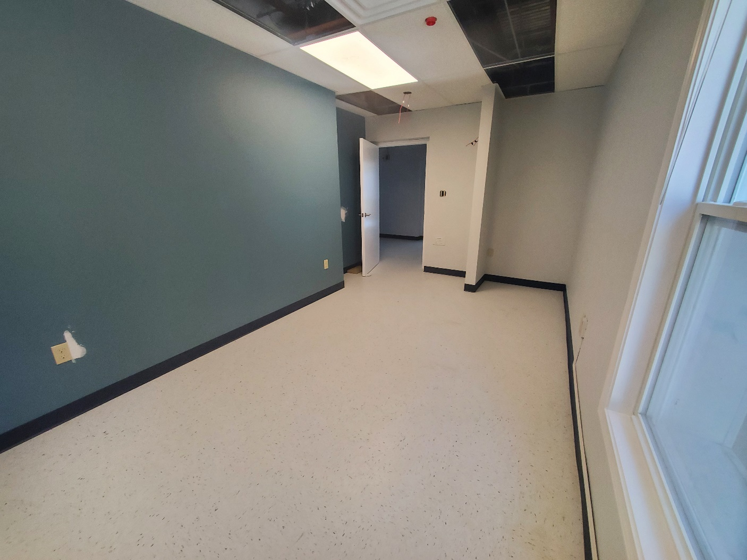

Slide 29
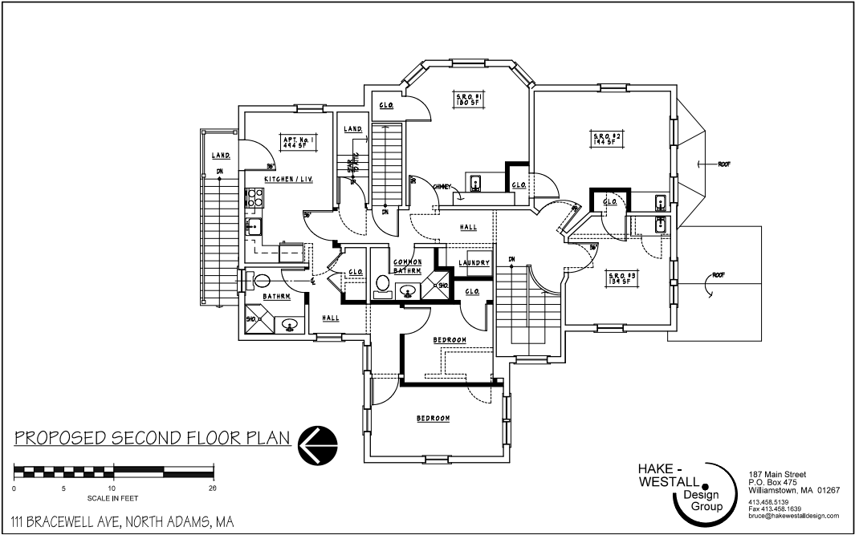
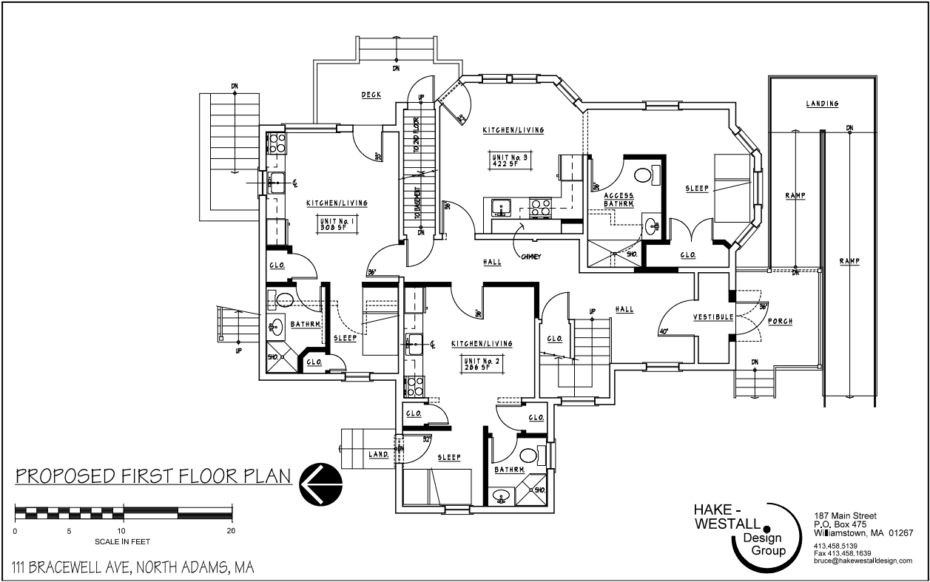
NEW Project for FY22!
Louison House, Bracewell. North Adams, MA. Youth and Young Adults
Kathy Keeser

Slide 30
Racial Equity Work Shaundell Diaz
Three County Racial Equity Action Plan
Priority 1: Coordinated Entry
Goal: Redesign the coordinated entry, assessment, and prioritization system to center racial equity.
Priority 2: Data
Goal: Ensure that the CoC’s homeless population reflects the racial, ethnic, and linguistic diversity of the populations we serve without disparities in performance measures.
Priority 3: Organizational Training and Development
Goal: Increase organizational efforts towards anti-racism work and support the hiring, retention, and leadership development of a diverse and inclusive workforce in CoC-funded organizations and partners.
Priority 4: Housing Continuum
Goal: Increase shelter capacity and availability of low-barrier housing accessibility for people of color experiencing homelessness.
Priority 5: Lived Experience
Goal: Bring people with lived experience of homelessness into decision-making roles
Priority 6: Legislative Policy
Goal: Influence local and state policy and funding to support communities of color to prevent and end homelessness.
Notes:
Centering racial equity in our homelessness response is more urgent than ever. We have spent a few years with consultants to analyze our data to determine how the local homelessness response is centering the needs of POC,
provided trainings for the community, held strategy sessions with our projects and our coordinated entry partner agencies to consider our goals, and based on that, to develop a long term plan for disrupting racism in our CoC’s system of care.
Through the strategies outlined in this plan, we will continue to work to center racial equity in everything we do to prevent and end homelessness in Franklin, Hampshire, and Berkshire Counties. The main priorities are on Coordinated Entry, Data, Organizational Training and Development, Housing Continuum, Lived Experience, and Legislative Policy, as listed here on the screen.

Slide 31
Racial Equity Plan- Current Work Lisa Sirabella
Coordinated Entry
Expansion of the experience and expertise of assessors
Data
Racial disparities analysis of the new CE tool
Membership survey & evaluation, charters and surveys
Housing Continuum
Engaging the community in efforts for housing development with an equity lens
Lived Experience
Recruitment/building community partnerships
Legislative Policy
COVID-19 Housing Equity Bill, Right to Counsel in Evictions, etc.
Responding to the C4 Innovation Evaluation of the CoC
Agency level policy and development
CoC-wide Anti- Discrimination and Equal Access Policy
Trainings
Applying for funding to increase capacity to utilize a broad voice
Development of an Advisory Council
Supporting congregate and non-congregate shelter capacity development
Organizational Training and Development
Increasing language and accessibility measures
Notes:
Here are just some of the Racial Equity Focal Points as outlined in the previous slide, that the COC is working on now & I will just name a few -
In Coordinated Entry, we are working to Respond to a recent Evaluation of our Coordinated Entry system through a racial equity lens; increasing language access & identifying accessibility needs; For the Data goal; we wil be Examining whether the new vulnerability assessment tool will make a difference in addressing racial inequities we have seen in access to housing for various populations. The CE work group is tasked with identifying strategies to reduce high acuity disparity| Stratifying performance measures in annual racial disparities report across all household types and project types to identify racial disparities which basically means that we'll look at performance measures (exits to housing, increases in income, etc) by race, ethnicity, and primary language to see if there are racial or ethnic disparities within different project types or household .
IN the Organizational Training and Development: we will work to be sure the recently implemented CoC-wide anti-discrimination and equal access policy is being followed on the funded program level and providing needed trainings – as mentioned earlier.
For the Housing Continuum goal: there are regional efforts in housing development and shelter capacity.
Lived Experience: we are focused on the creation of a Lived Experience Advisory Group facilitated by partners with Lived Experience.
Legislative Policy: COVID-19 Housing Equity Bill, Right to Counsel in Evictions, which Pamela Scwartz from the Western Mass Network to End Homelessness spoke about earlier.

Slide 32
A Look at Data
Michele LaFleur, Three County CoC Data & Evaluation Manager
Notes:
Next we’re going to be taking a quick look at data around homelessness in Hampshire, Berkshire, and Franklin Counties

Slide 33
Notes:
Here we have a chart looking at the percentage of people who entered permanent housing after leaving emergency shelters, transitional housing, and rapid rehousing, from 2019 through 2022, currently in this most recent year 36% of people entered permanent housing when they left one of these programs. This increase in the proportion of people being housed over the past few years is in large part thanks to the work of ServiceNet, Craigs Doors, Louison House, Eliot Human Services, and many youth & veteran service providers working hard to secure housing for people experiencing homelessness as well as, of course, all of the providers providing housing or supportive services. Since October 1st, 2021, 136 people have entered permanent housing after leaving a shelter, transitional housing, or rapid rehousing program.
Out of 374 total exits

Slide 34
Notes:
In this chart we're looking at the same 2019 through 2022 time frame again but here we're looking at a racial and ethnic breakdown of, out of everyone in a particular population who exits shelter or transitional housing or rapid rehousing, what percentage of people are heading to permanent housing. Looking at this chart we can see that there have been improvements in some areas and losses in others. The percentage of all individuals who exit to permanent housing has increased a bit although Hispanic/Latino/a/x individuals (the red line) have a lower rate of exits to permanent housing than White Non-Hispanic/Latino individuals (blue line) or Black or African American individuals of any ethnicity (yellow line) and are exiting to permanent housing less frequently than in 2019 and 2020.

Slide 35
Notes:
This next chart shows how people of different races are spending different amounts of time in homelessness before they enter permanent housing, looking again at 2019 through 2022. People are spending longer amounts of time in homelessness before being housed than in previous years, likely due to a shortage of affordable and available housing. Lengths of stay in homelessness are at some of the highest times we've seen in recent years, and there have been increases for everyone in shelter but the increase for Hispanic/Latino/a/x individuals has been especially sharp, from 5.8 months to 10.2 months, and lengths in 2022 are more than double what they were in 2019 for Hispanic and Latino individuals.
Something being seen across the state and country

Slide 36
CoC Racial Equity Analysis Tool, American Community Survey 2015-2019 5-year estimates, 2022 Point in Time Count
Notes:
Here we have a screenshot from HUD’s CoC Racial Equity Analysis Tool which compares the racial and ethnic breakdowns of a CoC’s general population and the population considered to be in poverty using American Community Survey data, to the CoC’s most recent point in time count data. The point in time count is an annual count of everyone experiencing homelessness in a CoC on a single night in the winter, and this year it was conducted on February 23rd. This chart in particular shows a breakdown by ethnicity. The top section is everyone and the bottom section is just family households with children. We want to look at this chart particularly, because we see a full quarter of everyone counted in the recent point in time count identifying as Hispanic or Latino despite making up 5% of the total population. This overrepresentation is even more pronounced when we look at just families with children, where Hispanic or Latino families account for over half of all families experiencing homelessness. This racial equity analysis tool is available for download on HUD’s website called the HUD Exchange and can be used to look at this information for any CoC across the country.

Slide 37
2020 Census, HMIS enrollments in shelter or transitional housing 2021- 2022 and HMIS exits
Notes:
This next graph is based on 2020 Census data for the general population and 2021 – 2022 HMIS data, and here we are looking at both race and ethnicity. When we look at the racial breakdown of everyone in the Three County area (top row) compared with everyone in shelter or emergency housing over the past year (middle row) and everyone exiting shelter to permanent housing (bottom row, still past year), we still see significant disparities in who is experiencing homelessness. White persons of any ethnicity make up about 85% of the general population but just about 80% of everyone experiencing homelessness. We can see significant overrepresentations of Black, Latino, Native American and Indigenous, and Multi-racial individuals and families in the population experiencing homelessness compared to the general population but we also know there are societal reasons behind this. People of color historically and currently are subject to discriminatory lending and hiring practices, redlining, over incarceration, and other forms of institutional racism that also contribute to less generational wealth which all create additional barriers in finding and maintaining housing. When we compare those experiencing homelessness to those exiting homelessness to permanent housing, American Indian or Indigenous individuals make up 1.7% of the population experiencing homeless (0.1% of the general population) and only .6% of those entering housing from a shelter or transitional housing or RRH.

Slide 38
System Modeling with Stella M Michele LaFleur
Notes:
HUD has recently released a new tool to help communities determine the best strategies for improving service outcomes and best resources to prioritize with new funds. This tool is called Stella Modeling, or Stella M, and it involves inputting some known data about a community and setting targets and then will generate recommendations for housing inventory for those experiencing homelessness. This screenshot is from a test we did of the system, entering data we know, our best guesses for things we didn't know, and a target year of 2025. The tool presented this dashboard (this is only a portion), recommending an additional 200 emergency shelter beds, slight reduction in transitional housing beds, and an increase in both Rapid ReHousing (25-30) and Permanent Supportive Housing beds. With this proposed inventory, the tool estimates that we would be able to serve 1,196 people, 4 people would remain unserved or unsheltered, and those served would have an average of 263.4 days in homelessness, 27% would exit to permanent housing, and about 4.9% of those served would return to homelessness within 2 years. The annual cost is only blank because we didn't test out that feature, but it can technically estimate the cost of the proposal if we know the cost for each individual resource.
Stella M uses information we know about housing pathways through our system to predict these outcomes and make these recommendations- for example, for each possible combination of paths through the homelessness response system – whether that's from emergency shelter straight to permanent housing, or from transitional housing to rapid rehousing, or just in one type of project then exiting to housing- we enter the average exits to permanent housing and average days homeless and average returns so that it can recommend the most successful paths.
This information can be very useful for planning a system based on what has been working most effectively so far. It isn't meant to be done in a silo, however, and is intended to be a community process with partners who want to help drive the direction of future CoC funding priorities. What we've done so far is just a test, and we're previewing this system because in 2023 we'd like to convene a group to begin utilizing this tool for real, and setting goals that are important to the community as a whole which inform our work. Be on the lookout for some communication around Stella Modeling, or system modeling next year and please participate in that process with us!

Slide 39
Requesting Local Data Michele LaFleur
Looking for more data?
Outcomes, rates of homelessness
By race, ethnicity, gender, age range, disabling condition
Federal reports and a request form for other local data can be found here:
https://www.threecountycoc.communityaction.us/local-data
Notes:
If you're interested in seeing more data or have questions on what was just presented, please visit our website or reach out to me directly and we'll do our best to find and send what you're looking for. Next I would like to invite Brad Gordon, Executive Director of Berkshire County Regional Housing Authority and Co-Chair of the CoC Board of Directors, to lead us in the membership votes. I’m going to welcome back Brad who will start us in the membership votes.

Slide 40
Board and Membership Votes Brad Gordon Keleigh BenEzra Michele LaFleur
CoC Governance Charter updates
HMIS Charter updates
2022 Board Slate Membership Vote

Slide 41
Governance Charter Updates & Membership Vote Keleigh BenEzra, Brad Gordon
Suggested areas to pull for Board Recruitment:
Representatives from HUDs priority populations/those with experience of marginalization: chronic, youth, family, individual, veteran, domestic violence survivor, GLBTQ, persons with disabilities, persons with lived experience of homelessness, BIPOC.
New Permanent Seat addition -
Local Shelter Provider

Slide 42
HMIS Charter Updates & Membership Vote Michele LaFleur, Brad Gordon
Reflection of our move from Social Solutions ETO to Bitfocus' Clarity HMIS.
Added in references to the statewide Rehousing Data Collective Warehouse and changed some references to the CoC's Green River Data Warehouse as we phase out of utilizing our own warehouse.
Changed language around the release to the new document- HMIS Data Agreement and Provider Release
Notes:
Changes made were most often a reflection of our move from Social Solutions ETO to Bitfocus' Clarity HMIS which will begin in December of this year. In some cases, just changing the language and in others identifying new features available to us. Other changes include removing mentions of the "Data Security plan" and changing the "Privacy Plan" to be the "Privacy & Security Plan" as well as changing the "Data Warehouse Integration" section to be the "Data Integration" section and altering the language to reflect the new process of uploading data to Clarity instead of the Green River Data Warehouse. Finally, a commitment to Equity section has been added to reflect the CoC's commitment to promote equity within all our work and includes specific actions the HMIS Lead will assist with.

Slide 43
Board Membership Update and Vote Brad Gordon
New Board Members, Joined in 2022 (Term Ending 2024)
New Permanent Required Seats | New Representative
Affordable Housing Advocate Representative | Raquel Manzanares, Community Legal Aid
Local Shelter Provider Representative | Erin Forbush, ServiceNet
Department of Children and Families (required by YHDP) Representative | Georgia Walters, DCF CRA Unit
Members with Lived Expertise | Omayra Quinones, Latina/x Advocate, Salasin
Members with Lived Expertise | Deb Gonzalez, PLE advocate
Members with Lived Expertise | Lisa Sirabella, PLE advocate for the Homeless
Funded Project Representative | Emily English, Gandara Center, Inc.
Funded Project Representative | Olivia Bernstein, Mental Health Association, Inc.

Slide 44
Board Membership Update and Vote Brad Gordon
Members Continuing, New 2 year cycle (Term Ending 2024)
Permanent Required Seats | Continuing Representative
College Representative | Tina Schettini, Berkshire Community College
Employer/Employment Agency Representative | Cynthia Ray, Mass Hire Franklin/Hampshire
Veterans Services Representative | Mike Hagmaier, Soldier On
Funded Project Representative | Betsy Shally-Jensen, A Positive Place/Cooley Dickenson Hospital
Funded Project Representative | Kathy Keeser, Louison House

Slide 45
Board Chairs/Secretary Brad Gordon
Board Members to be Voted On (Term Ending 2023)
Chair Agency | Representative
Berkshire County Regional Housing Authority | Brad Gordon, Executive Director
Center for Human Development | Theresa Nicholson, Director of Housing
Secretary Agency | Representative
Community Action Pioneer Valley | Keleigh Pereira, CoC Director/Collaborative Applicant

Slide 46
Three County CoC Funding Competition Brad Gordon
In August, The Three County CoC released a Request for Proposals (RFP) as part of our annual funding competition and response to HUD’s annual application process. Projects are for renewal, expansion, and new projects for housing and supportive services specifically to serve persons experiencing homelessness in Berkshire, Hampshire, and Franklin Counties. Project types allowable in this competition were:
Renewal & New Permanent Supportive Housing (PSH), Rapid Rehousing (RRH), and Joint Transitional Housing-Rapid-Rehousing (TH-RRH).
Thanks to our Community for Your Responsiveness and Efforts to make the
CoC application a collaborative acknowledgement of this region's work and
process to End Homelessness!!
The CoC is submitting the full application today for a total of over $3 MIL in housing and
service programming for people experiencing homelessness!
Visit our events page to learn more!
https://www.threecountycoc.communityaction.us/news-events

